Slide 1
WELCOME! Community Action Advisory Board Meeting
This meeting is being recorded.
Please identify yourself when talking so we can capture accurate minutes.
“Chat” function is not available due to public disclosure rules.
Closed Captioning now available
Turn on Webex Assistant and follow the prompts to turn on closed captioning
Lock participant videos in Webex
Lock up to 6 participants to see them regardless of who is speaking
Each person can customize their own set of pinned participants
Hover over the thumbnail location you want to lock a participant to
Click on More and select Lock a participant to this location
Select the participant from the list you want to lock in that position

Slide 2
CAP and HCRS Request for Application Presentations

Slide 3
Shelter and Transitional Housing

Slide 4
OUTSIDERS INN @ ST. PAUL’S
Men’s Shelter Program
Notes:
Good morning, it’s a pleasure to be presenting here this morning. I am Adam Kravitz and I am one of the Directors for Outsiders Inn. I am here to speak on behalf of the funding for the men's shelter at St. Paul Lutheran Church where we are honored to provide shelter to 25+ men each night.

Slide 5
OUTSIDERS INN @ ST PAUL’S CHURCH 1309 FRANKLIN AVE DOWNTOWN VANCOUVER, WA OPEN 7 NIGHTS A WEEK EVENINGS AND OVERNIGHTS 6:30PM TO 7:00AM WEEKENDS AND HOLIDAYS ALL DAY
Notes:
In 2020 St Paul’s Church asked if we could support the continued the operations of the winter-time men’s shelter (the Who) through all of the other seasons to keep it open year round…and we did. And today we are here to ask to continue that work with your support.

Slide 6
Outsiders Inn’s mission is to lift people out of homelessness through advocacy, support and resources, while serving the community with integrity, transparency and respect.
Notes:
AS YOU CONSIDER ADOPTING THE FUNDING OPPORTUNITIES BEFORE YOU, I WOULD LIKE TO SHARE WITH YOU WHAT MAKES OUTSIDERS INN’S MISSION ALIGNED WITH A PEER DIFFERENCE AND SOME OF THE SUCCESS WE HAVE HAD.
Our lived experiences and grassroot collaborations lead us to our mission “to lift people out of homelessness through advocacy, support and resources, while serving the community with integrity, transparency and respect.

Slide 7
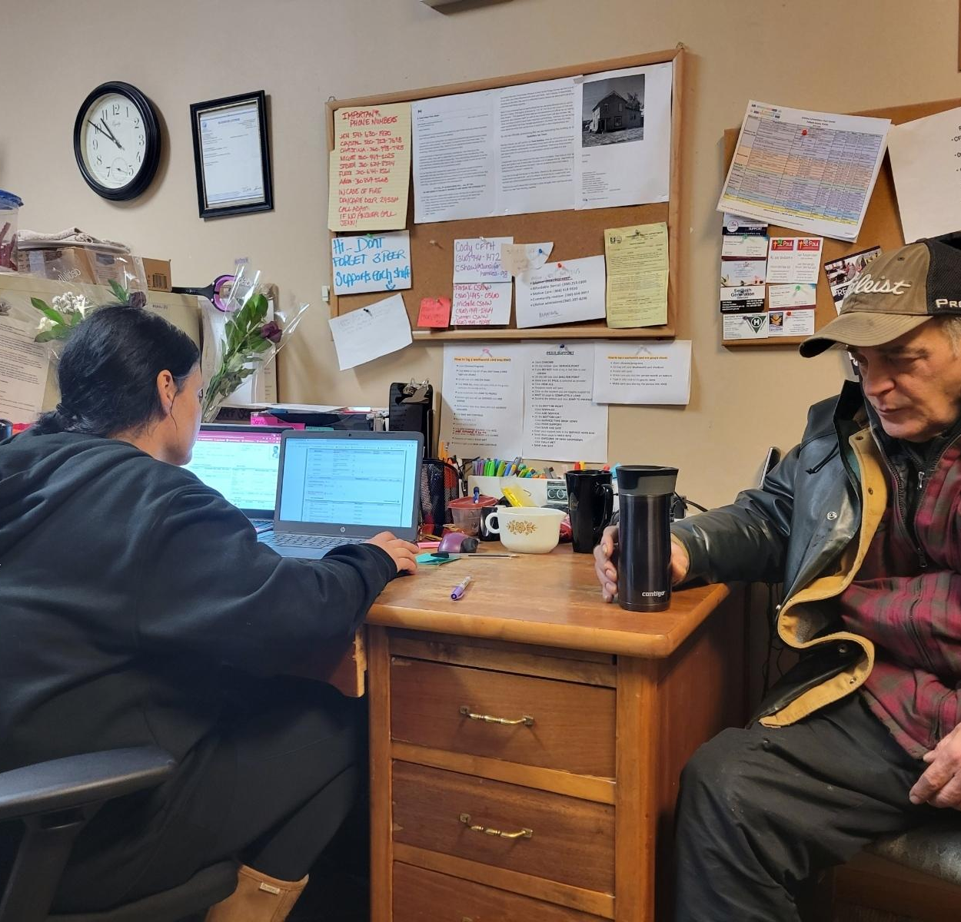
WE SUPPORT REACHING GOALS & REAL-LIFE ACHIEVEMENTS
CARE COORDINATION FOR
HEALTH INSURANCE
EMPLOYMENT
MEDICAL APPTS
DENTAL APPTS
CORRECTIONS SUPPORT
EBT / FOOD STAMPS
PHONE ACCESS
MAIL SERVICES
LAUNDRY SUPPORT
WI-FI COMPUTER ACCESS
HOUSING
Notes:
Since going all day on weekends and holidays, the Shelter Staff have been able to gain even more time to individual Care Coordination support. In partnership with SWACH, we brought the HealthConnect Pathways care coordination into our shelter programs to document our social and health referrals and progress. It helps us support people stabilizing by working on longer term housing goals along with their plans of action, life skills, transportation, communal chores and daily routines.

Slide 8
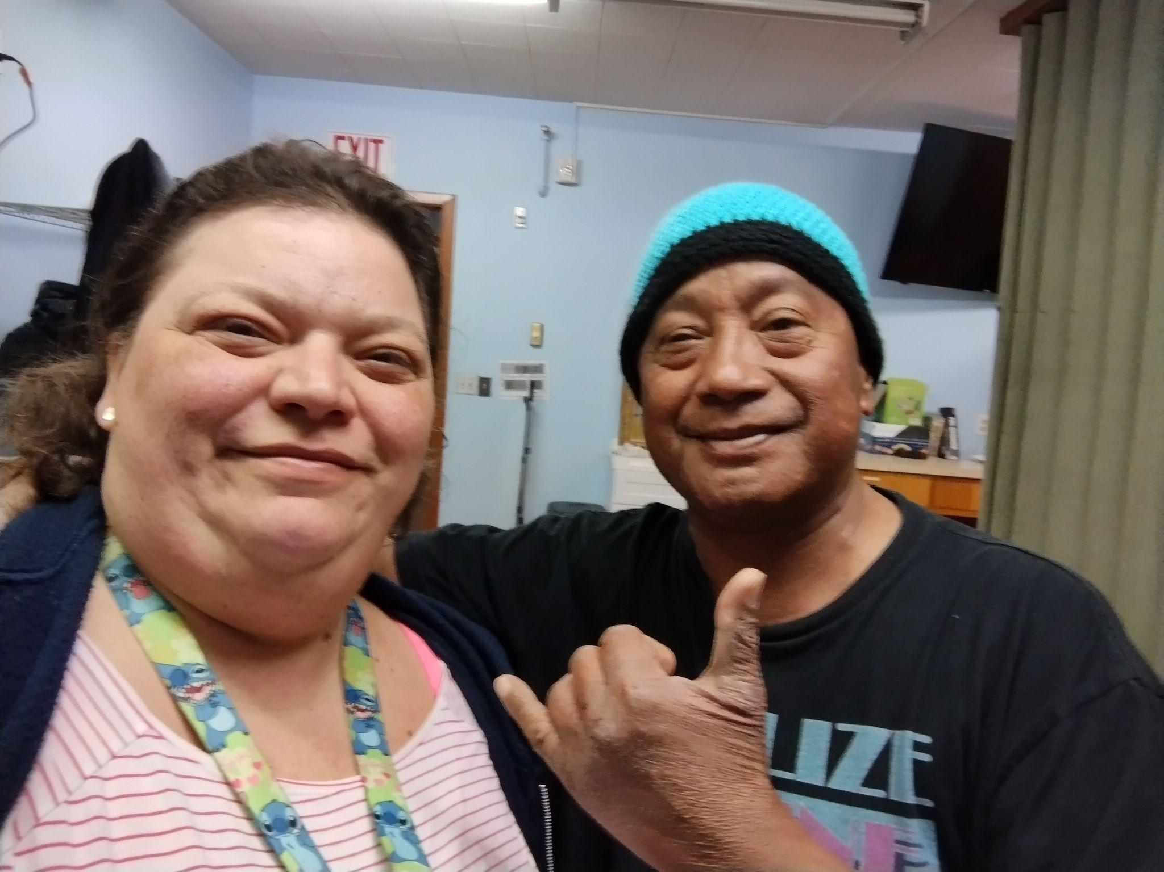
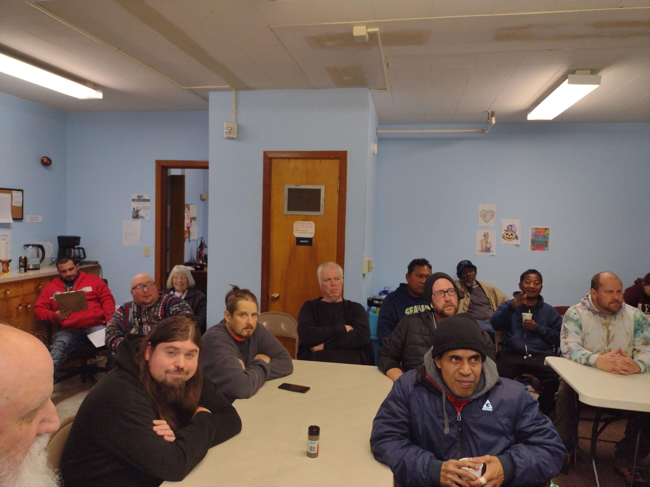
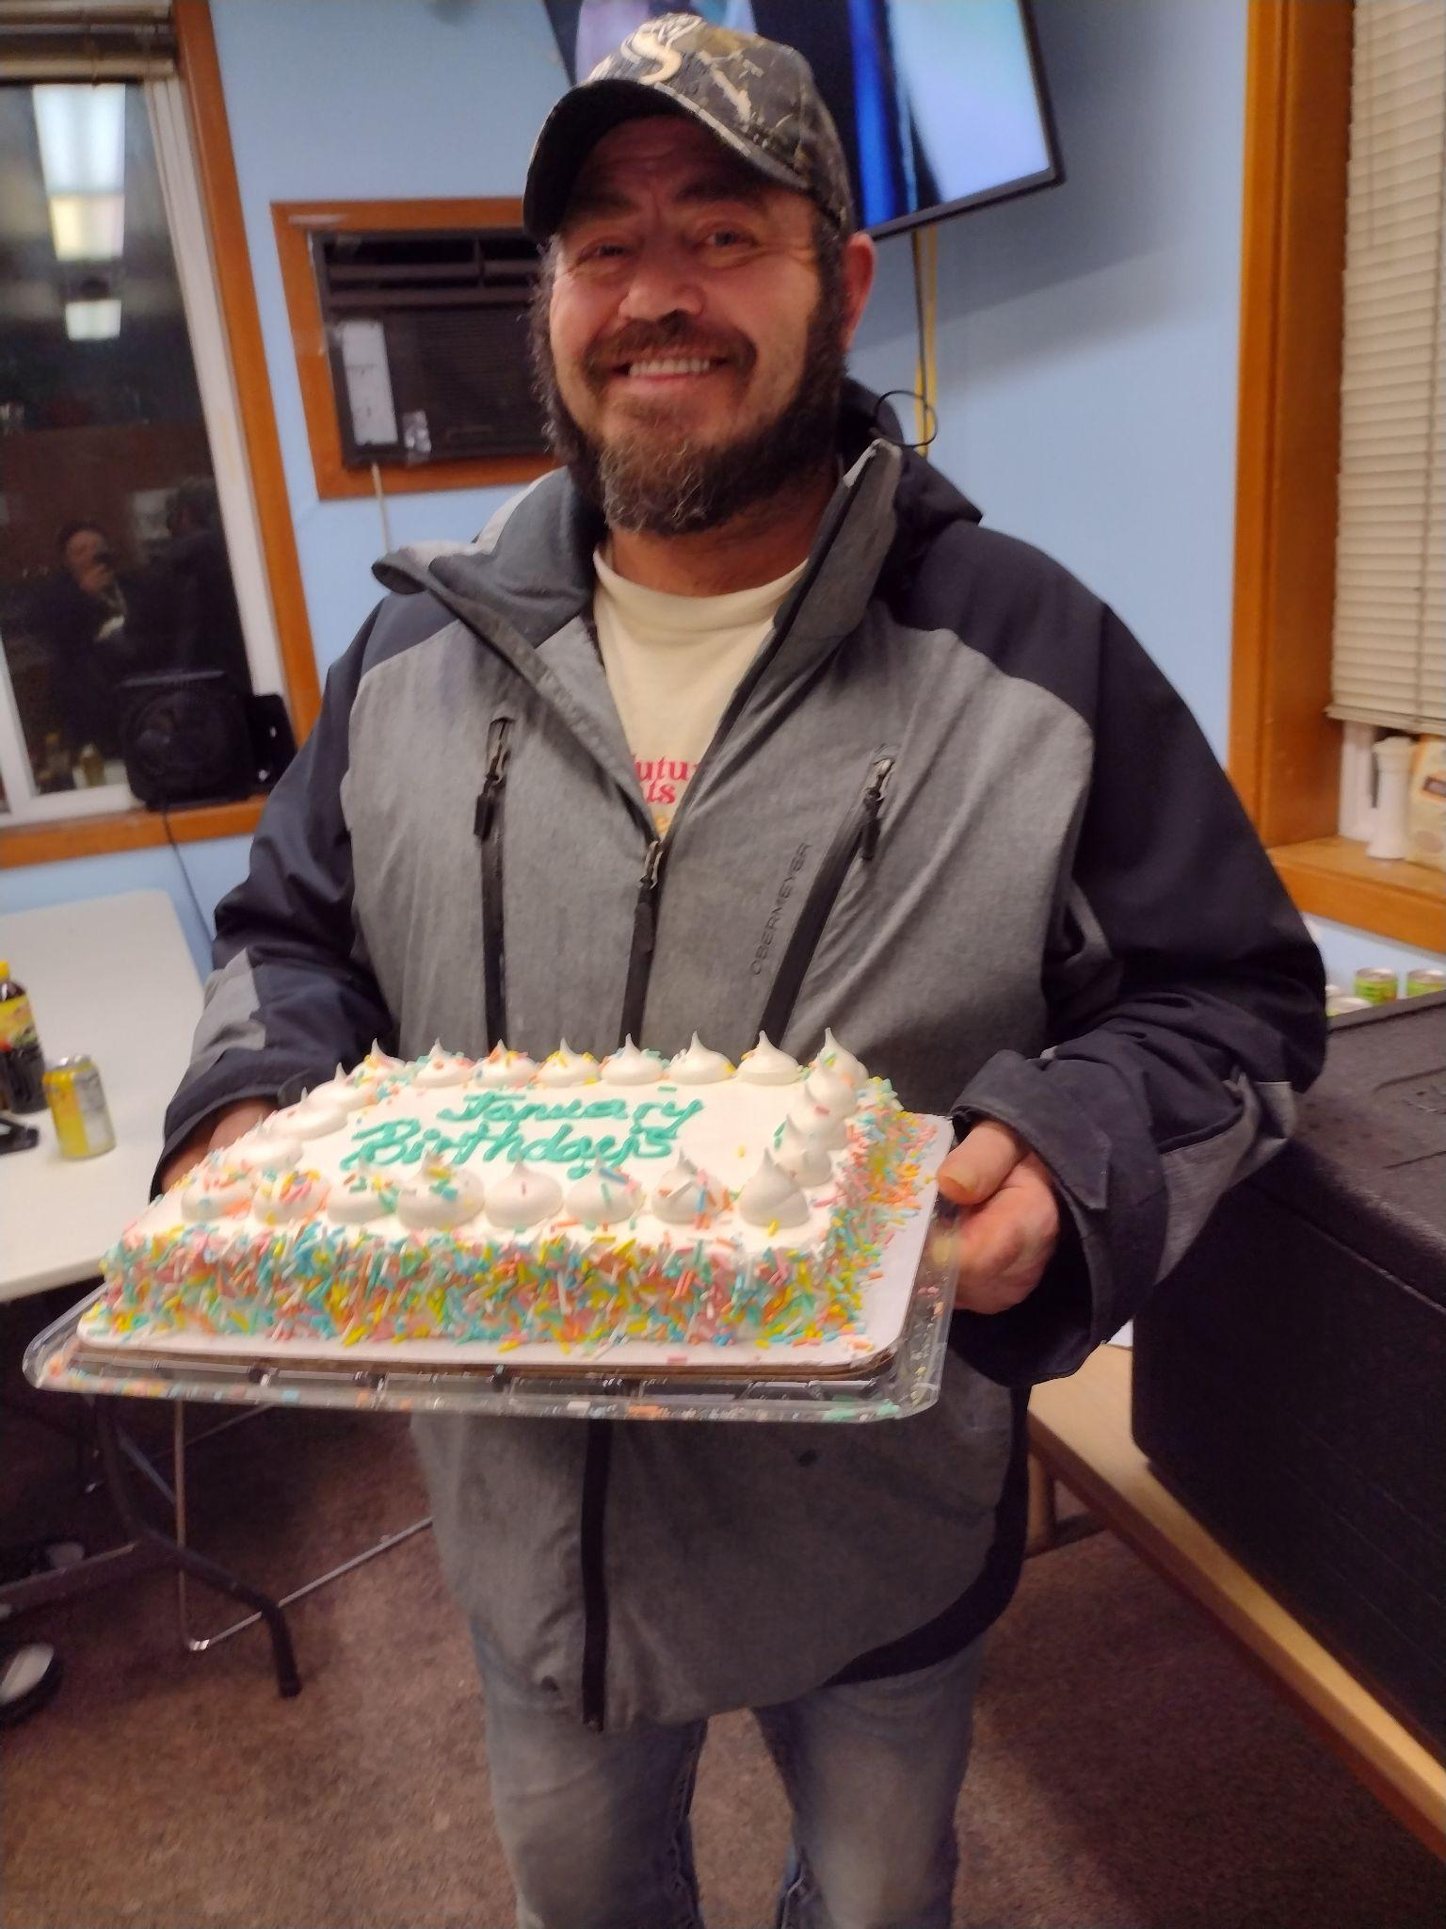
FOSTERING COMMUNITY CONNECTIONS & COMMUNICATION
Notes:
And in those routines, we foster connections and community building. We have weekly community meetings where we keep everyone in the loop about things happening and take deeper dives into topics to learn more about themselves and others in the room.
We celebrate birthdays, achievements and each other on a regular basis!

Slide 9
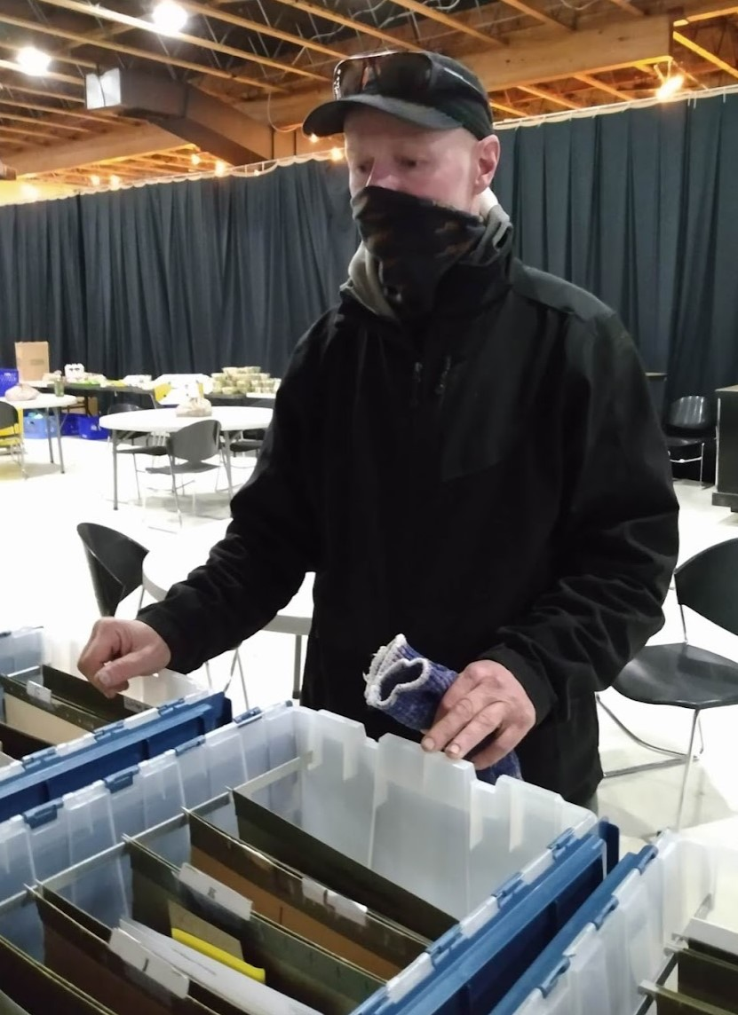
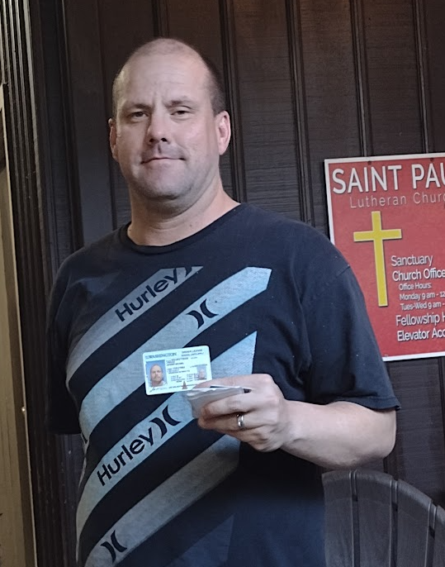
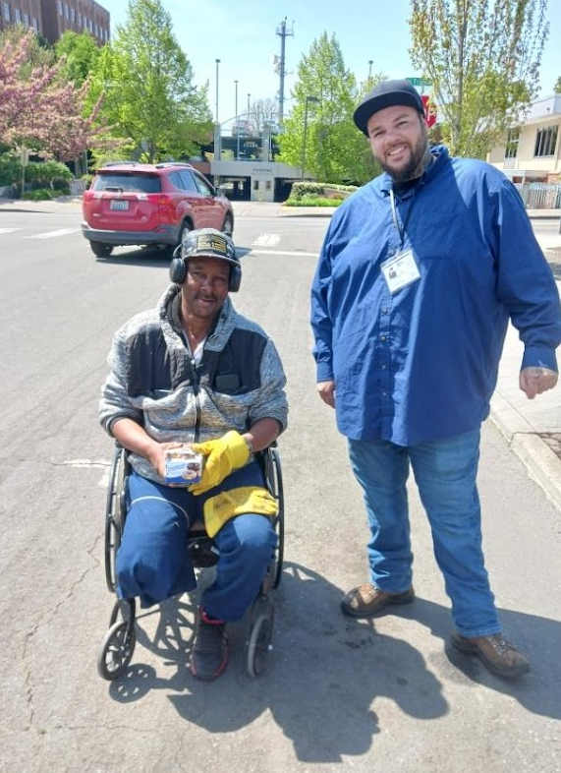
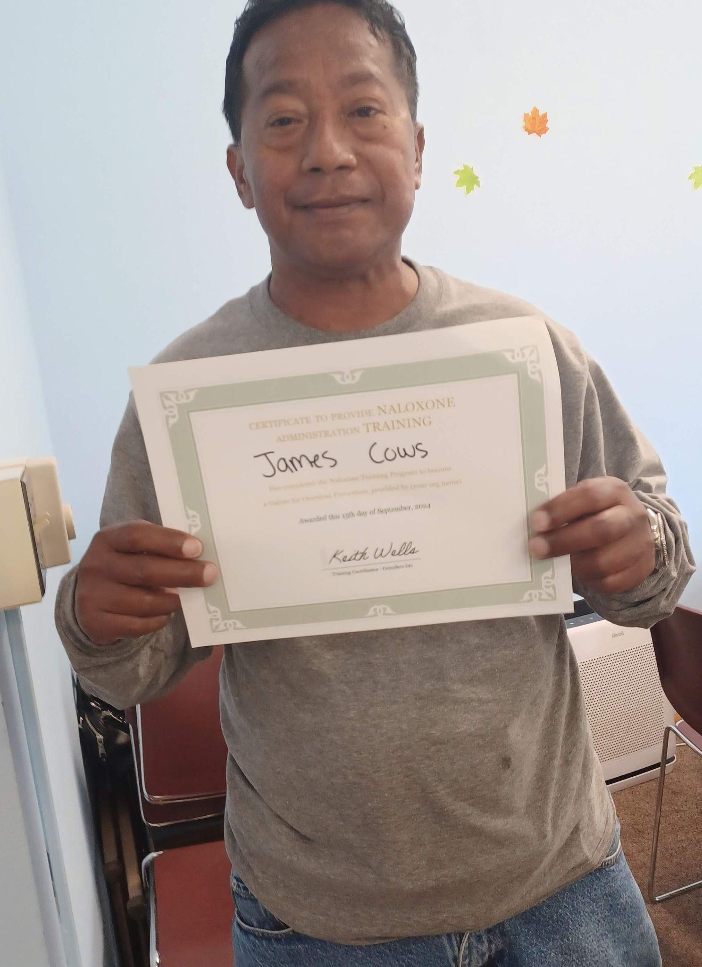
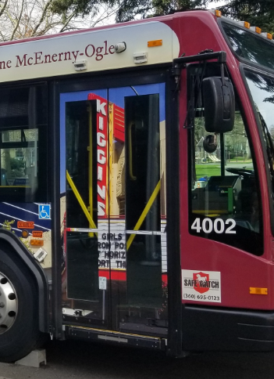
RESPONSIVE SERVICES
Supporting connection to programs that are embedded in the community to address emerging and changing needs.
UNHOUSED RESIDENT MAIL SERVICE
ID ASSISTANCE
HEALTH & SOCIAL SRV. REFERRALS
NARCAN TRAINING
TRANSPORTATION PROGRAMS
Notes:
Through this connection, trust is built so guests can successfully connect to internal Outsiders Inn and external community partner programs that are embedded in the community to be responsive to the individuals emerging and changing needs. These services are person-lead and might be
Mail Services for those without and address
ID/birth certificate assistance
Health and treatment referrals
Narcan Trainings
Transportation programs
Employment program referrals
Legal system navigation support

Slide 10
COMMUNITY SUPPORTED RESPONSES FOR Meals Ready to Eat.
OUTSIDER’S INN MEAL TRAIN VOLUNTEERS PREPARED OVER 16,000 MEALS IN 2024!
4,250 volunteer meals went to St Paul’s Shelter and they arrived hot and ready to eat and often they come WITH MESSAGES OF HOPE!
Notes:
Organization wide - Outsiders Inn has a vibrant list of over 287+ Meal Train volunteer cooks who HAVE HELPED US SERVE OVER 16,000 MEALS IN 2024 TO ALL OF OUR SHELTER GUESTS!! The St Paul’s program meals portion of that was 4,250.
We are grateful for these caring Individuals and church groups who come together to support these programs –
We help them connect with Foodworker cards and stay apprised of latest health information and we appreciate them with every meal that arrives warm and ready to eat.

Slide 11
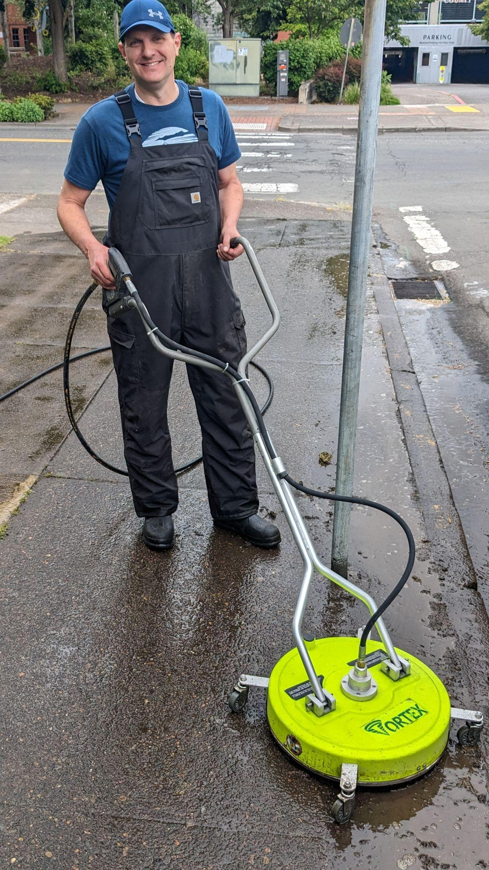
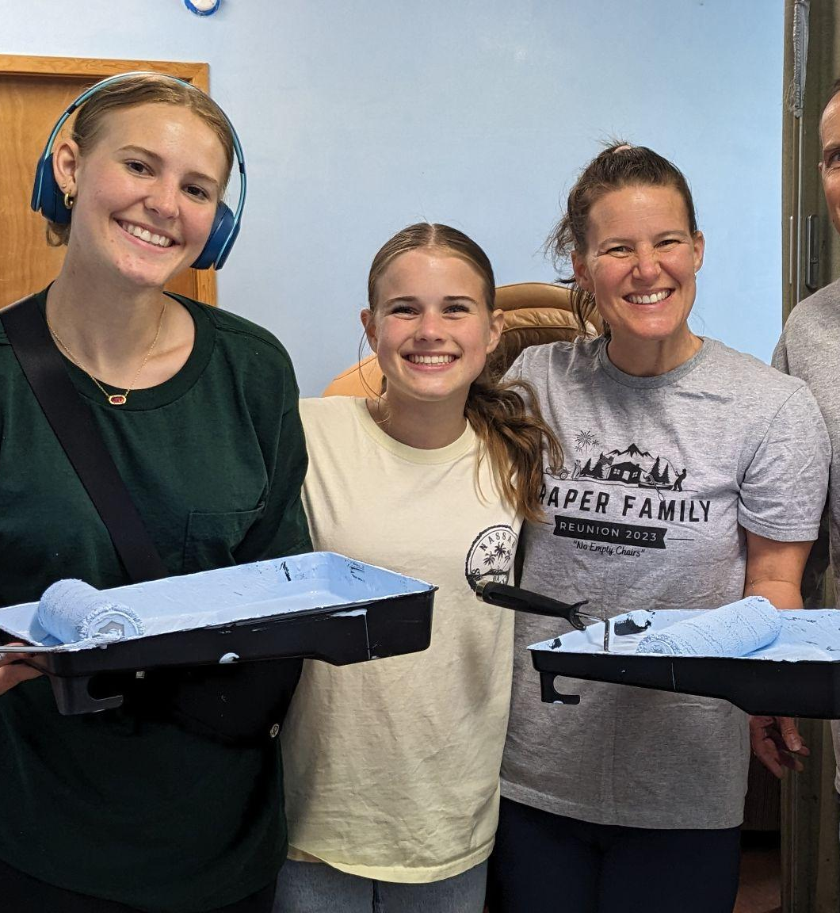
COMMUNITY SUPPORTED & VALUED
Notes:
and there’s more beyond the meals! Our caring community of supporters continues to show up in BIG WAYS!
Recently over the last contract period, we made significant improvements to the space with volunteer and community foundation supports.
The LDS Westside Ward volunteers came out and helped us give the ALL THE DORMS and hospitality areas a fresh coat of paint, and while everything was in motion, they cleaned cabinets and power-washed the sidewalks! It was an amazing month of service they generously provided for our community shelter.

Slide 12
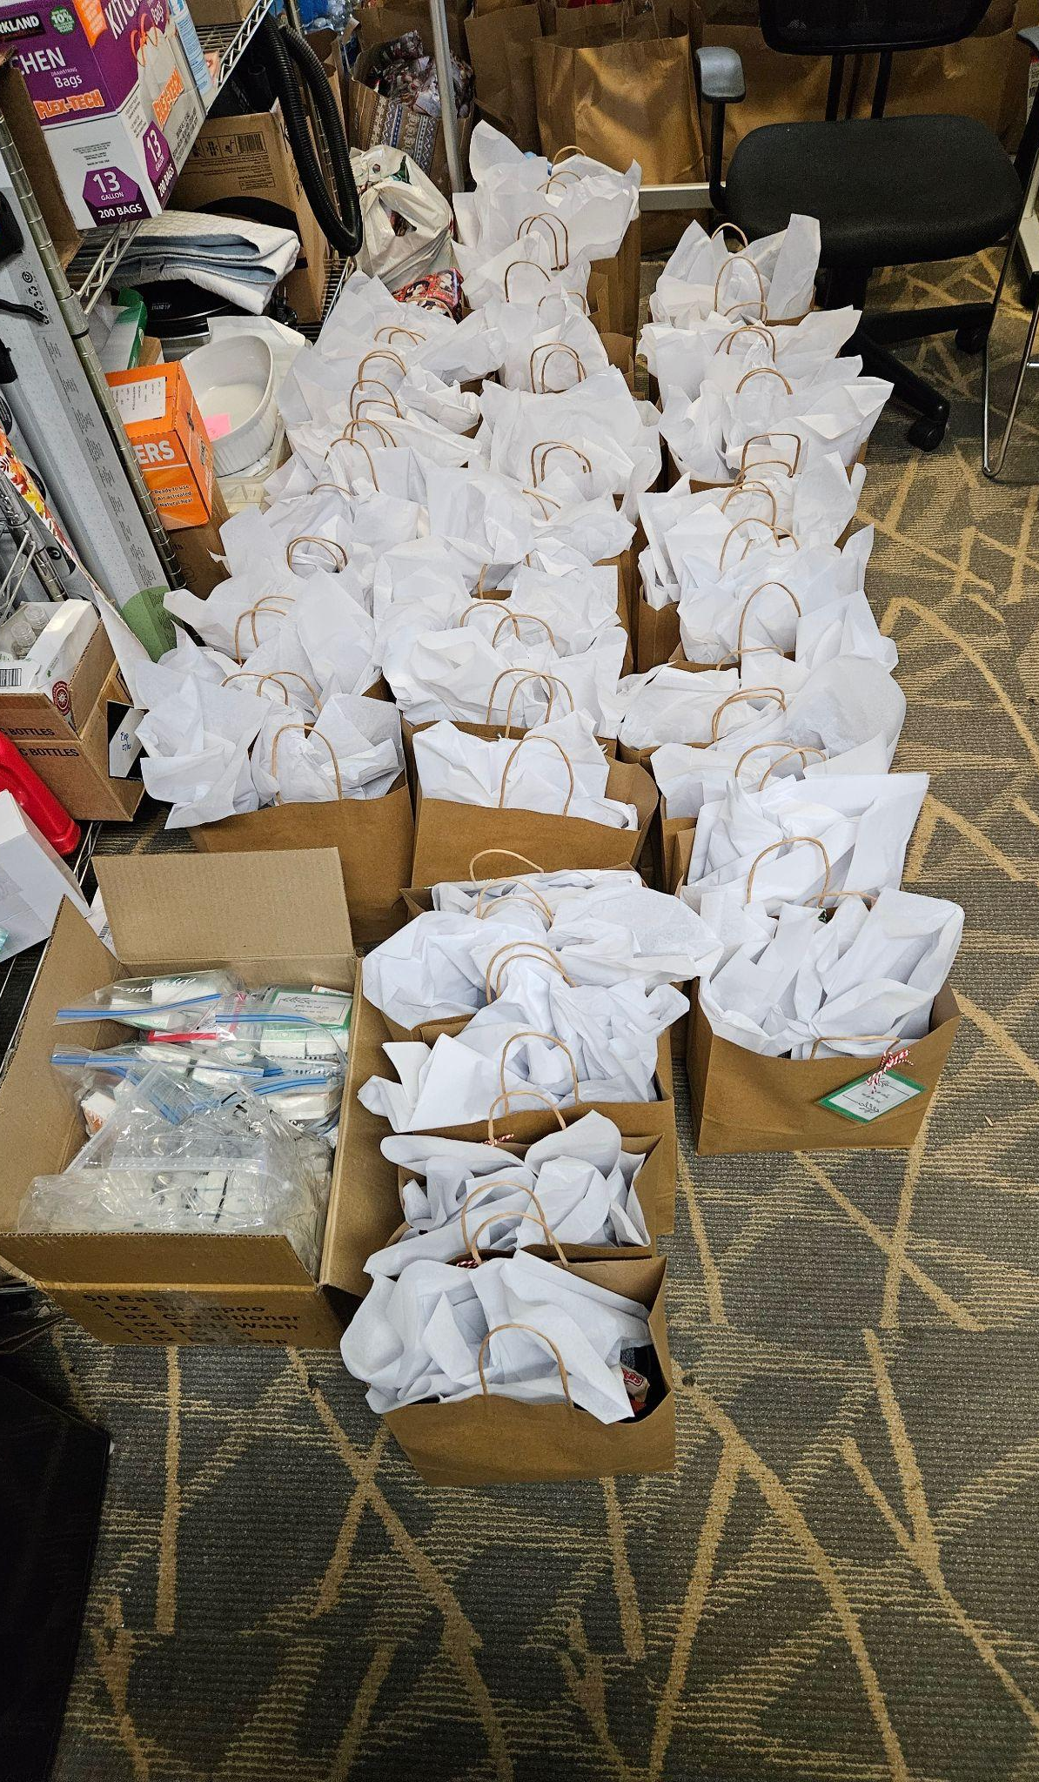
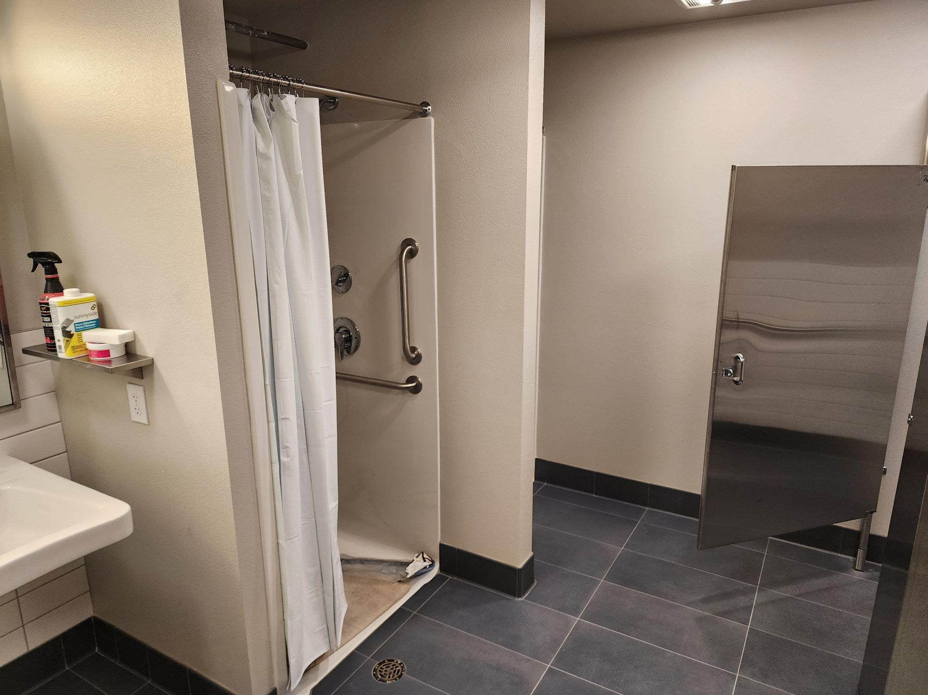
COMMUNITY SUPPORTED & VALUED
Notes:
The American Rescue Plan Funds helped us improve the bathrooms going from 2 single bathrooms with only 1 shower to a shared bathroom with 3 toilets, 2 urinals, 2 sinks, and 2 showers. Its amazing to be able to keep people moving through the space in a supported way.
Lynch Foundation also has supported structural improvements needed in regards to the outside lighting and roofing connected to the overhanging eaves.
Groups like Oddyssey World and NW CAVE rally their communities to provide Christmas gift bags and other holiday special touches.

Slide 13
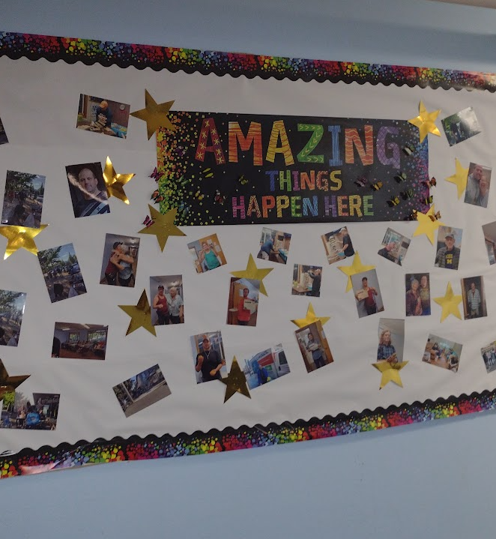
HOUSING POSITIVE SUCCESSES
Notes:
We are proud that all of that support leads us to documented successes.
We have 27 sheltered nightly (average)
88 men was served in 2024
15 exited to permanent situations
9 exited into temporary situations
and a LOT of steps were made towards goals made.

Slide 14
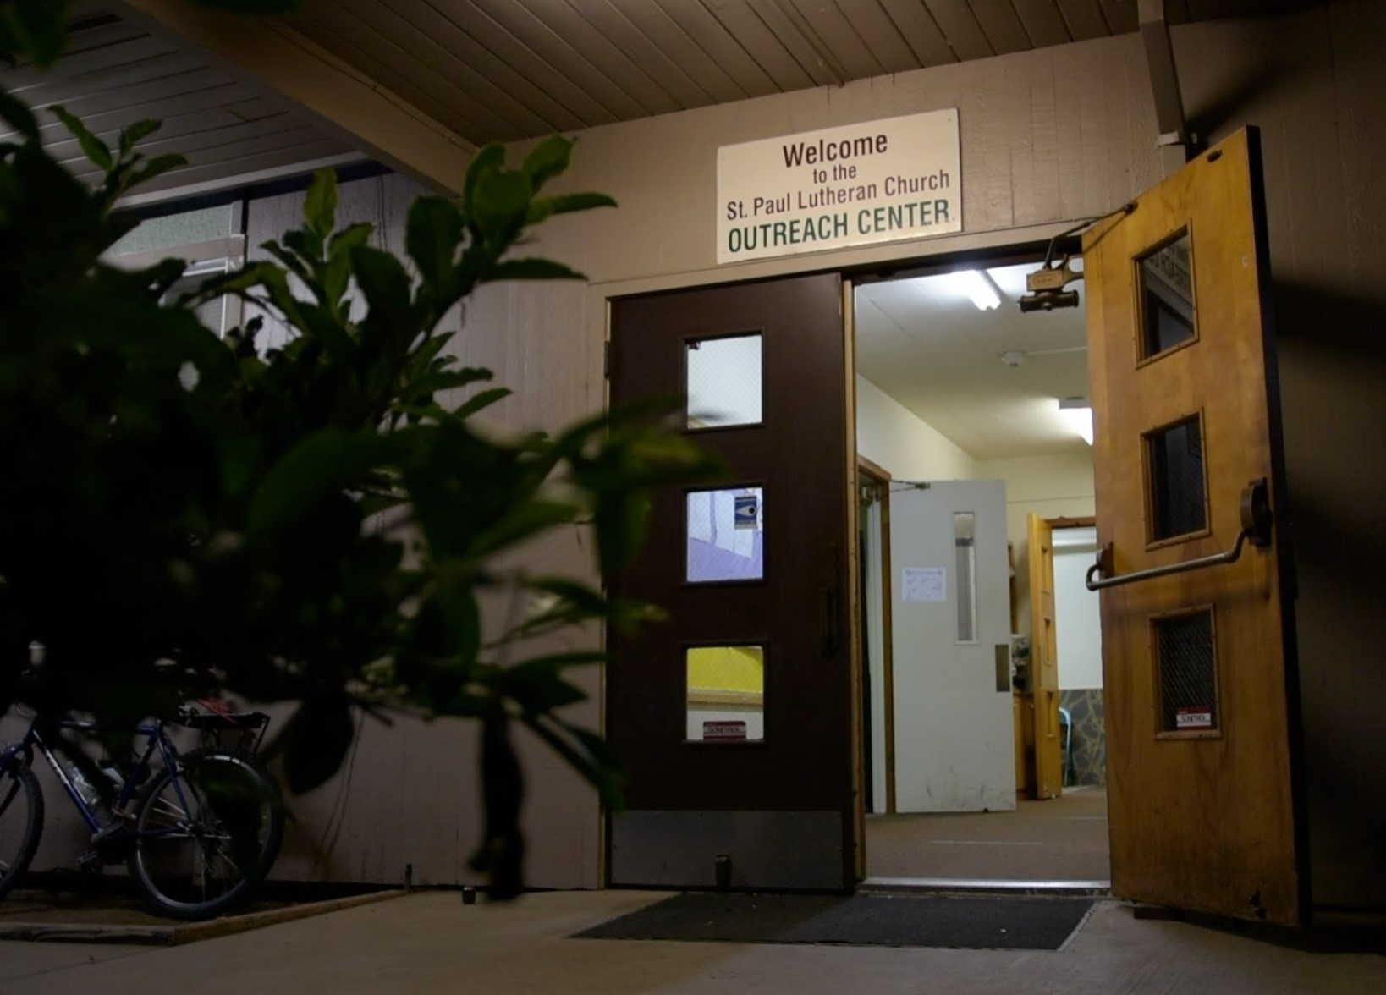
WITH THIS FUNDING WE CAN CONTINUE
MAINTAIN & SUPPORT 25+ BED SPOTS FOR MEN DOWNTOWN IN A SPACE THAT HAS BEEN MAINTAINED AND HAS RECENTLY RENOVATED
BATHROOMS AND SHOWERS
STAFFED BY A WORKFORCE OF PEOPLE WHO HAVE RECOVERED FROM LIVED-EXPERIENCES OF HOMELESSNESS, MENTAL HEALTH AND ADDICTION.
Notes:
So what we ask is important. With this funding we can maintain & support 25+ bed spots for men downtown in a space that has been maintained and has recently renovated bathrooms and showers. It will be staffed by a workforce of people who are earning a living to maintain their housing stability and recovery journeys, too.

Slide 15
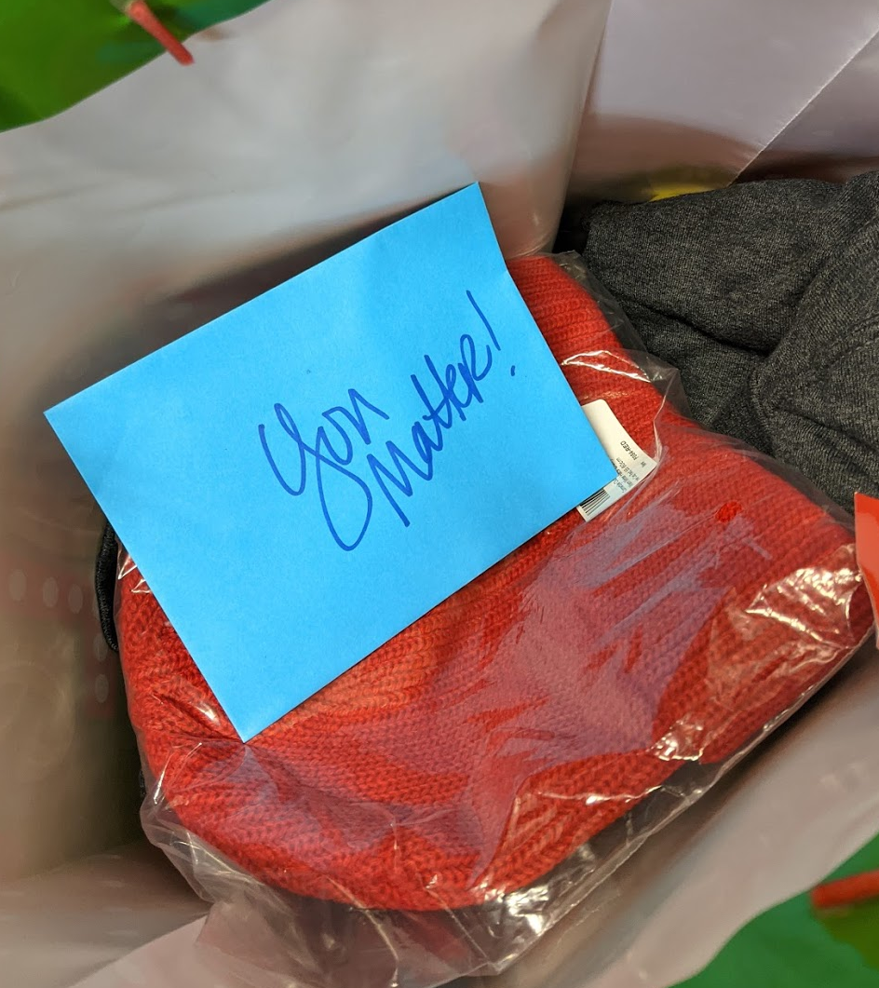
THANK YOU! QUESTIONS: CONNECT@OUTSIDERSINN.ORG
Notes:
WE WELCOME QUESTIONS NOW AND ANYTIME IN THE FUTURE TO CONTACT US AND LEARN MORE ABOUT OUR ORGANIZATION AND SHELTER’S PEER LIVED EXPERIENCE APPROACH AND MODEL.
THANK YOU FOR YOU TIME AND CONSIDERATION.

Slide 18
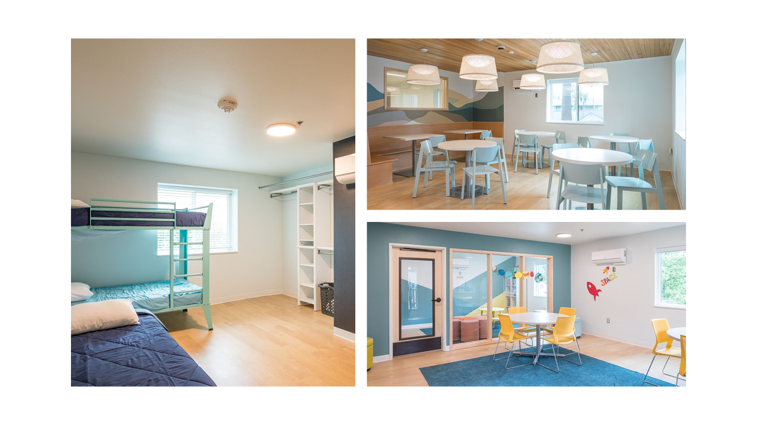

Slide 28
Homeless Outreach

Slide 29
Homeless Outreach

Slide 30
Homeless Outreach Program Goals
Case Managers will be out meeting and reconnecting with the houseless community 60% of their time.
40% of their time will be in office coordinating wrap around services i.e. Mental Health, Behavior Health, Veteran Services. Resourcing for their clients will be priority as well. (This can also happen in the field)
Focusing on the population with the highest barriers to finding housing by attending By Name List meetings.
Creating a meal program for distribution while in the field.
Creating a "SCOPE" like program for Clark County
https://ccsww.org/services/scope/

Slide 31
Training
Motivational Interviewing
Trauma Informed Care
Mental Health First Aid
https://www.relias.com/
DEI-CCS has hired an outside consultant for our DEI program. It will include multiple training sessions throughout the year.
Workplace Violence Prevention (AVADE)
https://avadetraining.com/workplace-violence-prevention/
Crisis Prevention Institute
- Verbal Intervention Training
- Nonviolent Crisis Intervention
https://www.crisisprevention.com/our-programs
(AVADE & CPI are offered by in-house trainers at CCS. It is taught by staff working in our Homeless division and on our Mental Health Team.)

Slide 32
Partnerships& Successes
Council for the Homeless
Coordinated Entry
Columbia River Mental Health
Behavior Health
Mental Health
Physical Health
We will also have access to our own Family Behavior Health team as well

Slide 33
Thank You!

Slide 34
Council for the Homeless is a non-profit organization whose mission is to provide community leadership, compelling advocacy, and practical solutions to prevent and end homelessness in Clark County, Washington.
COORDINATED OUTREACH
2025
Nathalie Aguilar
Outreach Manager, naguilar@councilforthehomeless.org

Slide 35
Leadership
Advocacy
Solutions

Slide 36
What is Coordinated Outreach in Clark County?
Response Team
Community Effort & Coordination
Severe Weather Response
Systemic Influence & Impact
Outreach & Volunteers initiating point in time count 1/30/25

Slide 37
OUT IN THE FIELD
Response Team- meets them where they are
Consistent engagement
Equitable , accountable and collaborative approach
Move-In Support & Housing Navigation
Eliminating Barriers
Client Centered, Trauma Informed practices
Community
When we talk about making home possible, it’s about standing alongside people at one of the most critical moments in their lives and ensuring they have a place to call their own. -Nathalie
Outreach & Volunteers initiating point in time count 1/30/25

Slide 38
OUR COMMUNITY
Coordinated Outreach Workgroup
System-wide planning, coordination & training
Service-Provider Liaison
Equitable , accountable and collaborative approach
Community Partners
Shared Resources
Enhancing Public Awareness
Project Homeless Connect 2025

Slide 39
SEVERE WEATHER
Preparedness Plan- Severe Weather Task Force
Heat and Cold Weather Protocols
Shelter & Basic Needs Services
Real-Time Communication
Engagement with Vulnerable populations

Slide 40
REGENERATING THE SYSTEM
Root Causes of Vulnerability
Data-Driven Decision Making
Equity in service delivery making it accessible to everyone
Long-Term Impact through engagement & sustainable practices

Slide 41
THANK YOU!
Nathalie Aguilar
Outreach Manager, naguilar@councilforthehomeless.org

Slide 42
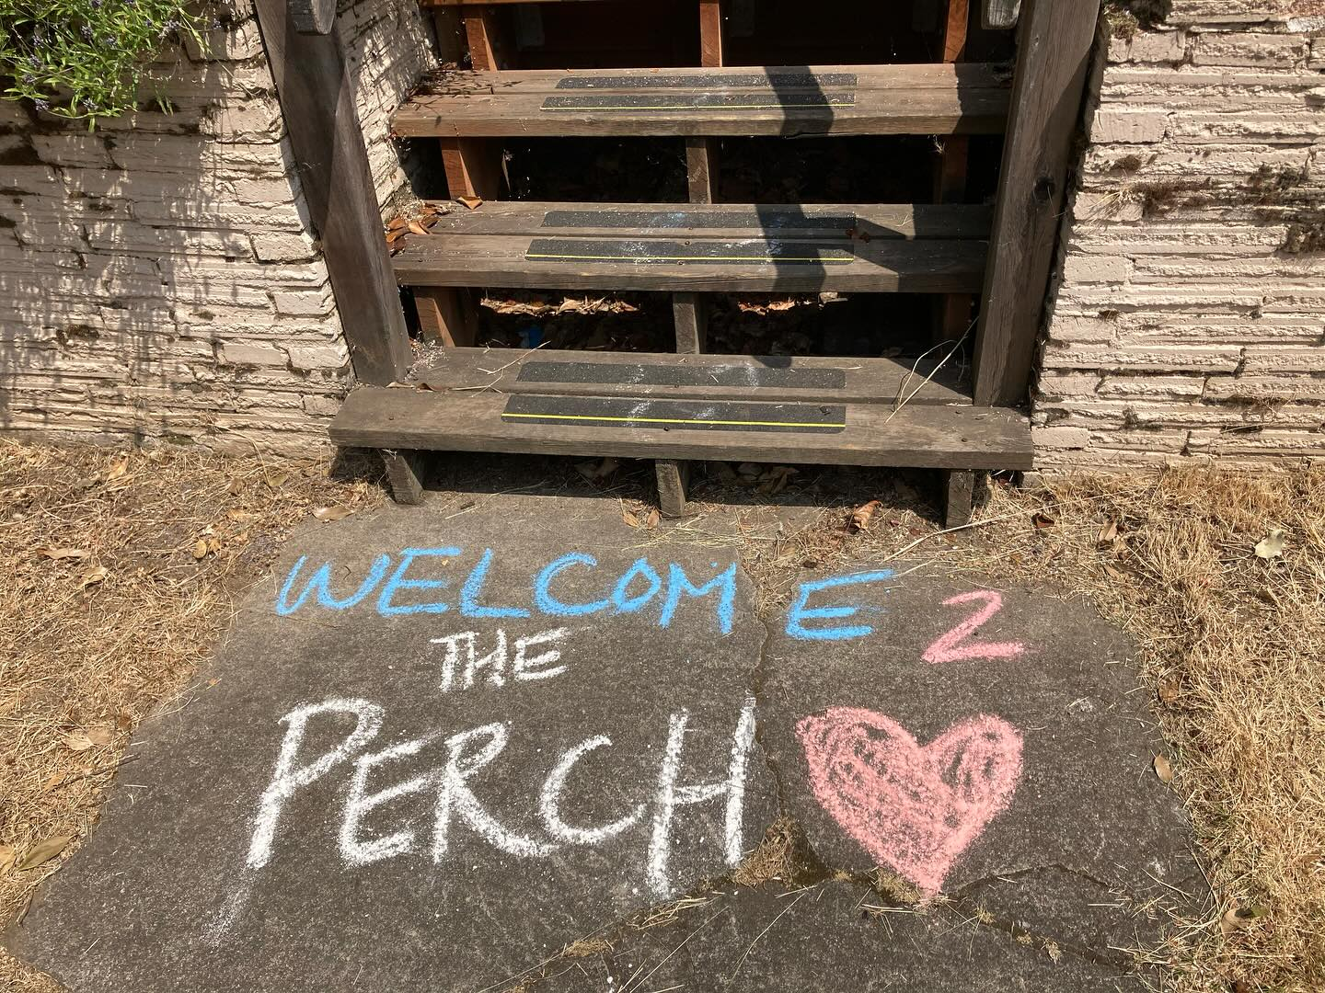

Slide 43
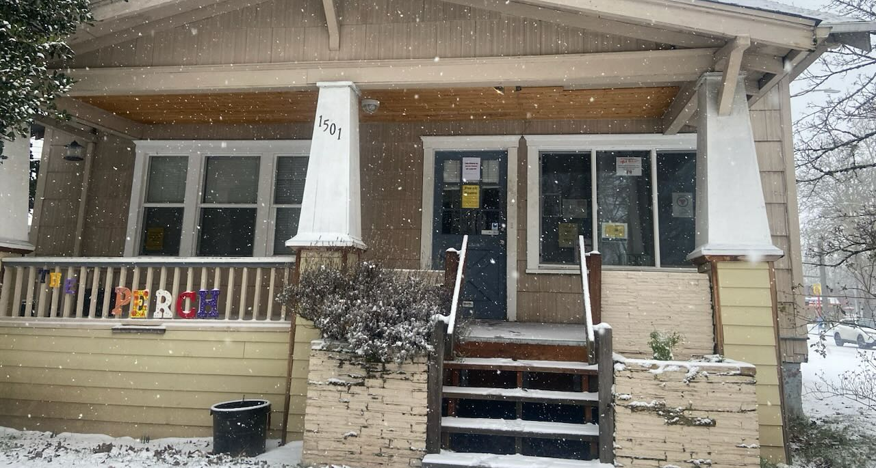
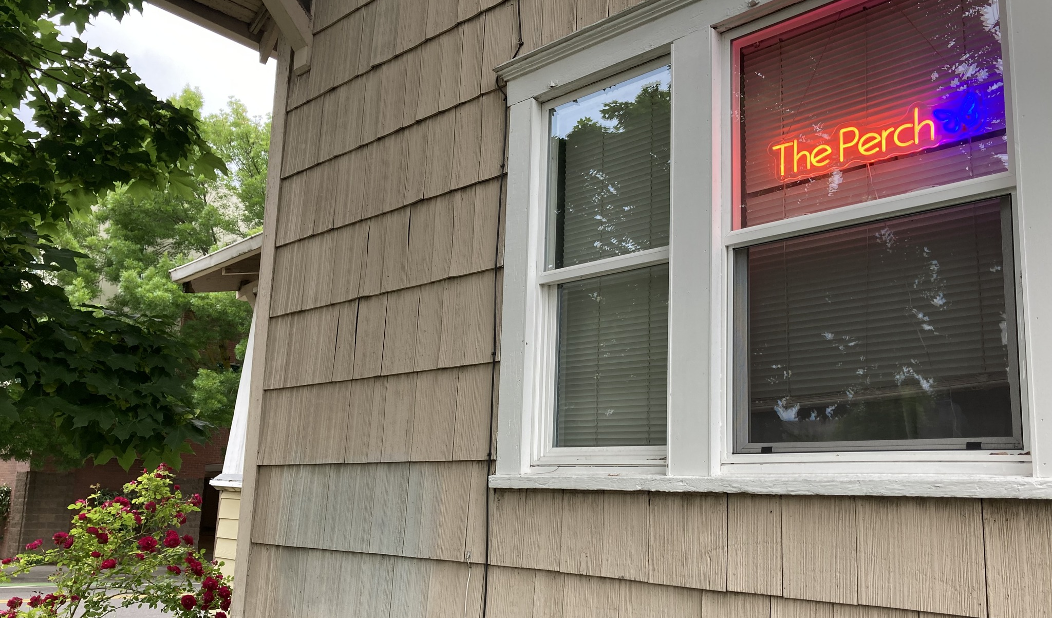
Perch Open Hours
Monday, Tuesday, Thursday, Friday
1:30PM – 5:30PM

Slide 44
2024 Numbers
at a Glance
Service Access
159 youth accessed services at The Perch
14 youth accessed community outreach
173 total youth received services
2025-2027 Goal: 120 youth/year

Slide 45
Warm in the Winter
Cool in the Summer
Always friendly staff

Slide 46
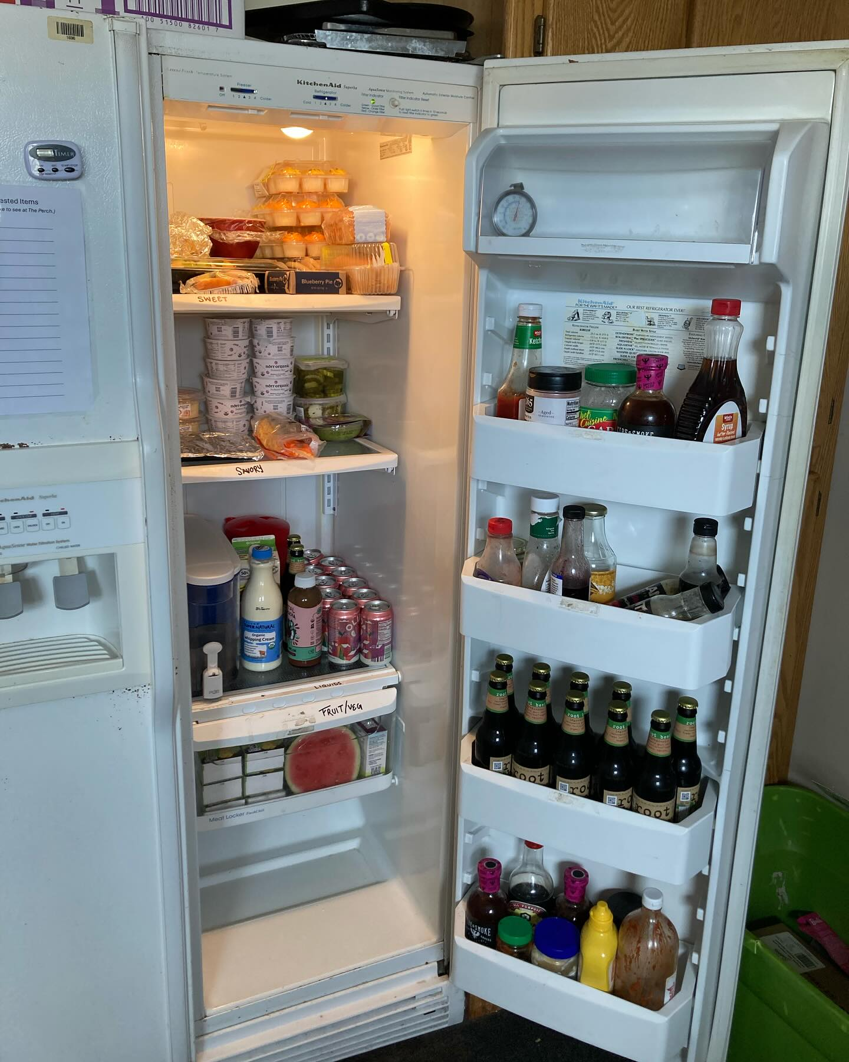
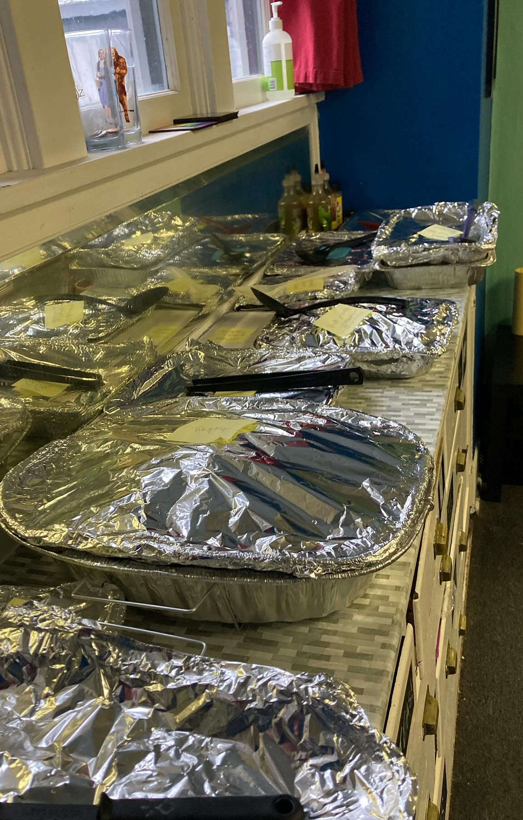
We’re here for hungry days and holiday magic.

Slide 47
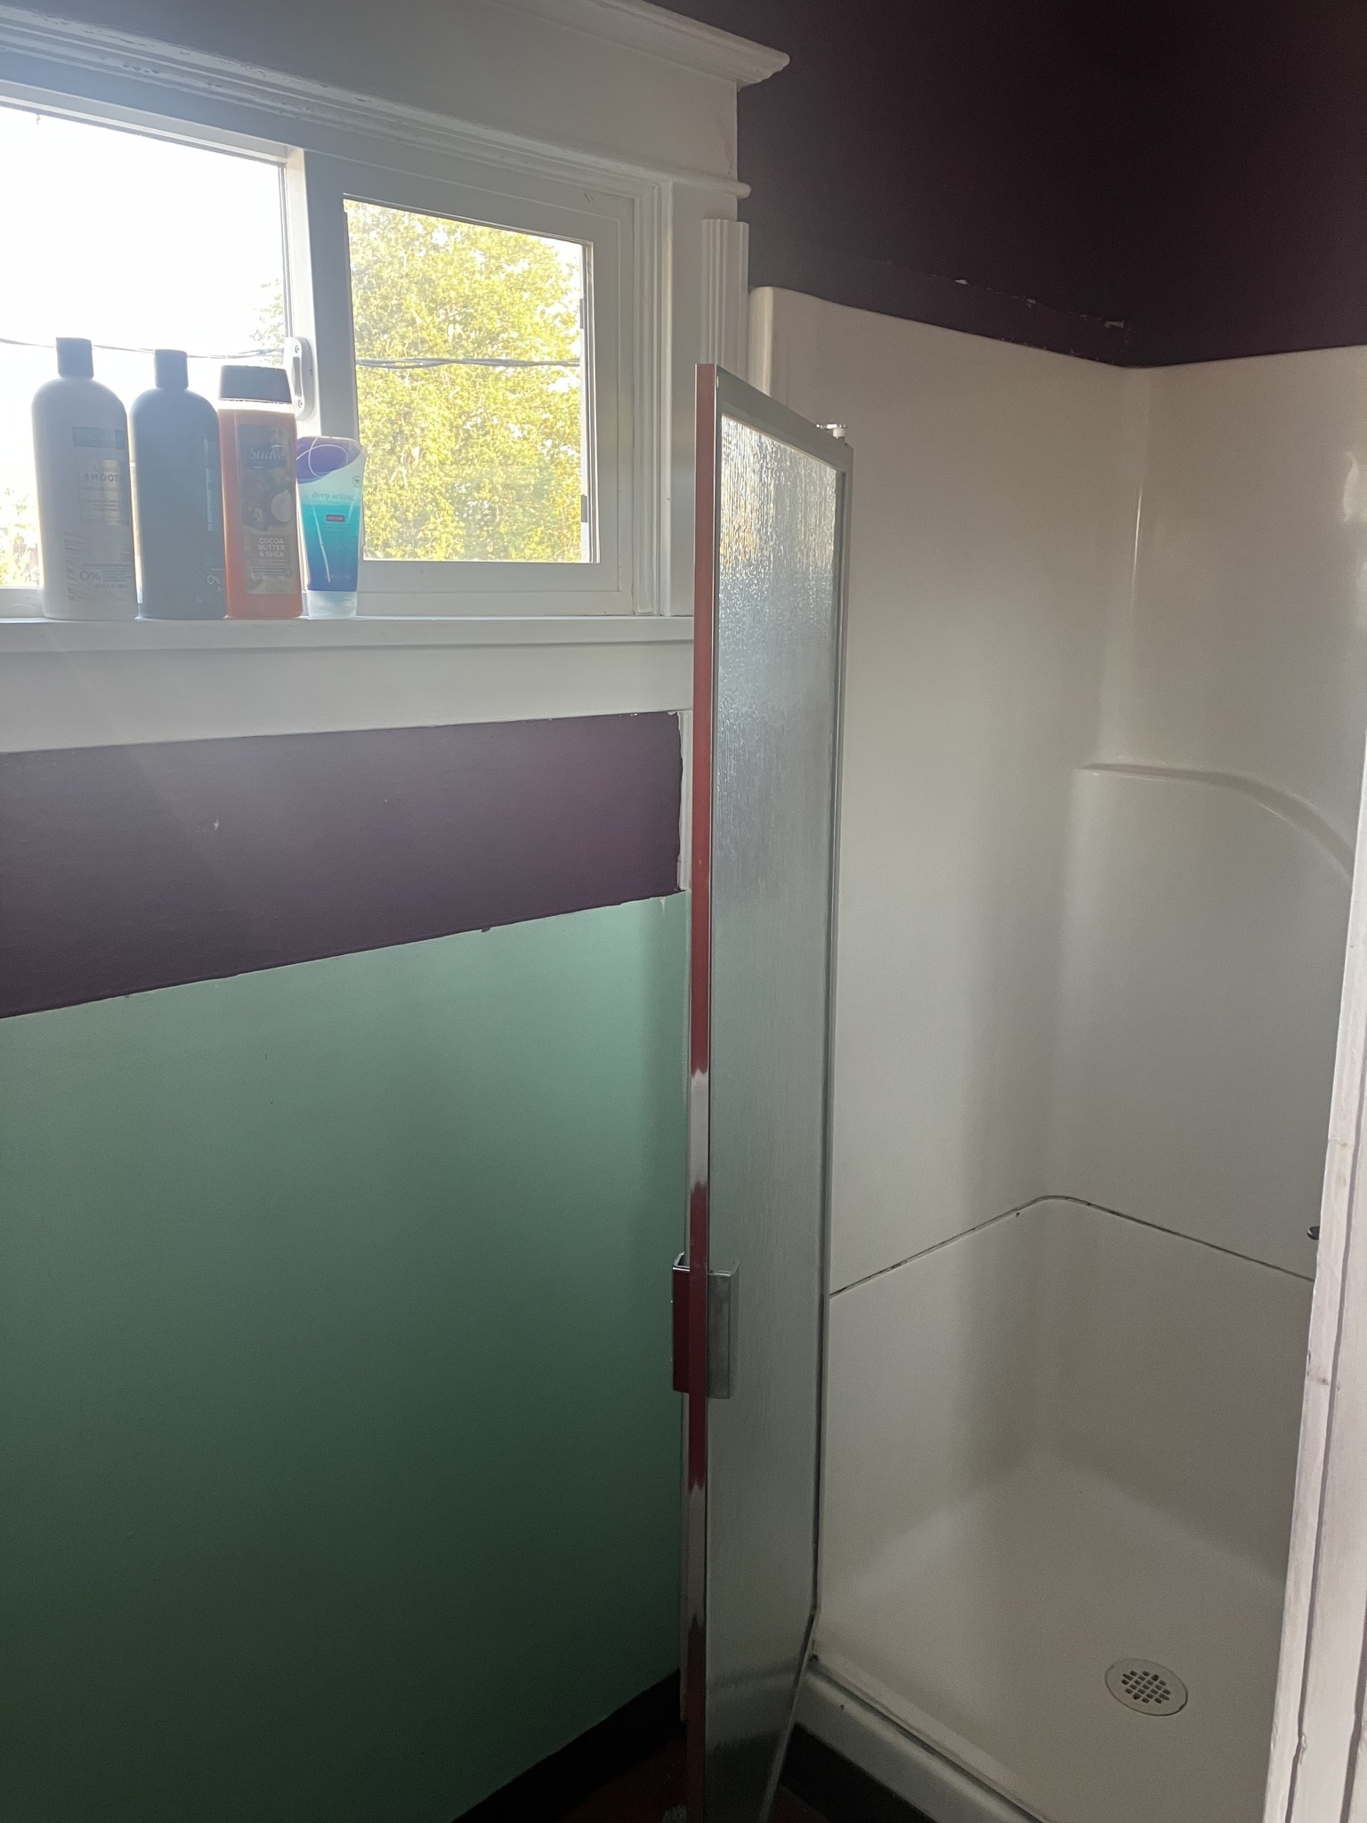
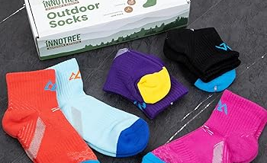
A hot shower and clean socks can make all the difference in how someone feels.

Slide 48
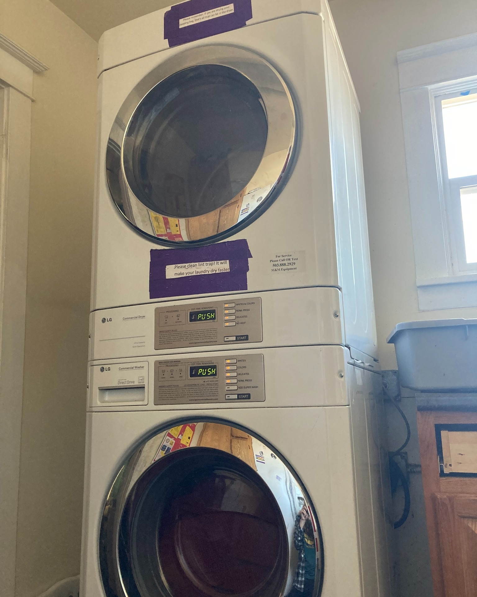
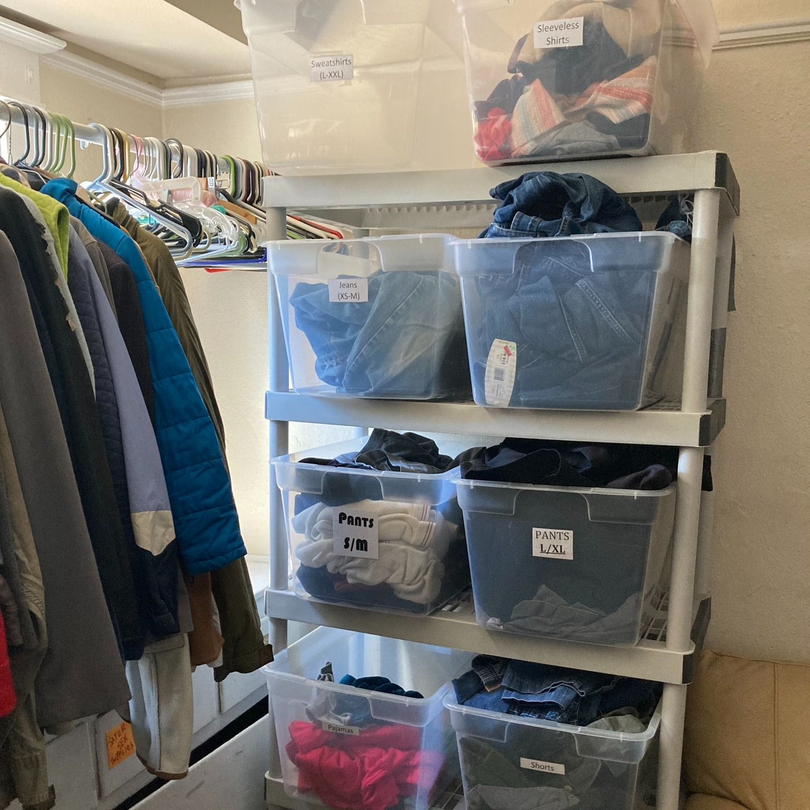
got clothes?
need clothes?

Slide 49
2024 Numbers
at a Glance
Income
31 youth maintained or increased income via employment or government assistance programs
2025-2027 Goal: 30 youth/year

Slide 50
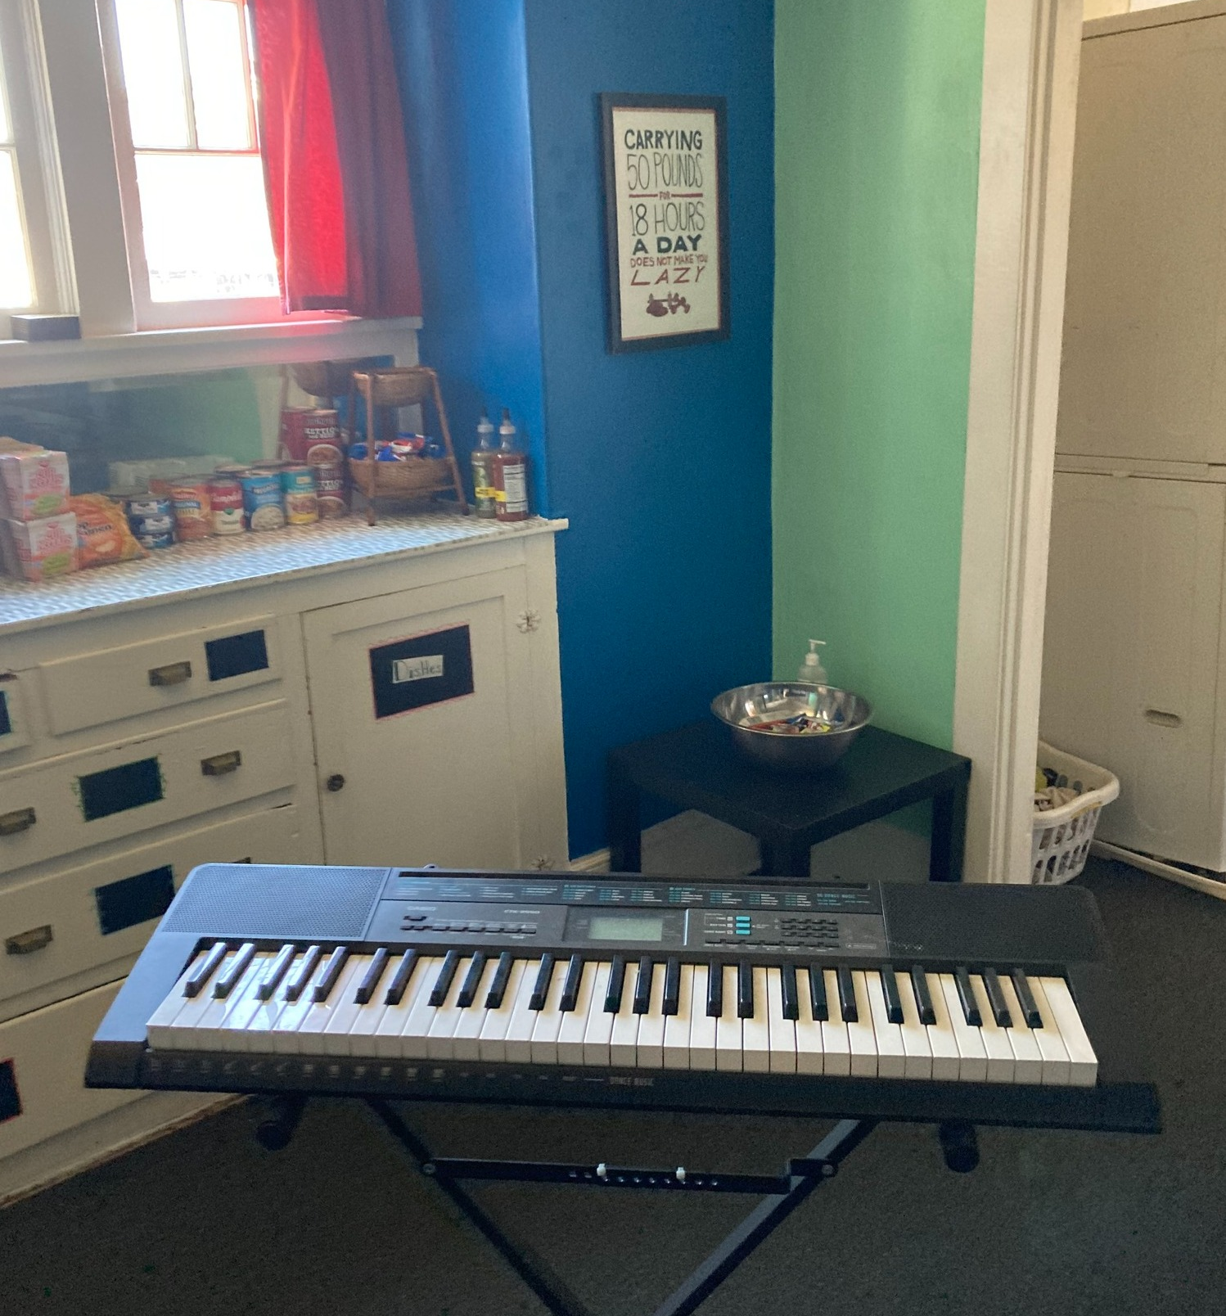
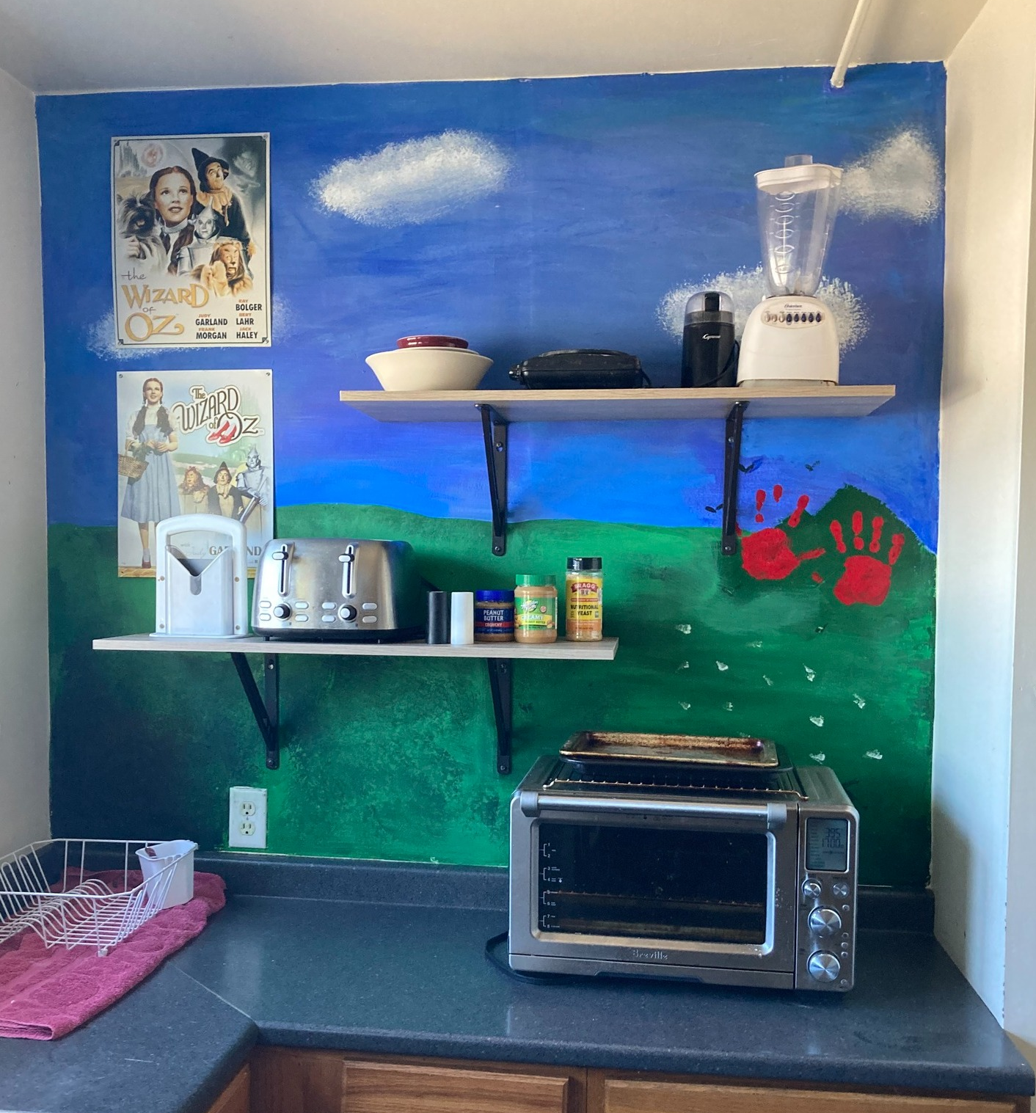
The Perch is about more than just getting basic needs met. Youth have an opportunity to explore who they are and build healthy coping mechanisms through activities like music and art.

Slide 51
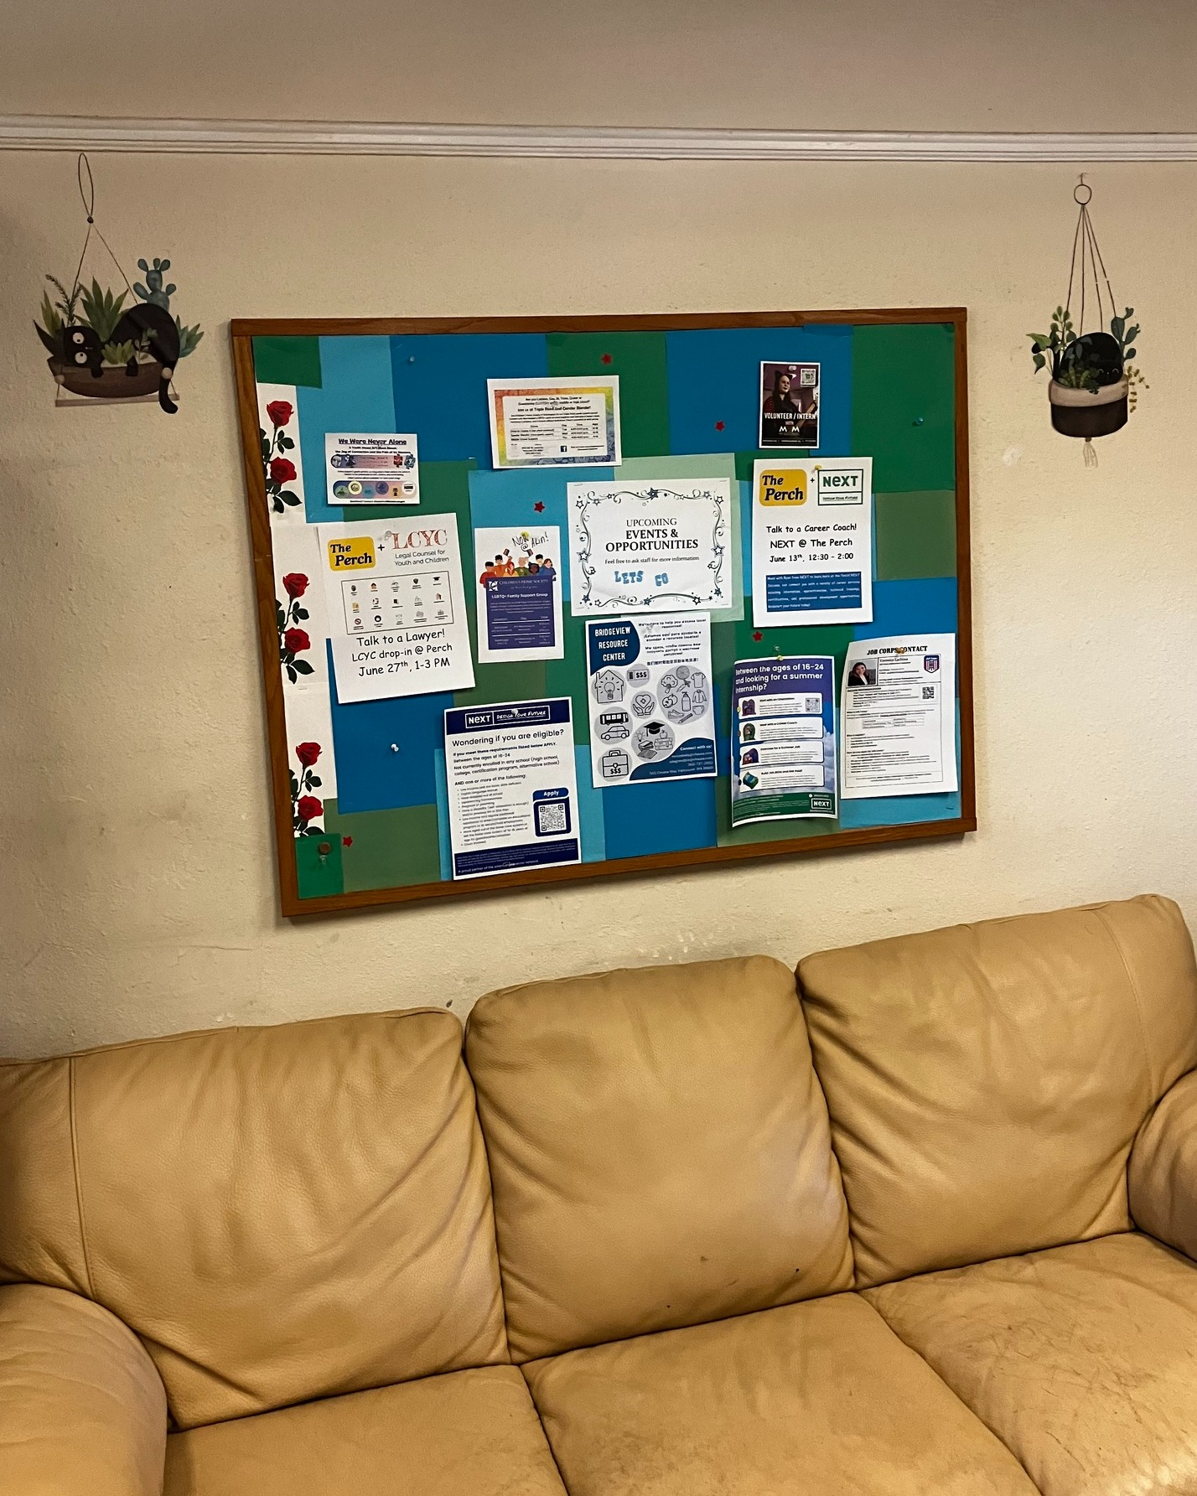
Events
Resources

Slide 52
2024 Numbers
at a Glance
Resource Connection
114 youth were connected with mainstream resources to support safety and stability
2025-2027 Goal: 90 youth/year

Slide 54
Water and snacks help keep youth focused and energized to find safety and stability.

Slide 55
2024 Numbers
at a Glance
Shelter
45 youth accessed shelter through Janus or Clark County’s coordinated entry system
2025-2027 Goal: 30 youth/year

Slide 56
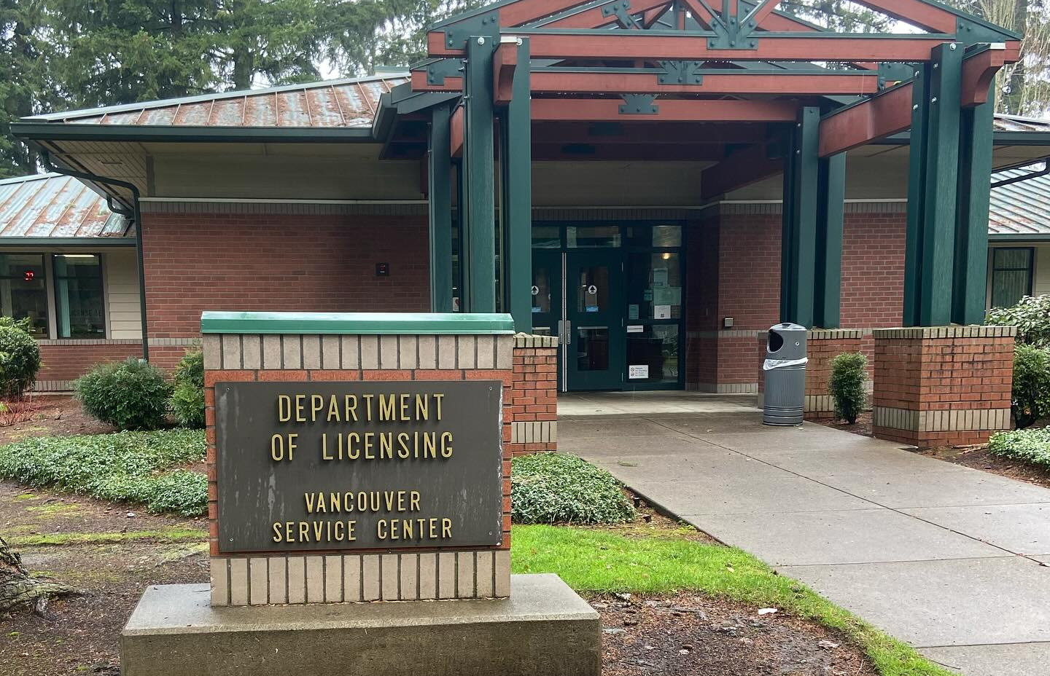
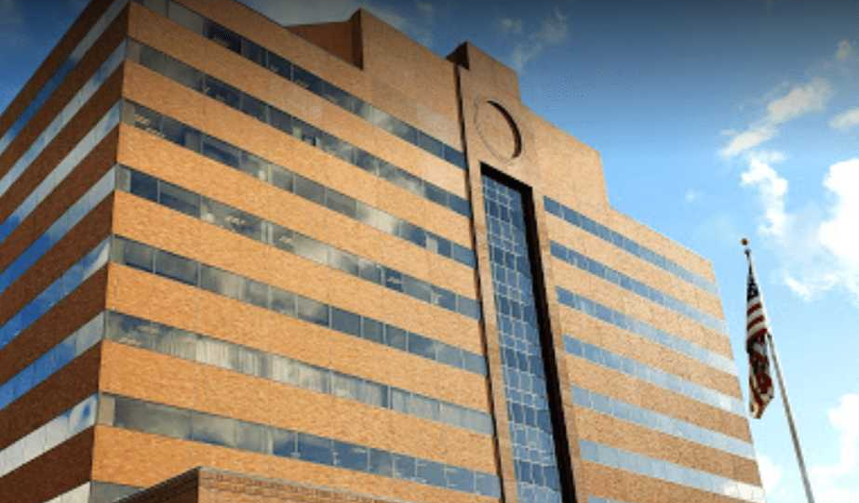
ID or social security card?
We’ve got youth covered!

Slide 57
2024 Numbers
at a Glance
Legal Documents
25 youth received birth certificates, social security cards, and/or state ID cards
2025-2027 Goal: 30 youth/year

Slide 58
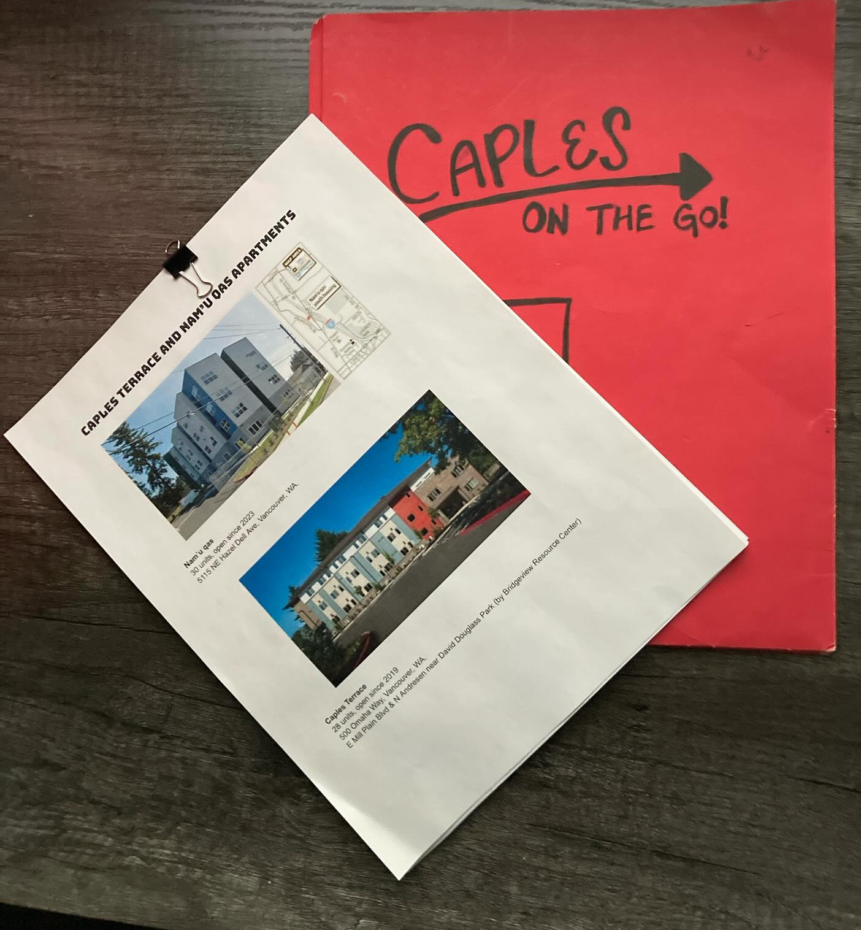
Housing Applications
& Assessments

Slide 59
2024 Numbers
at a Glance
Housing
20 youth obtained housing
18 additional youth were placed on a waitlist for youth-specific affordable housing
2025-2027 Goal: 30 youth/year

Slide 61
MAPS Program More Access to Peer support Homeless Support Services
Recovery Services
Notes:
I am Carl Robinson director of New Life Recovery Services. I am presenting the MAPS program, which is a homeless outreach program.

Slide 62
Homeless Outreach Team – Program Overview
1. Program Purpose & Target Population
The Homeless Outreach Team is dedicated to addressing homelessness by providing direct support to individuals facing barriers related to income, legal challenges, mental health, substance use, and criminal background. This team will prioritize serving individuals experiencing chronic homelessness and those who are disengaged from traditional service systems.

Slide 63
2. Outreach Team Structure & Services
Our outreach specialists, who have lived experience with homelessness, will work in the field to identify and engage unhoused individuals. Their core responsibilities include:
Conducting housing needs assessments.
Assisting clients in applying for housing, including rental units, supportive housing, and vouchers.
Expanding housing resources by strengthening partnerships with landlords, property managers, housing authorities, and service providers.
Connecting individuals to emergency shelters, transitional housing, and weekly community drop-in sessions where immediate services are available, such as:
Substance use and mental health referrals.
SNAP and health insurance enrollment.
Meal services.
For those unable to attend drop-in sessions, the team will provide direct referrals to appropriate community providers.

Slide 64
3. Post-Housing Retention Support
Once clients secure stable housing, we will offer two additional layers of support:
Housing Support: Assisting with crisis intervention (eviction prevention, emergency placements) and ensuring long-term housing stability.
Employment Support: Helping clients achieve and sustain meaningful employment by addressing barriers, assisting with job searches, and providing ongoing workplace support.

Slide 65
Based on recent data and developments in Vancouver, Washington this is why we need to expand these services in Clark County.
In 2024, the Point-in-Time Count identified 1,366 individuals experiencing homelessness in Clark County, a 5% increase from the previous year. columbian.com
Given this upward trend, it's reasonable to anticipate that the Homeless Outreach Team could engage with approximately 1,400 to 1,500 individuals annually. Assuming an average household size of 1.5 persons, this equates to serving around 933 to 1,000 households per year.
Funding allocations for homelessness services in Clark County provide a basis for estimating program costs. For instance, the county has designated approximately $1,030,132 annually for street outreach programs.
clark.wa.gov
Additionally, the operational costs for a 150-bed bridge shelter are projected between $6 million to $7 million annually.
columbian.com
Considering these figures, the Homeless Outreach Team's annual operating budget might be estimated between $1 million to $2 million, depending on the scope of services and staffing levels.

Slide 66
Need for Expansion
The consistent rise in homelessness, as evidenced by the 5% increase in 2024, underscores the pressing need for enhanced outreach services. Moreover, the city's efforts, such as the establishment of Safe Stay shelters, have provided housing for 125 individuals out of 430 residents, indicating ongoing demand for supportive housing solutions.
columbian.com
To effectively address these challenges, expanding the Homeless Outreach Team is crucial for:
Increased Engagement: Reaching a larger portion of the homeless population to provide essential services.
Comprehensive Support: Offering tailored assistance to individuals with complex needs, including mental health and substance use challenges.
Resource Coordination: Strengthening partnerships with local landlords, housing authorities, and service providers to secure more housing opportunities.

Slide 67
MAPS Program More Access to Peer support Homeless Support Services
Recovery Services

Slide 68
Project HOPE
Street Outreach
A program of
Notes:
Good morning, it’s a pleasure to be presenting here this morning. I am Adam Kravitz and I am one of the Directors for Outsiders Inn. I am here to speak on behalf of the funding for the Project HOPE Street Outreach Team.

Slide 69
PROJECT HOPE STREET OUTREACH 104 SE 107TH AVE VANCOUVER, WA OPEN 6 DAYS A WEEK 8:00AM TO 6:00PM Weekdays and Sundays
Notes:
Project HOPE Street Outreach is Outsiders Inn’s team of Peers and Recovery Coaches with lived experiences of homelessness and substance use now in new chapters of their life helping others in our community. They have been connecting unsheltered residents with hope, resources, and pathways to housing since 2021, and today we are here to ask to continue that work with your support.

Slide 70
Outsiders Inn’s mission is to lift people out of homelessness through advocacy, support and resources, while serving the community with integrity, transparency and respect.
Notes:
It is our mission “to lift people out of homelessness through advocacy, support and resources, while serving the community with integrity, transparency and respect. WE OPERATE ON THE PREMISE OF RECOVERY, THAT EVERY PERSON IS NEEDING TO HAVE HOPE THAT RECOVERY FROM HOMELESSNESS, TRAUMA, ADDICTION AND MENTAL HEALTH IS POSSIBLE NO MATTER WHERE THEY LIVE.

Slide 71
WE EMBODY HOPE.
We believe in the value of the lived experience of peers working alongside people as they create self-directed goals towards housing.
Notes:
BY OUR VERY PRESENCE IN THIS WORK - OUR TEAM EMBODIES THAT HOPE. We believe in the value of the lived experience of peers working alongside people as they create self-directed goals towards housing. We have no problems meeting people where they are at whether its deep in the woods or a doorway downtown.

Slide 72
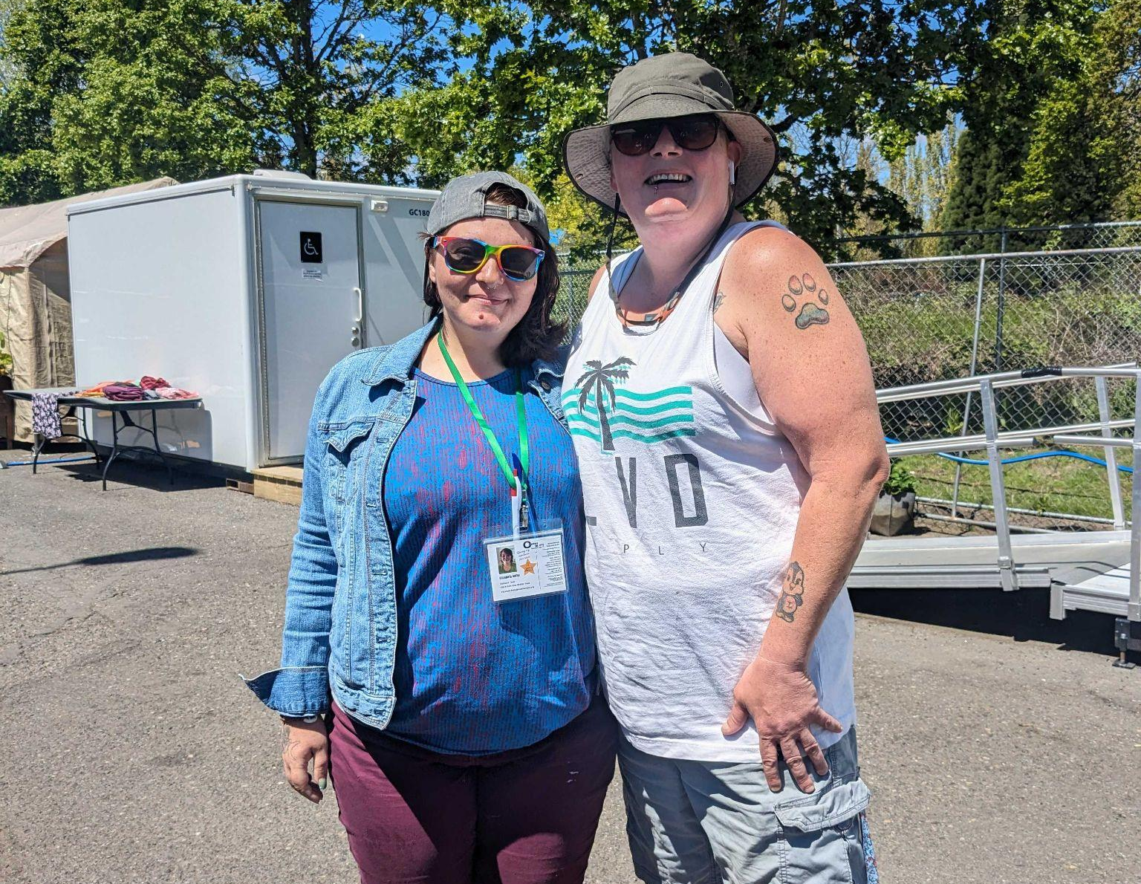
FOSTERING COMMUNITY CONNECTIONS & COMMUNICATION
Coordinated Entry Housing and other supportive assessments available out in the field.
Close communication with community outreach teams and healthcare system partners
Supporting referrals into housing, treatment programs and mental health assessments.
Notes:
We have close communication with other outreach teams and healthcare system partners to bridge gaps and reduce barriers. We attend the required by name groups and coordinated outreach meetings
Our work in the HMIS system is current and updated, and it is just one of the places we document,
We also use HealthConnect Care Coordination System to securely document referrals into treatment programs, or other health or social service referrals which adds to our community’s regional knowledge on emerging needs, trends, and our responses.

Slide 73
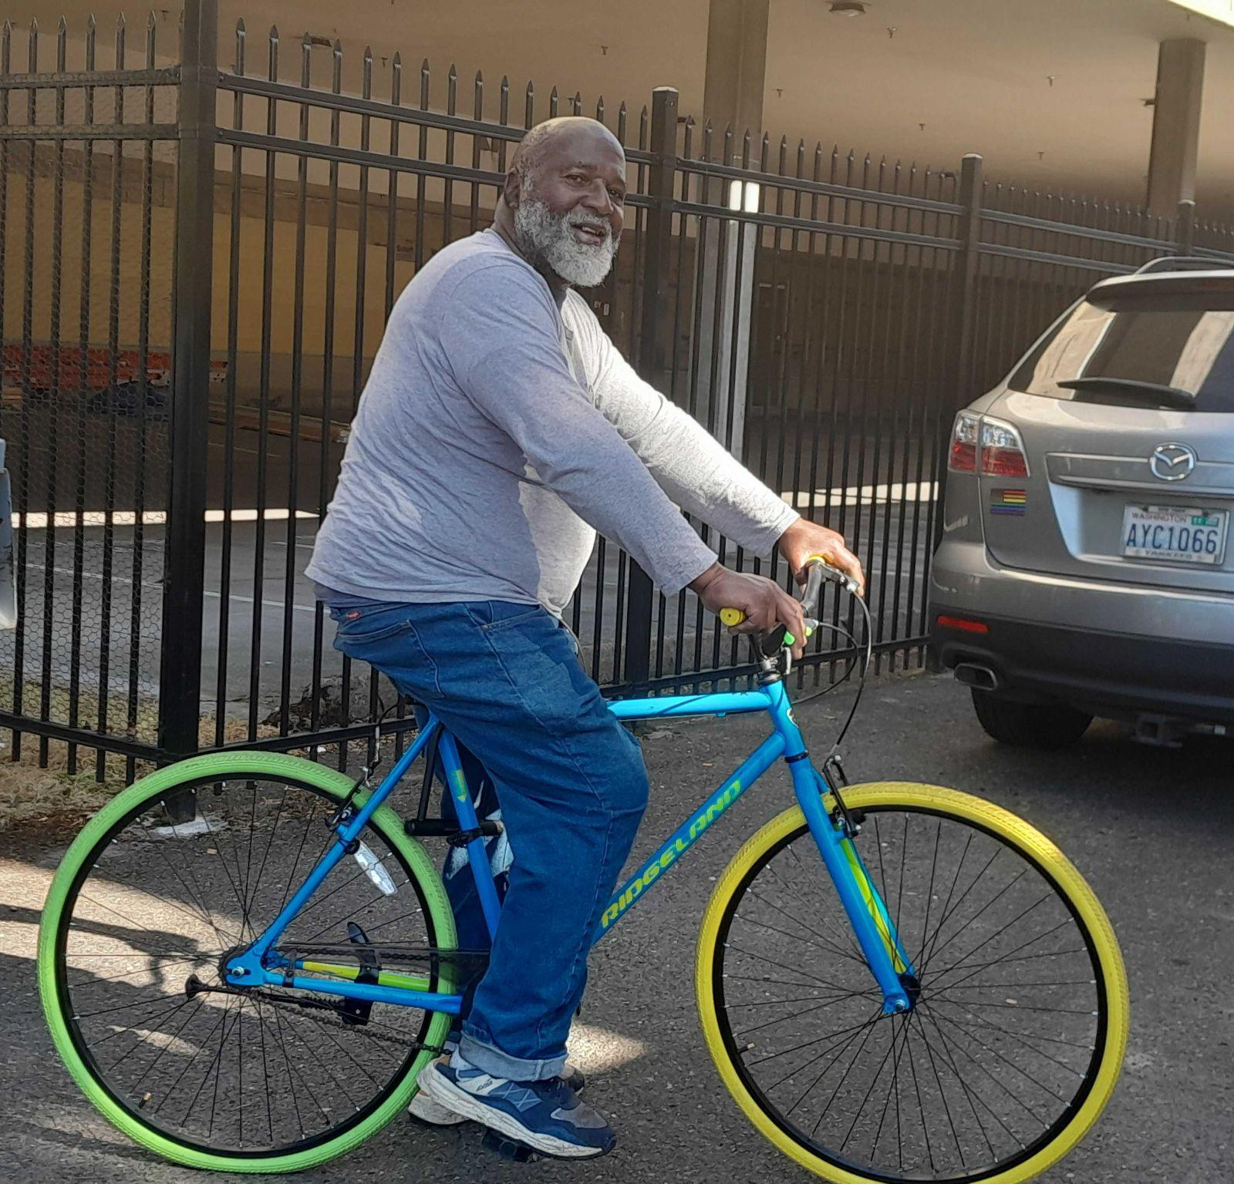
REAL-LIFE ACHIEVEMENTS & GOALS
CARE COORDINATION FOR
HEALTH INSURANCE
EMPLOYMENT
MEDICAL APPTS
DENTAL APPTS
CORRECTIONS SUPPORT
EBT / FOOD STAMPS
PHONE ACCESS
MAIL SERVICES
LAUNDRY SUPPORT
WI-FI COMPUTER ACCESS
HOUSING
Notes:
The addition of HealthConnect Pathways into our Outreach program was to more clearly capture the continued progress of social and health referrals. Our team intends to support people stabilizing by providing a process, and routine then documenting the work that’s happening. Each persons housing stability plan includes things like life skills, health appointments and daily routine improvements.

Slide 74
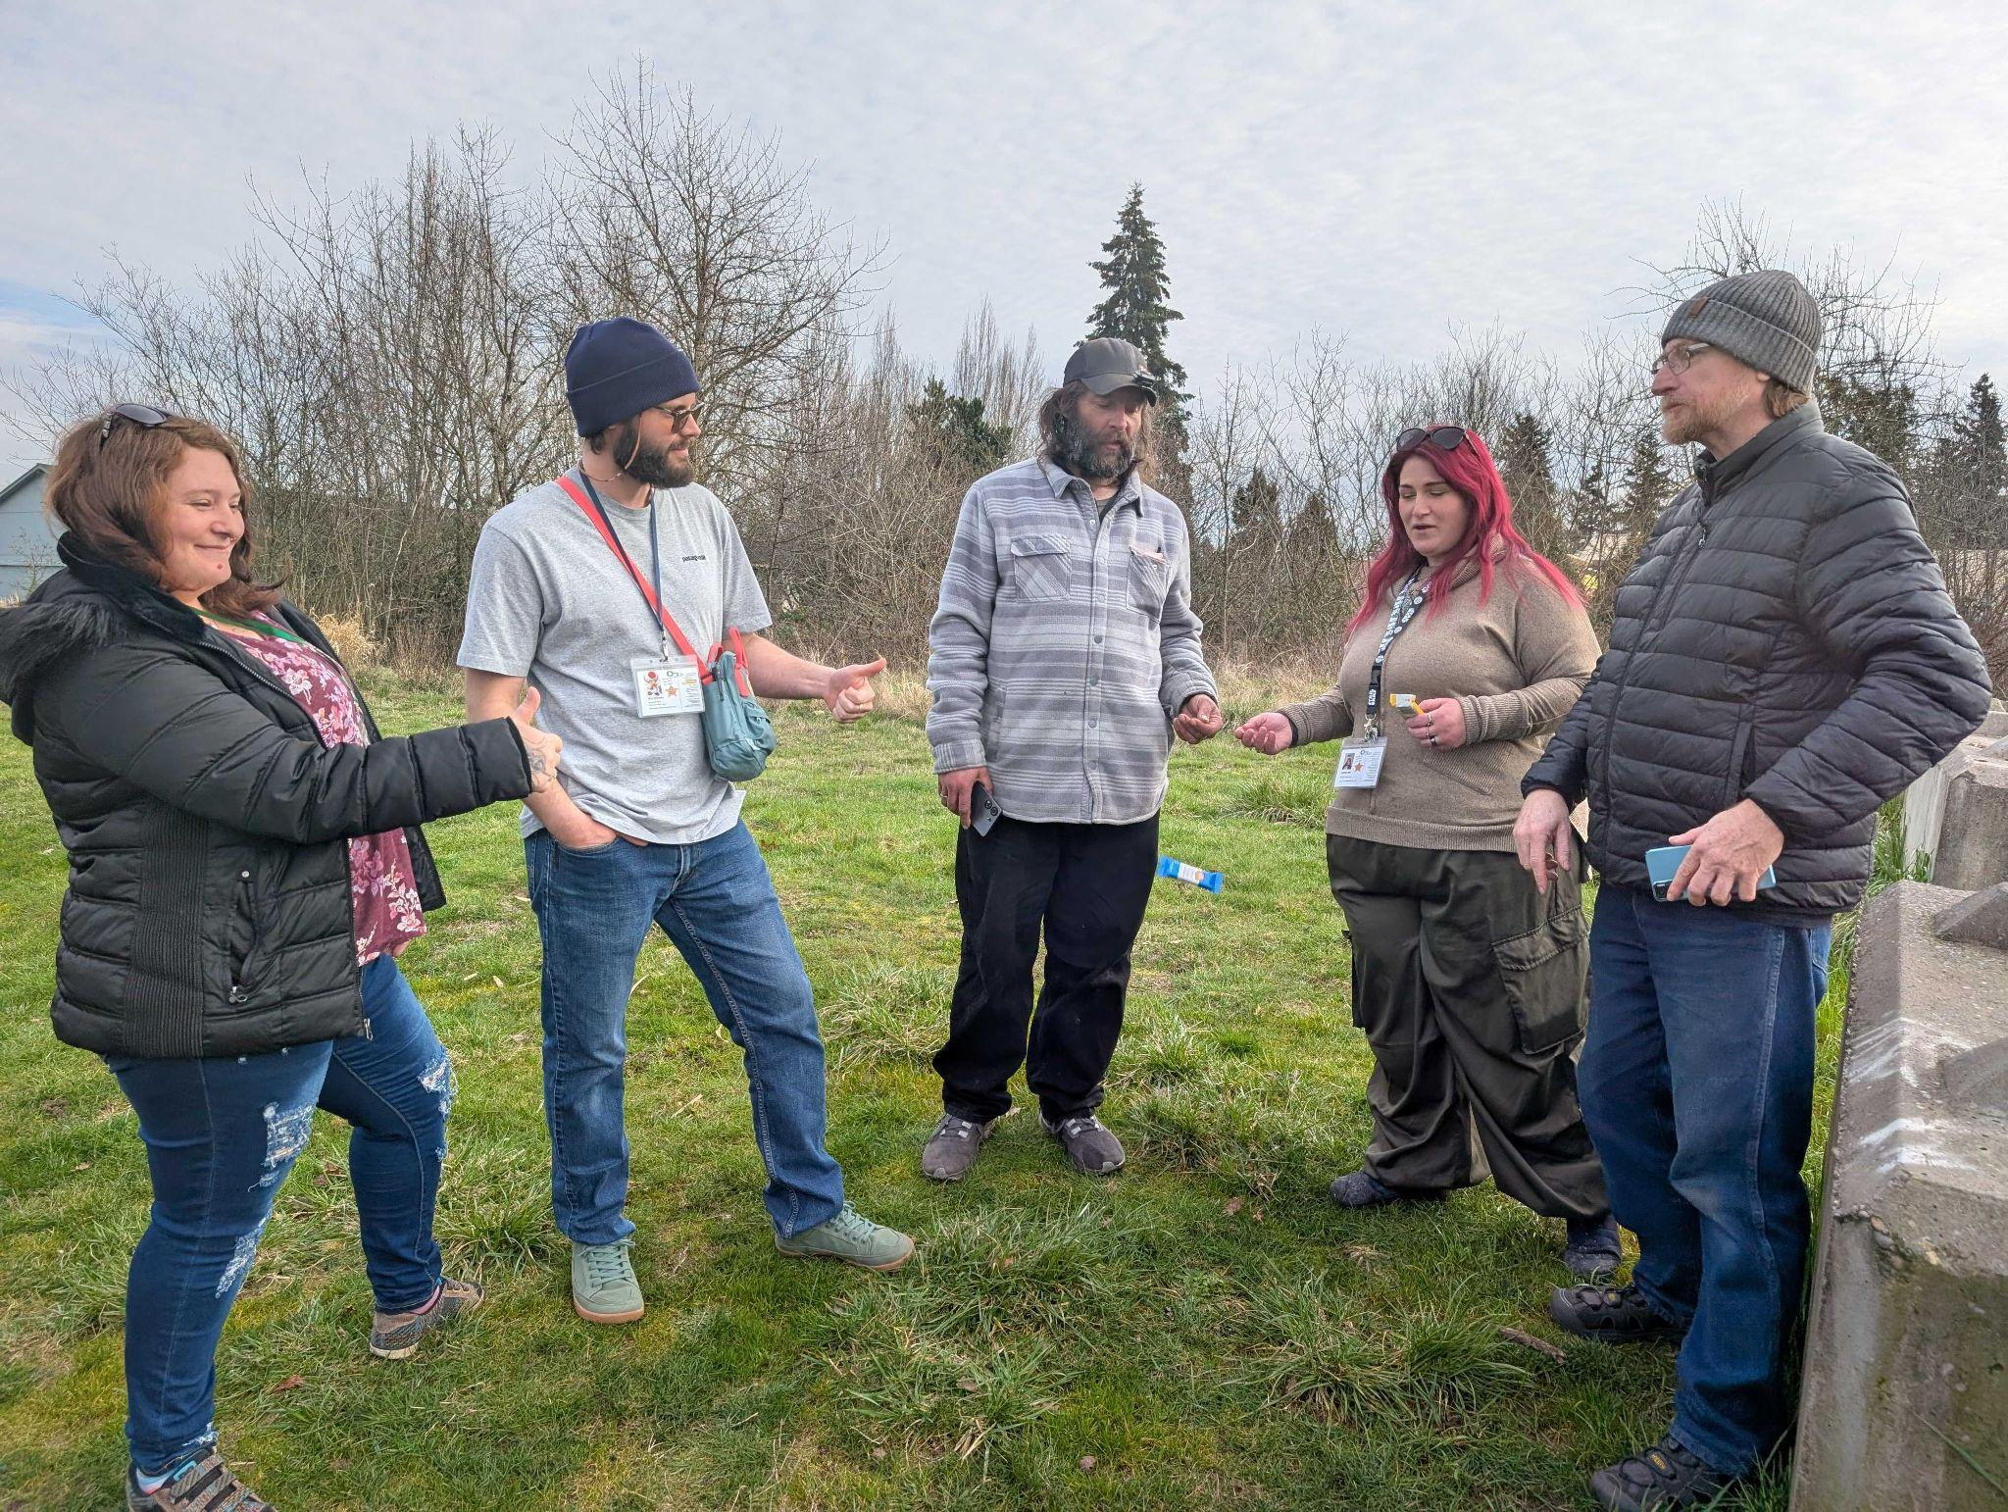
RELATIONSHIPS AND RESPECT
We work together in relationships based on equality and respect. We believe in making the right choices with transparency and accountability.
Notes:
So how does this play out in real time outside of the documentation? - It start with basic needs.
Hygiene products and supplies, Food, water, and other emergency supplies
Shelter items (tents, sleeping bags,tarps ,garbage bags), and other Seasonal supplies like hand warmers, sunglasses, bandanas for covering head or face in wildfire seasons.
Then with consistent and regular visits We try to establish strong relationships with the individuals in our community — listen to their concerns, provide information and resources, helping to create natural support networks, and advocating for long-term housing focused solutions.

Slide 75
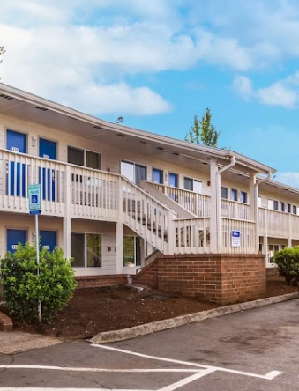
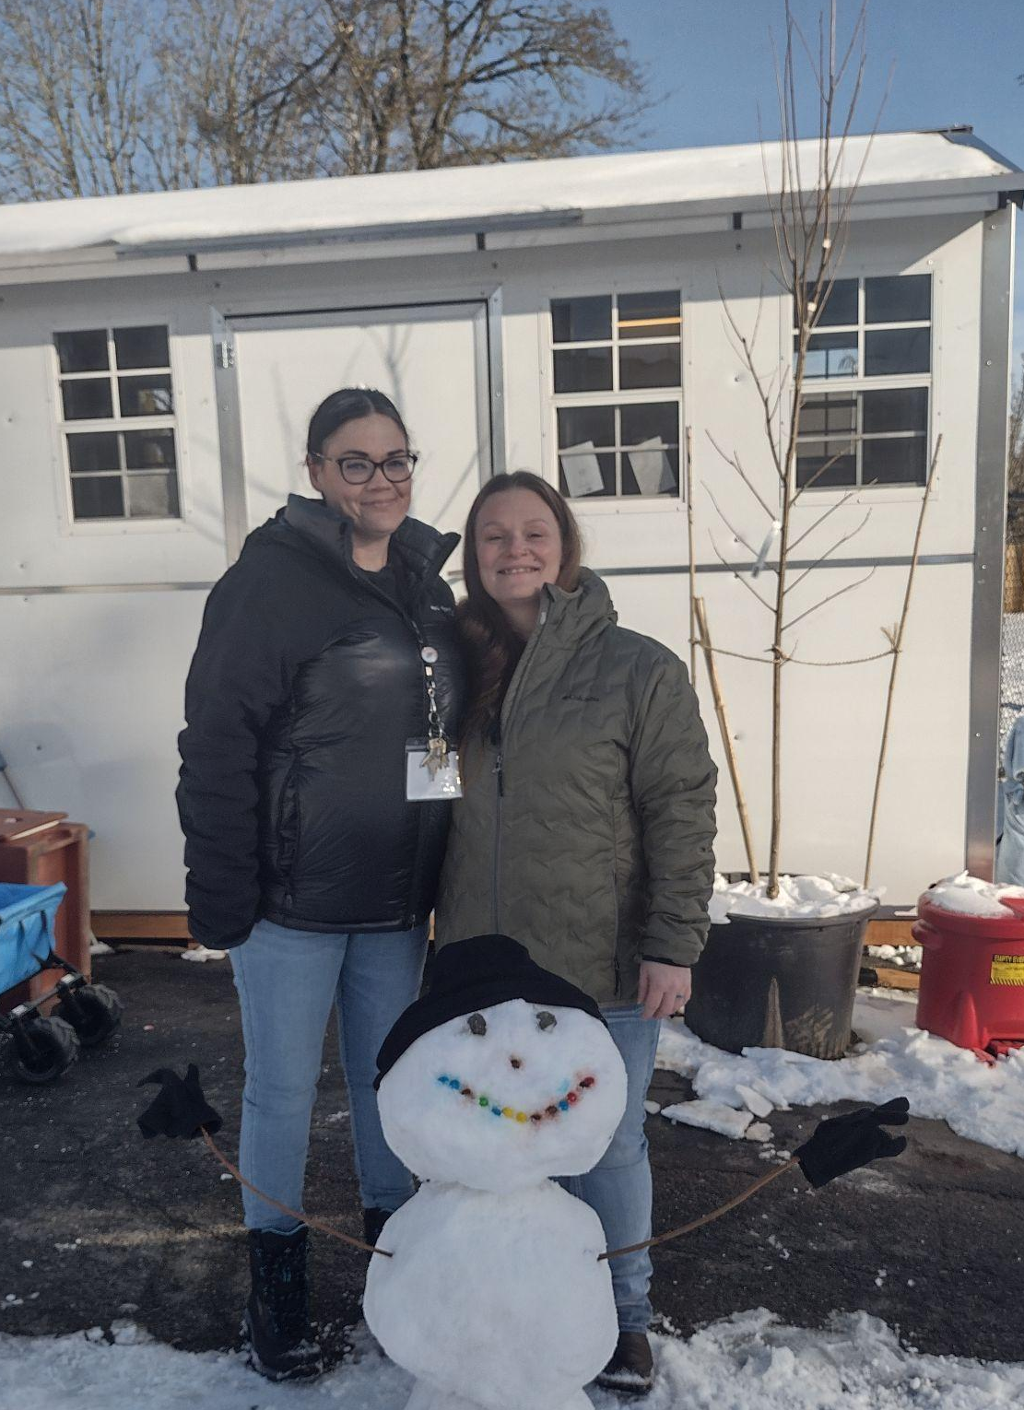
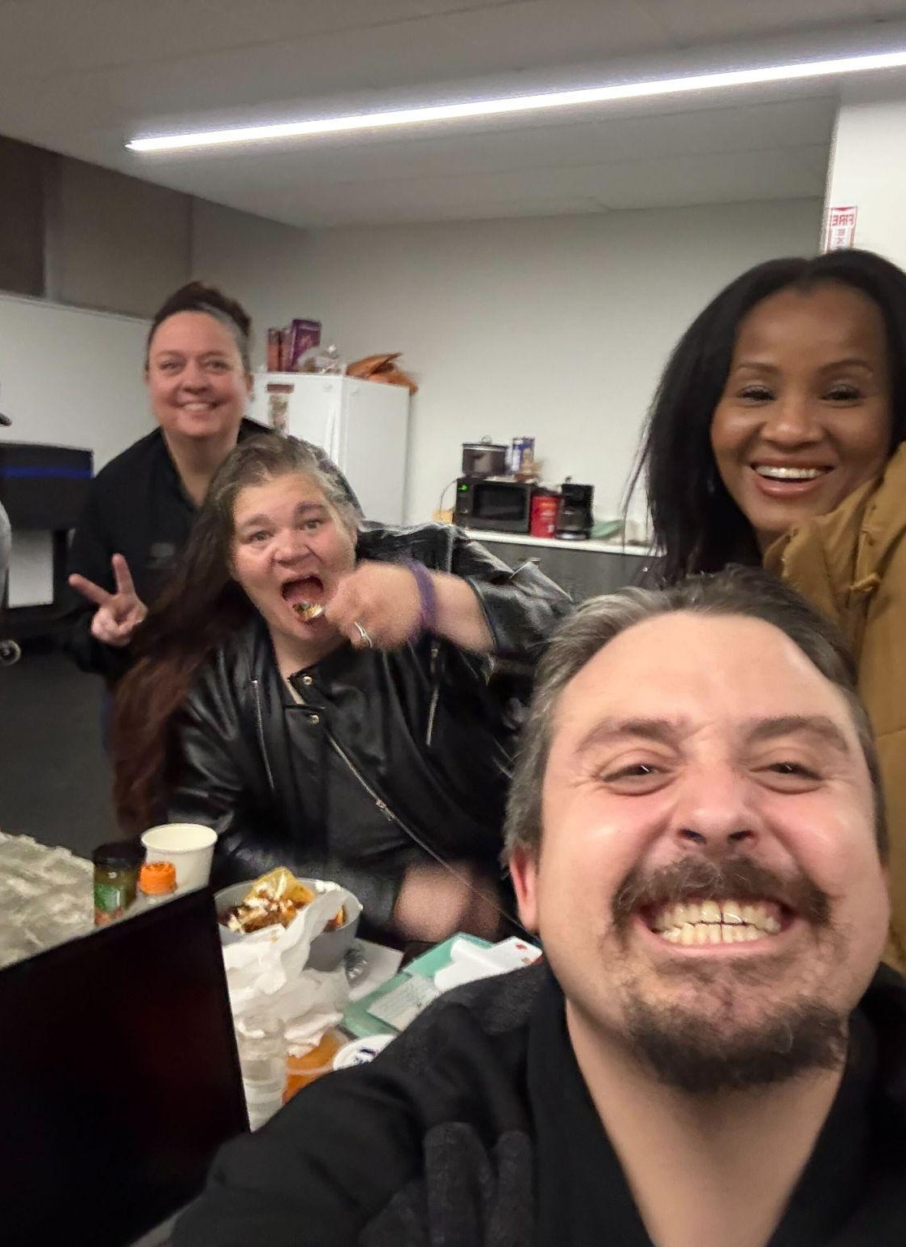
RESPONSIVE OUTREACH
Connecting to internal and external programs that are embedded in the community to be responsive to emerging and changing needs.
UNHOUSED RESIDENT MAIL SERVICE
MOTEL VOUCHER PROGRAMS
SAFE STAY PROGRAMS
WINTER SHELTER PROGRAMS
Notes:
In this progressive engagement, trust is built so they can successfully connect to internal Outsiders Inn and external community partner programs that are embedded in the community to be responsive to the individuals emerging and changing needs. These services might be
Support for shelter access or Safe Stay applications
Knowledge on safe locations to be.
Mail Services for those without an address
ID/birth certificate assistance
Health and treatment referrals
Employment referrals
Legal system navigation support
What makes our approach unique and effective
Peer Support Model: Using lived experience to connect authentically and build trust
Housing Focus: Prioritizing housing outcomes while meeting immediate needs
Integrated Partnerships: Working collaboratively within the broader system of care

Slide 76
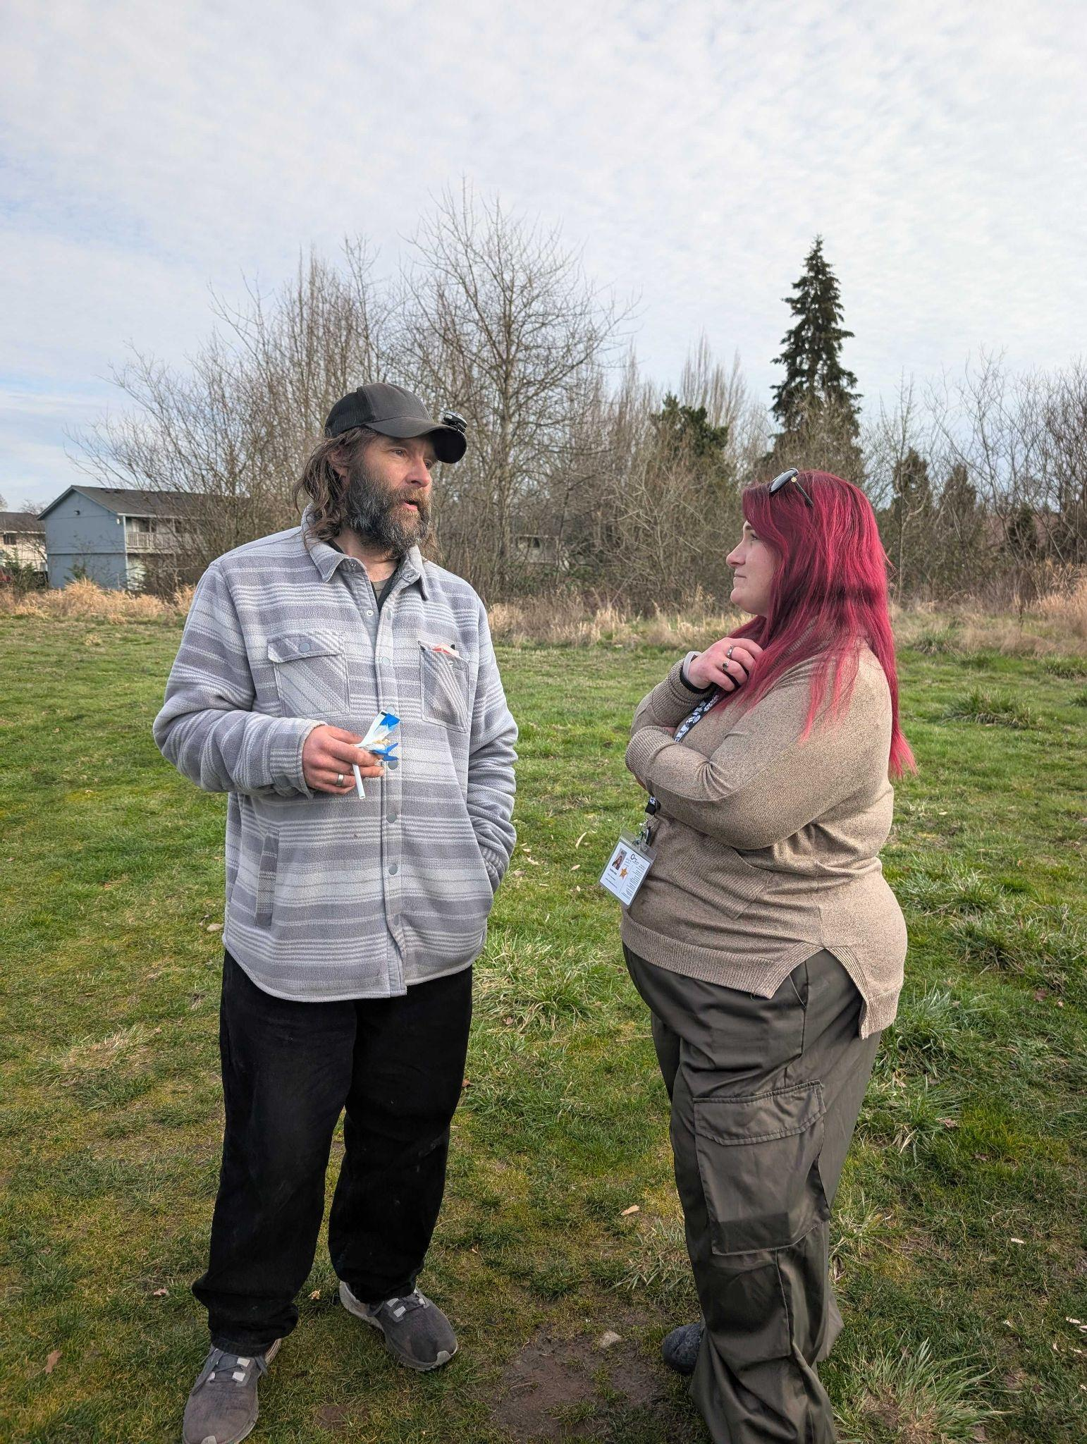
Successful Work Highlights
Our team has helped clients overcome complex barriers including:
Supporting clients with trauma histories
Coordinating care for those with cognitive impairments
Helping clients navigate substance use disorders
Supporting mental health needs
Notes:
Our team has helped clients overcome complex barriers including:
Supporting clients with trauma histories
Coordinating care for those with cognitive impairments
Helping clients navigate substance use disorders
Supporting mental health needs

Slide 77
POSITIVE SUCCESSES
Program Outcomes (2023-2024):
Exceeded annual service goal with 140 clients served
100% of clients connected to mainstream services
Clients maintained or increased income when applicable
Increased positive exits from 50% to 56%
Strengthened support for those connecting with homeless Community Court
Notes:
Program Outcomes (2023-2024):
Exceeded annual service goal with 140 clients served
100% of clients connected to mainstream services
Clients maintained or increased income when applicable
Increased positive exits from 50% to 56%
Strengthened support for those connecting with homeless Community Court

Slide 78
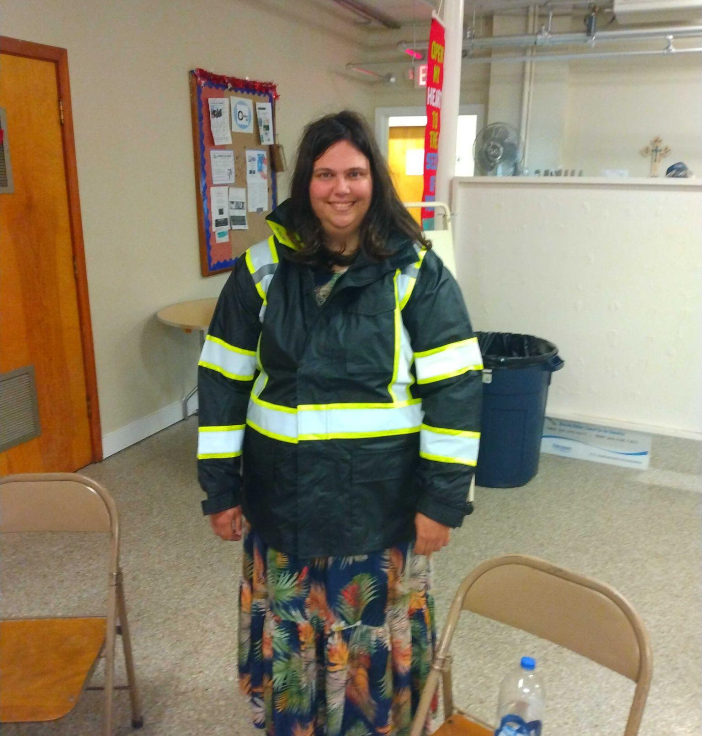
WITH THIS FUNDING WE CAN CONTINUE
MAINTAIN & SUPPORT TO OUR COUNTY OUTREACH SUPPORT, ESPECIALLY AS ORDINANCES AND LAWS EVOLVE AROUND UNSHELTERED HOMELESSNESS.
SUPPORT OUR STAFF OF PEOPLE WHO HAVE RECOVERED FROM HOMELESSNESS AND NOW ARE WORKING TO HELP OTHERS WHILE THEY WORK TO STAY ON THEIR PATH AS WELL
Notes:
So you see this is important. With this funding we will be able to connect people in encampments and on the streets to next steps in their journey. We will be able to compassionately continue our county outreach efforts, especially as ordinances and laws evolve around unsheltered homelessness, while providing employment opportunity to our other program graduates to continue to be able to offer quality lived-experience modeled services.

Slide 79
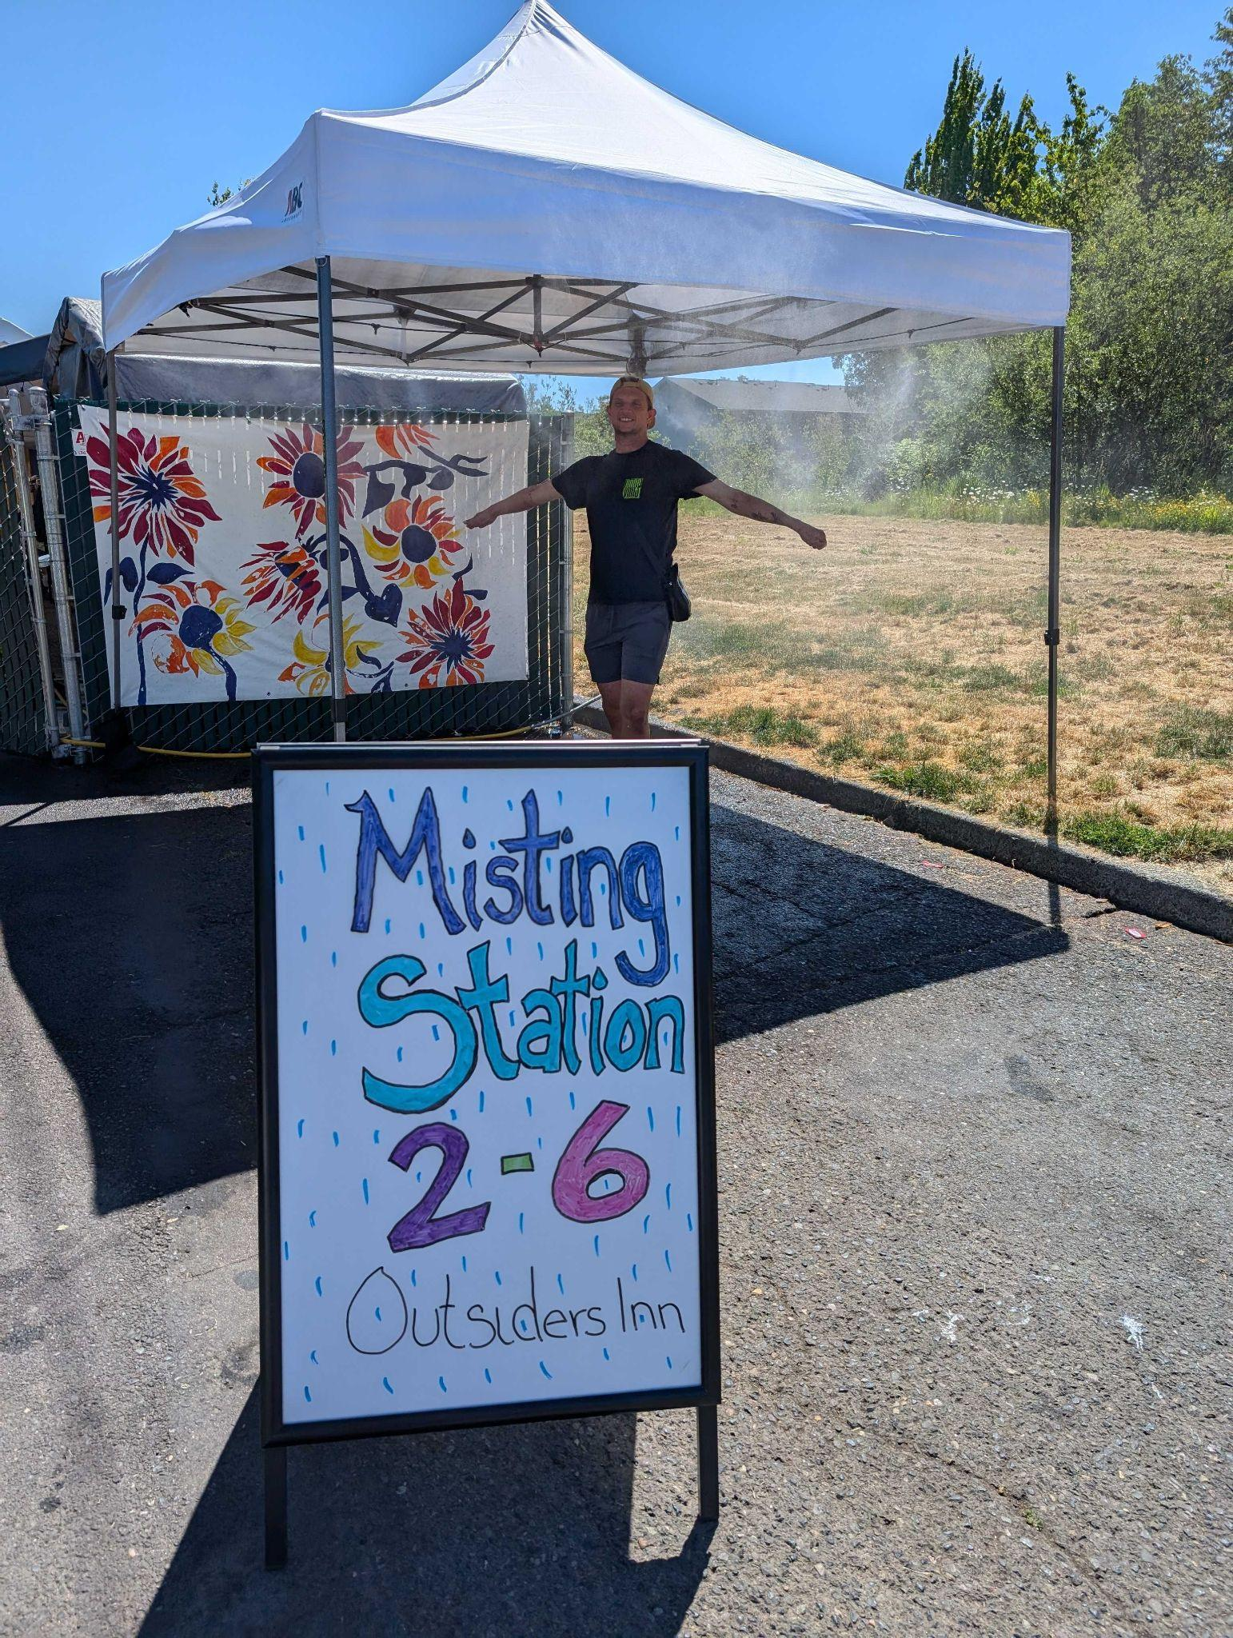
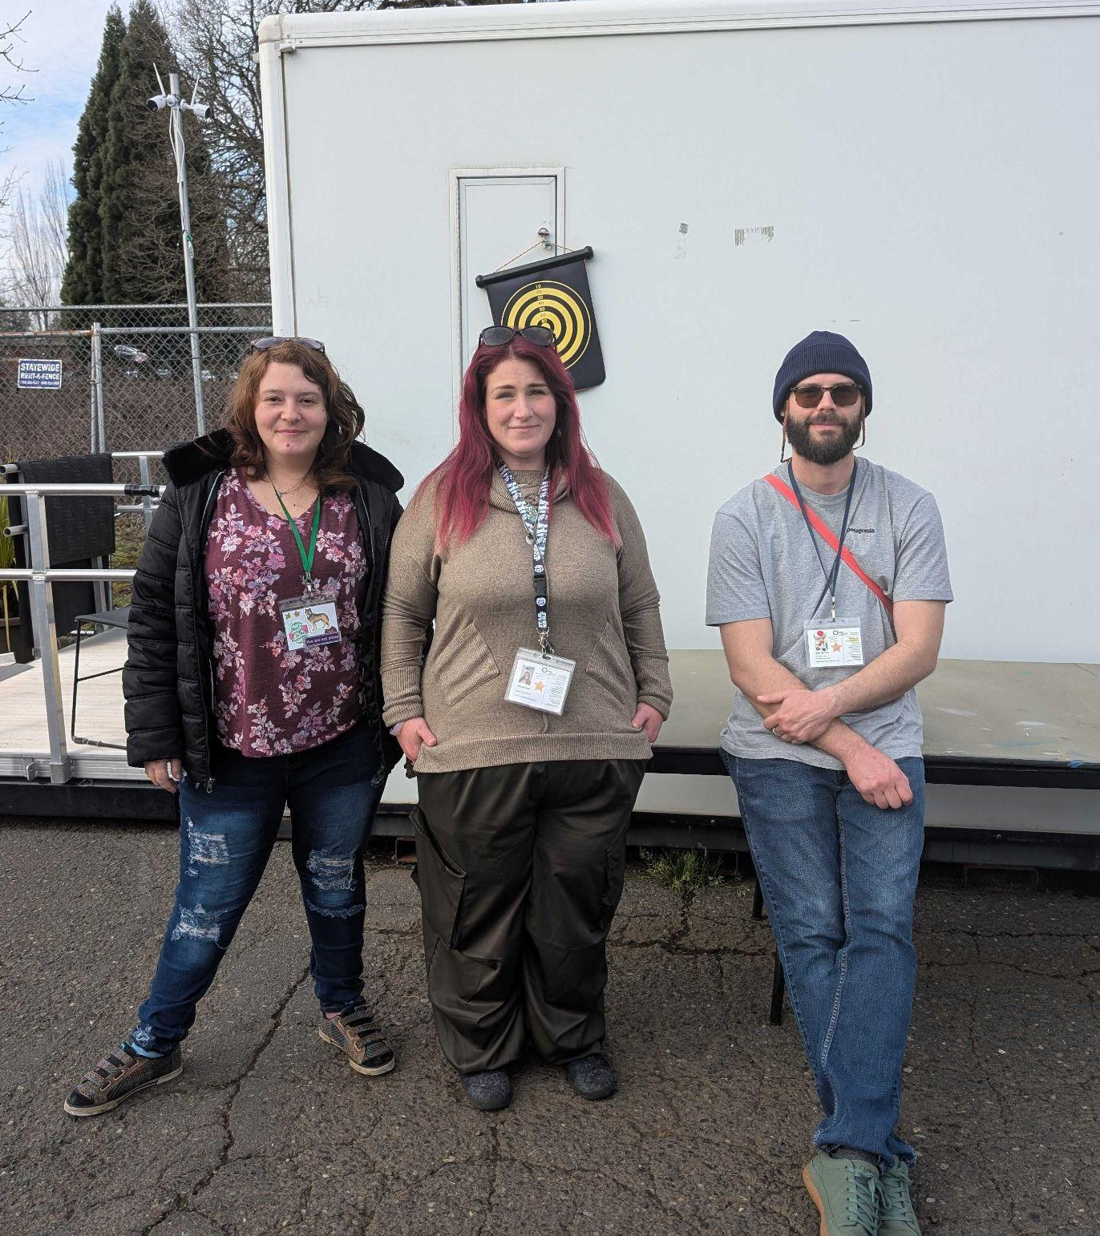
THANK YOU! QUESTIONS: CONNECT@OUTSIDERSINN.ORG
Notes:
WE WELCOME QUESTIONS NOW AND ANYTIME IN THE FUTURE TO CONTACT US AND LEARN MORE ABOUT OUR ORGANIZATION, AND OUTREACH TEAM
THANK YOU FOR YOU TIME AND CONSIDERATION.

Slide 80
Outreach Program
Jacky Snell
Outreach Program Manager

Slide 81
Goal:
To provide services to people experiencing homelessness, whether they are living on the streets or in their vehicles.
Funding will support Care Coordinators to:
Provide essential needs such as water, food and hygiene.
Help clients reduce their barriers to housing and employment.
Assist clients with housing and employment search.
Navigate systems with clients to access benefits.
Facilitate move-in costs for clients.

Slide 82
Strategies for Success with Clients:
Build trust and foster meaningful connections
Low-barrier access
Collaborate with community partners
Flexibility in service delivery
Feedback loops to ensure client voices are heard
Trauma-informed approach
Culturally responsive

Slide 83
Clark County’s 2024 Community Needs Assessment Report: Housing assistance is a critical need by 80% of survey respondents
Program Accomplishments since July 01, 2024:
61 households permanently housed.
170 clients were provided with Case Management.
174 clients were given information or referred to other services.
5000+ basic need items were provided to unhoused individuals.
1500+ harm reduction kits handed out.

Slide 84
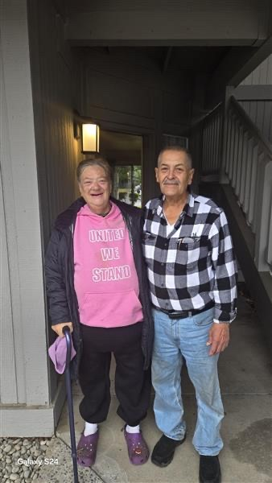

Slide 85
Thank you for your time.

Slide 86
Eviction Prevention Rental Assistance Program (EPRAP)

Slide 87
Cascade aids Project (CAP) EVICTION PREVENTION for People living with HIV/AIDS in Southwest Washington

Slide 88
what is CAP?
Cascade AIDS Project (CAP) is the oldest and largest HIV-services and LGBTQ+ healthcare provider in Southwest Washington and Oregon.
At CAP, we believe that housing in healthcare. Over the last year, we have offered eviction prevention and short and long term housing support to 95 HIV+ clients in SW Washington.
Our agency focuses on people of color, transgender and non-binary people, and other marginalized communities disproportionately impacted by HIV, houselessness, mental illness, substance use disorder, and more.

Slide 89
PRIORITY POPULATION
We provide eviction prevention and housing services to clients living with HIV and AIDS
Up to 50% of HIV-positive people are at risk of losing housing (National AIDS Housing Coalition).
People living with HIV/AIDS who are homeless or unstably housed are less likely to receive and adhere to lifesaving anti-retroviral therapy, are more likely to be hospitalized and use emergency rooms, and experience higher rates of premature death (National AIDS Housing Coalition).
When housed, hospitalizations for people with HIV decreased by nearly 60%, mortality for people with an AIDS diagnosis decreased by 80% after they received supportive housing, and among clients in the Ryan White Program, 90.8% achieved viral suppression after being housed

Slide 90
SCOPE of eprap project
From July 2024-February 2025, we’ve provided $46,054 in eviction prevention and rent assistance to 32 households. We are projected to expend another $64,000 and serve another 30 households in eviction prevention by June 30th, 2025.

Slide 91
Goal: Stable housing
Stable housing will be achieved through eviction prevention assistance and participant return to independent payment. This will be made possible through CAP'S wrap around service model coupled with external referrals.
Participation in and referral to other services within CAP if interested: Employment & Benefits Navigation, Peer Support, Prevention Services, Medical Case Management
Referrals for services outside of CAP: legal support, immigration assistance, food pantry, medical and dental, transportation assistance, mental health & substance use treatment, community support groups for women living with HIV and DV survivors, etc.

Slide 92
Participant Progress towards goals
Participants will be checked in with regularly on progress towards the following goal areas:
Housing – address barriers to stable housing, including housing searches, completing applications, and providing reasonable accommodation support
Health – connection to care
Financial – budgeting and employment/benefits navigation
Staff will assess if barriers can be reduced through services offered at CAP or elsewhere and offer this additional support wherever possible.

Slide 93
THANK YOU!
Jasmine Gruenstein, Director of
CAP SW Washington Services
Jgruenstein@capnw.org
Emma Burridge, Housing Services Coordinator
Eburridge@capnw.org

Slide 94
Council for the Homeless
Eviction Prevention Rental Assistance Program
April 2, 2025

Slide 95
What is Prevention?
Rental assistance for households who are behind in rent
Engaging in meaningful conversations to find solutions to barriers that contribute to evictions
Creating a housing plan that would assist client with sustaining their rent
Participant-centered and trauma-informed

Slide 96
Clark County’s Need
22% of households are renting
Estimated eviction filing rate = 2.7% of renter households annually*
1,709 UDAs filed in 2023 = 1 in every 308 residents*
79.6% of UDAs caused by non-payment of rent**
Gap in representation and legal support for tenants
at risk of eviction
Households re-entering the system
*UD Filing Data 2023, Administrative Office of the Courts
**Washington State’s Appointed Counsel Program: Baseline Report, University of Washington

Slide 97
Our Solution
Case management – address underlying issues and reduce housing barriers
Creative problem-solving
Client-centered
Culturally specific
Legal assistance – direct representation and advice to tenants at risk
Rental assistance – payment of rents, including arrears
Referral to wraparound services – to address root causes of instability
Reduce recidivism – prioritize tenants with multiple evictions
Notes:
I am here today to talk about Dynamic Diversion.
SHORT-TERM SERVICES ONE-TIME FINANCIAL ASSISTANCE Direct services from Diversion-trained staff Housing search • Creative problem solving Mediation or conflict resolution (with landlords, relatives, friends) Connections to community resources Job search and referral • Credit repair • Legal aid Housing-related costs Rent • Landlord fees • Moving expenses Security deposits • Utility bills • Background check Non-housing-related costs Employment certifications and licenses Interpreter services • Transportation • Work supplies

Slide 98
The Impact
Early identification – support renters before eviction to decrease number of households entering the system
Longer term solution – provide case management until stabilization is reached, reducing recidivism
Formal collaboration – increase access to legal supports, wraparound services, and financial assistance
System expansion – increase capacity and sustainability of eviction prevention services

Slide 99
Any Questions?

Slide 100
Eviction Prevention Program
2025-2027

Slide 101
Current Landscape
Clark County Needs Assessment identified that 80% of respondents reported housing resources as a critical need
Year-over-year rent increases in Clark County are currently 4.5 percent, outpacing state (1.7 percent) and national (3.3 percent) Metro-wide averages
Clark County has seen an increase of 22.8% in eviction filings making it the highest per capita in the state
Eviction Demographics
56% of people facing eviction in Clark County identify as people of color
70% identify as women
12% identify as members of the LGBTQIA+ community
30% of tenants state that they're unsure if they can pay rent moving forward
*This is aligned with national demographic data from NCSC

Slide 102
Proposed Activities
Provide Conflict Coaching sessions
Provide Landlord / Tenant mediations
Provide Housemate / Roommate mediations
Provide referrals
Provide specialized trainings for Property Managers / Landlords
Focus on pre-filing interventions

Slide 103
CMS will focus on pre-filing interventions.
Helping people navigate housing conflict before it escalates into crisis.
Through our current collaboration with NCSC and Clark county courts, we have identified a huge need for pre-filing interventions to prevent evictions leading to houselessness.
CMS uses its expansive database of landlords and tenants for outreach
CMS will work with community partners through a reciprocal referral process to get clients services before they reach a critical point
CMS will help clients navigate conflict to retain stable housing by employing tools such as Mediation, Conflict Coaching, Education and Resource Referrals

Slide 104
Conflict Coaching
1:1 session with a trained facilitator to assist with conflict management
Conflict analysis & navigation
Employ process skills to develop clarity
Identify needs & outcomes
Provide skills & tools for effective communication
Assist in drafting letters & rehearsing conversations
Mediations
CMS will provide Outreach to increase awareness of
pre-filing eviction alternatives.
Address behavior issues & air grievances
Address late rent repayment & accommodations
Repair, strengthen & amicably terminate relationships if necessary
Avoid eviction process entirely and prevent houselessness
Find solutions through a needs-based lens
Statistically proven to create more sustainable resolutions & fully executed agreements

Slide 105
Provide Training
Priority Populations:
Families, Youth & Aged Populations
However, services will be available to all residents of Clark county.
Trainings cover a myriad of skills including but not limited to:
Active listening
Non-Violent Communication
De-Escalation
NLP
Effective Negotiation Techniques
After completing the trainings, landlords & property managers will have effective tools & better understanding on how to navigate conflicts with tenants in crisis.
Providing Referrals
Provide customized ongoing resource referrals including but not limited to:
Legal Aid
Housing Assistance
Behavioral Health
Job Training / Placement
Food Resources
Provide ongoing case management to clients with comprehensive needs & recurring conflicts

Slide 106
Questions?
Presented by:
Nate Powers
npowers@cmswa.org

Slide 107
Eviction Prevention &
Rental Assistance Program:
Children & Families
Shane Scalf, Executive Director

Slide 108
PREVENTION = KEY TO ENDING HOMELESSNESS
Keeps At-Risk Families Housed Before They Enter the Homeless Response System
Reduces Family & Child Trauma
Equips Children & Families with Skills to Break Generational Cycles of Homelessness & Poverty

Slide 109
Temporary Rental Assistance
Resource Navigation & Community Referrals
Online Good Tenancy & Basic Financial Management Classes
Ongoing, Wrap-Around Case Management Support
SPECIFIC SERVICES PROVIDED

Slide 110
CURRENT IMPACT
With an average cost of $1,000 per family, FPCC was able to:
Prevent 126 individuals (80 children, 46 adults) from 71 households from experiencing homelessness in 2024.
Empower 100% to Remain in Stable Housing One-Year after Prevention Assistance

Slide 111
EVICTION PREVENTION RENTAL ASSISTANCE PROGRAM (EPRAP)

Slide 112
Program Fundamentals
INW Service Model:
Housing First with barrier removal
Strength-Based, Person Centered Case Management
Progressive Engagement
Trauma Informed Care
Harm Reduction
Barrier Removal
Client-Centered Action Planning (including - tenant ed, life skills development, community involvement)
Landlord Advocacy/Coordination/Mediation
Retention and Follow-Up Support (After Care)
Intervention:
Mobile intake/outreach to CFTH ref’d clients
Safety planning and expedited response to crises
Creative partnerships for wrap-around support
Continual Landlord Engagement
Landlord/Tenant Mediation
Emergency Basic Need Resources
Notes:
112

Slide 113
EPRAP Experience
INW has been providing EPRAP since 2024, but has had experience providing eviction prevention in City of Vancouver since 2018; overall, INW has provided prevention services for 20+ years in Multnomah County;
Prioritized Populations served:
HHs who have experienced chronic homelessness,
HHs exiting incarceration, hospitalization, other systems of care, or are engaged in the court system
HHs with a history of homelessness (including currently staying with friends/family),
HHs who have previously been evicted,
Youth exiting foster care, and
HHs receiving child welfare services.
EPRAP
FY24: 10 HH (24 individuals) served
FY25: 22 HH (67 individuals) served

Slide 114
EPRAP Program Goals
Number of HH served FY25 - 22
Number of individuals served FY25 - 67
Percentage of individuals from institutional setting or temporarily staying with family/friends FY25 - 18%
Percentage of individuals that have experienced past homelessness FY25 - 40%
Number of individuals maintaining or increasing income FY25 - 63
Number of individuals referred to mainstream resources/services FY25 - 60
Percentage of individuals remaining housed 12 months after exit FY25 - no data

Slide 115
Successes and Challenges
Successes
Obtain and Maintain Housing
Relationship/Trust Building
Improved Quality of Life
Addressing the historically marginalized and underserved populations in Clark County
Spectrum of programs meet variations of needs
Clark County Flexible Funds
Challenges
Higher vulnerability scores being referred to lower scope of services
Limited mental/behavioral health services
Substance Use Disorder vs. Engagement
Fixed Incomes/Low Wages vs. Housing Market
Difficulty finding living wage jobs
Community need is still above resources available
Staff turnover

Slide 116
Success Story
Lucy is a single mother in her 50s with an elementary school age child. She has a history of working in home care, but was laid off by her agency when they downsized. She entered EPRAP after exhausting her savings and facing eviction due to rental arrears. She had been actively looking for work.
During the intake and assessment, Lucy identified a need for employment support and finding a new job. Her INW Housing Specialist referred her to WorkSource where Lucy accessed resources in revising her resume and identifying computer skills she needed to improve. She took several classes at WorkSource focusing on increasing these computer skills.
Lucy also identified having high levels of anxiety when interviewing for jobs. WorkSource connected her with an online AI program where she could practice her job interview skills. She stated that this has been very helpful. Just recently, Lucy was hired back in her field as an in-home care provider serving adults with developmental disabilities. Soon Lucy will be able to graduate, as her income and monthly budgeting shows progress to meet all of her needs.

Slide 117
Partnerships
Council for the Homeless/Housing Solutions Center: coordinated entry, referrals, warm handoffs
Partners In Careers: shared office space, coordination of services, community resource referrals.
NAMI of SW Washington: mental health and crisis intervention resource referrals
Clark County Volunteer Lawyers: legal barrier removal, legal resource coordination, eviction mediation & support
YWCA: provides emergency D/V services and ongoing supports
Providence & Kaiser Medical: healthcare navigation, benefit registration, information/referral
Private landlords and Property Managers

Slide 118
Questions?

Slide 119
Unidos

Slide 120
Who we serve:
Youth ages 18- 24
Youth at risk of homelessness or couch surfing
56% BIPOC Community
Often families with children

Slide 121
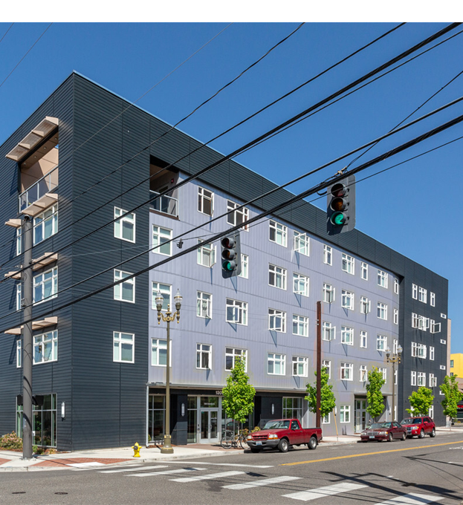
Case Management
Stabilize housing
Pay of past due (eviction prevention)
Find stable housing (couch surfing)
Build trust
Intensive case management
Life skills
Referrals to outside agencies

Slide 122
Best Practice Models
Positive Youth Development
Self Governing Model
Progressive Engagement
Trauma informed Care
Housing First
Harm Reduction
Motivational Interviewing
DEI
Service Integration

Slide 123
Outcomes
&
Success Rates
Success defined as:
Youth being self-sufficient
Maintaining housing
This year:
Spent $380K
Assisted 60 individuals
Low because of staffing issues
Success rate: 100%

Slide 124
Return on Investment
The goal of Unidos is to be the last service youth will ever need for housing.
Unidos average cost per household: $6,500
Savings to community estimated to be:
Male: $1,000,000
Female: $2,000,000

Slide 125
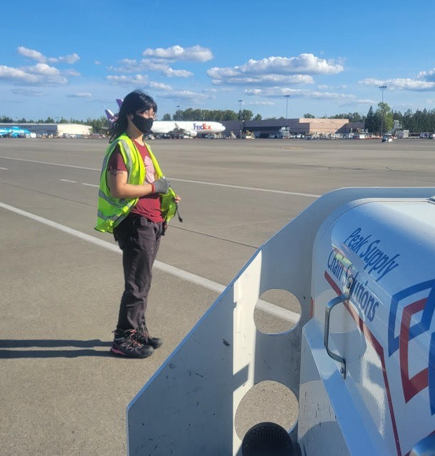
Success Story
Unidos has helped to create many success stories, here is one.

Slide 126
Questions about Unidos?

Slide 138
Eviction Prevention Rental Assistance Program (EPRAP) Application Presentation
Thalia McDaid-O'Neill
Affordable Housing and Stability Program Director
Feb. 2025

Slide 139
Program Impact & Specifications
Share’s Eviction Prevention Rental Assistance Program is designed to prevent homelessness and housing instability by providing targeted rental assistance, case management, and supportive services.
How’re we aiming to address homelessness with this program?
Preventing households from falling into homelessness
Targeted Prevention Screening Tool
Providing resources and referrals
Landlord/Tenant mediation
Clark County Volunteer Lawyers Program
Northwest Justice Project

Slide 140
What does EPRAP and Case Management look like?
Two Adult Household – Newly housed, one adult lost employment within a month, left to maintain on part-time job from other adult. Received 6 months of rental assistance.
Landlord negotiation and conflict resolution
Behind in rent, mediation to avoid notices
Strengths-based & Client-centered
Determined and resourceful
Resource and referral connections
Employment services, budgeting, finances/saving account, mental health services
Outcome: gained full-time employment, able to pay rent on their own, accessed 3 additional months of assistance and graduated!

Slide 141
Previous One-Year Outcomes 07.01.23 – 06.30.24
Number of individuals served: 71
100% of client exited to permanent housing, 0% exited to homelessness, and the average length of stay was 116 days. 16 unemployed adults obtained employment. 31individuals received budgeting assistance.
Client Satisfaction Survey Responses:
“A shine of hope”
“How helpful and knowledgeable staff was. Also a speedy process, felt very comfortable”
“Staff made me feel very comfortable, their energy amazing and very reassuring”

Slide 142
Thank you! Q & A
Thalia McDaid-O’Neill
Tmcdaid-oneill@sharevancouver.org
360-952-8205

Slide 149
Open Public Forum and Other Business
Open Public Forum (up to 3 minutes)
Adjourn
Save the date: Next CAAB Meeting
May 7, 2025 starting at 9am

