Slide 1
WELCOME! Community Action Advisory Board Meeting
This meeting is being recorded.
Please identify yourself when talking so we can capture accurate minutes.
“Chat” function is not available due to public disclosure rules.
Closed Captioning now available
Turn on Webex Assistant and follow the prompts to turn on closed captioning
Lock participant videos in Webex
Lock up to 6 participants to see them regardless of who is speaking
Each person can customize their own set of pinned participants
Hover over the thumbnail location you want to lock a participant to
Click on More and select Lock a participant to this location
Select the participant from the list you want to lock in that position

Slide 2
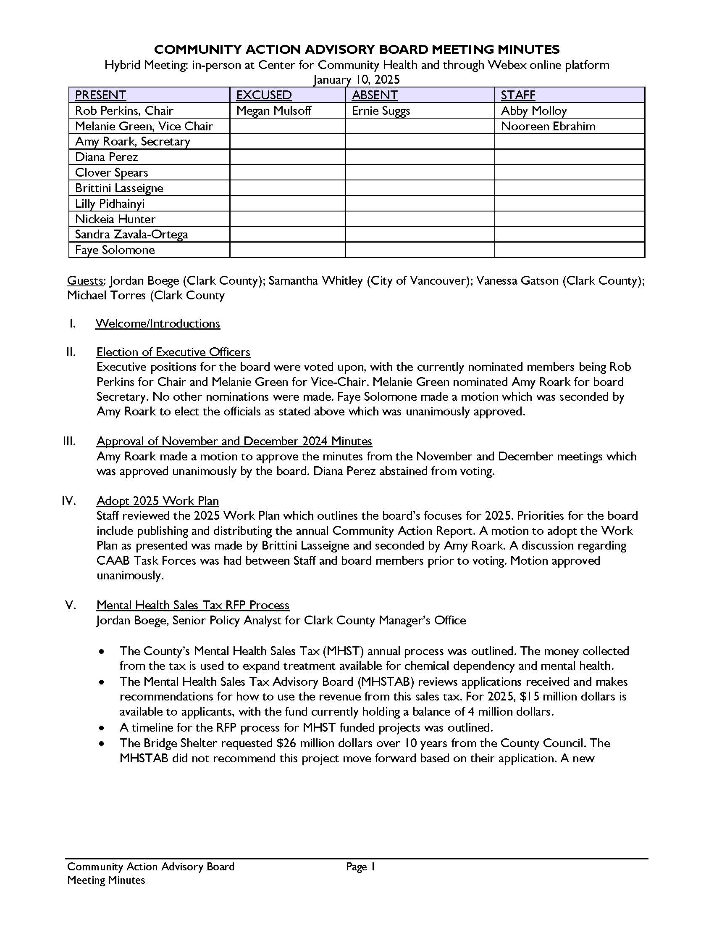
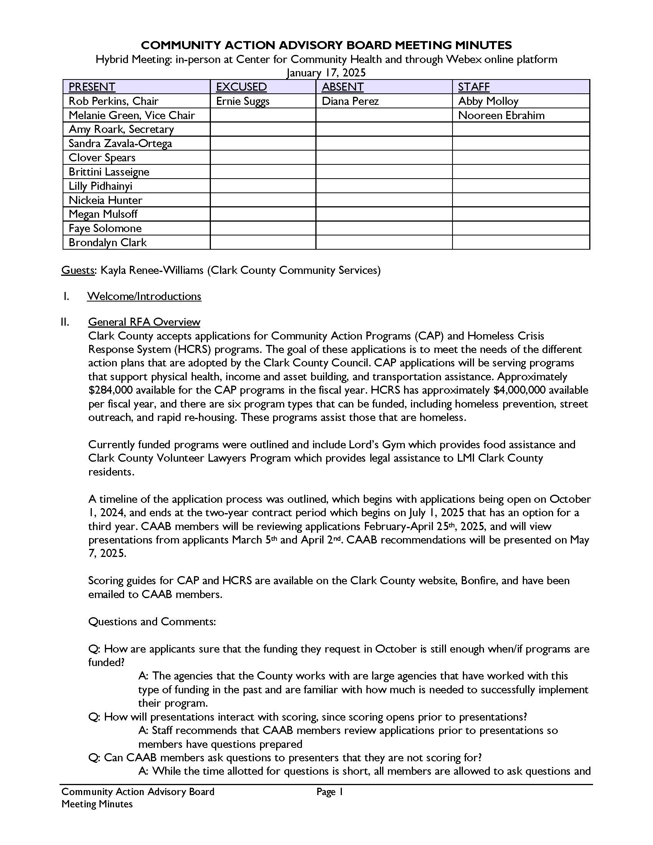
Approval of Jan and Feb 2025 Minutes

Slide 3
July 2024 – December 2024 Outcomes Report
Abby Molloy
Notes:
Share screen
Here we have the outcomes report for CAP and HCRS programs from all of FY24 (Jul 1, 2023 – June 30, 2024). I sent out electronic copies over email and have physical copies available in the room.
Most of you have seen this report many time, but for those who haven’t, each CAP and HCRS program and annual report period in orange. The green section shows the annual proposed goals, achieved YTD, and percent achieved. At this point, we have completed the fiscal year so most of the programs will be around 100% achieved. For programs that have significantly overachieved or underachieved on their proposed goals, we have received explanations which I can pull up if anyone is curious about a specific indicator. For example, you’ll see that under Lord’s Gym food assistance program, they anticipated that 40 youth would be assessed for food insecurities, however, only 9 were due to changes in leadership and unanticipated challenges in tracking this outcome. We are working with agencies to reassess if goals achieved differed significantly (under 80% or over 120%) from expected goals. In blue, you will see the annual contract amount, the total spent as of June 30, the balance as of June 30, and the percent spent. You’ll see that most programs are 100% spent but for those that were underspent these funds have either been rolled over into the next fiscal year or recaptured to fill the HB deficit depending on the funding source.
Some things to note about the CAP programs on the first page:
First of all, the Clark College Financial Wellness program ended on January 5, 2024 and remaining funds have been reallocated to other CSBG programs.
Second, all CAP contracts, except for Clark College, have been renewed for another year at the same amount.
Like I mentioned, targets are being reevaluated for the next Fiscal Year, as needed.
Moving to the HCRS programs, these are organized by program category in the same way they have been in the past. We have system coordination and data collection, core support services, outreach services, shelter services, etc. You’ll again notice here that most of the programs are around 100% of their achieved goals but some are higher or lower. For example, you’ll see that the CFTH HSC program was able to assess many more households than anticipated because CFTH has implemented a improved and consistent structure for assessment trainings in the community. On the other hand, if we look at Share’s Rent Well program you will see some indicators that were under achieved such as the number of rent well graduates. They let us know that this was due to a period of staff transition which resulted in low Share participants in quarter one, no classes being taught in quarter 2 and then beginning to increase classes in quarter 3 but they were unable to make the proposed outcomes in that time. So we will check in with both of these orgs to discuss these targets and re-project as needed.
There are a few things that I want to highlight:
First, the Share HO program is currently billing to other grants, which is why you will not see any spending for this contract.
Second, I mentioned this last time, any remaining state and local funds were recaptured and used for the House Bill deficit. Any remaining EPRAP funds were rolled over to the next fiscal year (FY 2025).
Third, targets are being reevaluated for the next fiscal year, as needed.
The last page shows information which is pulled from program reports and HMIS. On the top left, you will see the participant satisfaction survey data. During FY24, programs have sent out 6171 surveys and received 1381 responses for a 21.4% response rate. Of these responses, 89.4% indicated a positive overall experience which is great
Next we have community engagement which shows the number of volunteers and volunteer hours who help operate these programs. This year there have been 2363 total volunteers, with 29855 volunteer hours, 6814 of which were by low-income volunteers, for a total value of $1,171,483. I mentioned this last time, but a recent report by Independent Sector at University of Maryland calculated that the current value of a volunteer hour in Washington State is $40.28. This rate is being used by WSCAP and is what we use to calculate volunteer hour value for our reports.
The next chart shows the number of grievances received by the programs. Out of 48 programs which report grievance information 33% have received a grievance. There were 115 total grievances received, 82 of which have been resolved. The rest are in the process of being resolved and staff will keep and eye on these to make sure they have been resolved. We are not concerned by the number of grievances at this time, it is very common for participants to be unhappy with parts of their assistance and answers to certain questions. But we do keep an eye on the number of grievances received by each agency and will note if there are any red flags.
And then we have an overview of the some of the demographics that we collect. Not all programs report on every demographic, and you will see the number of responses for each demographic at the top of each chart. This helps us get a better understanding of who is engaging with our programs and where we might be missing people.
Talk through charts.
That is all I have. Any questions?

Slide 4
CAP and HCRS Request for Application Presentations

Slide 5
CAP – Physical Health

Slide 6
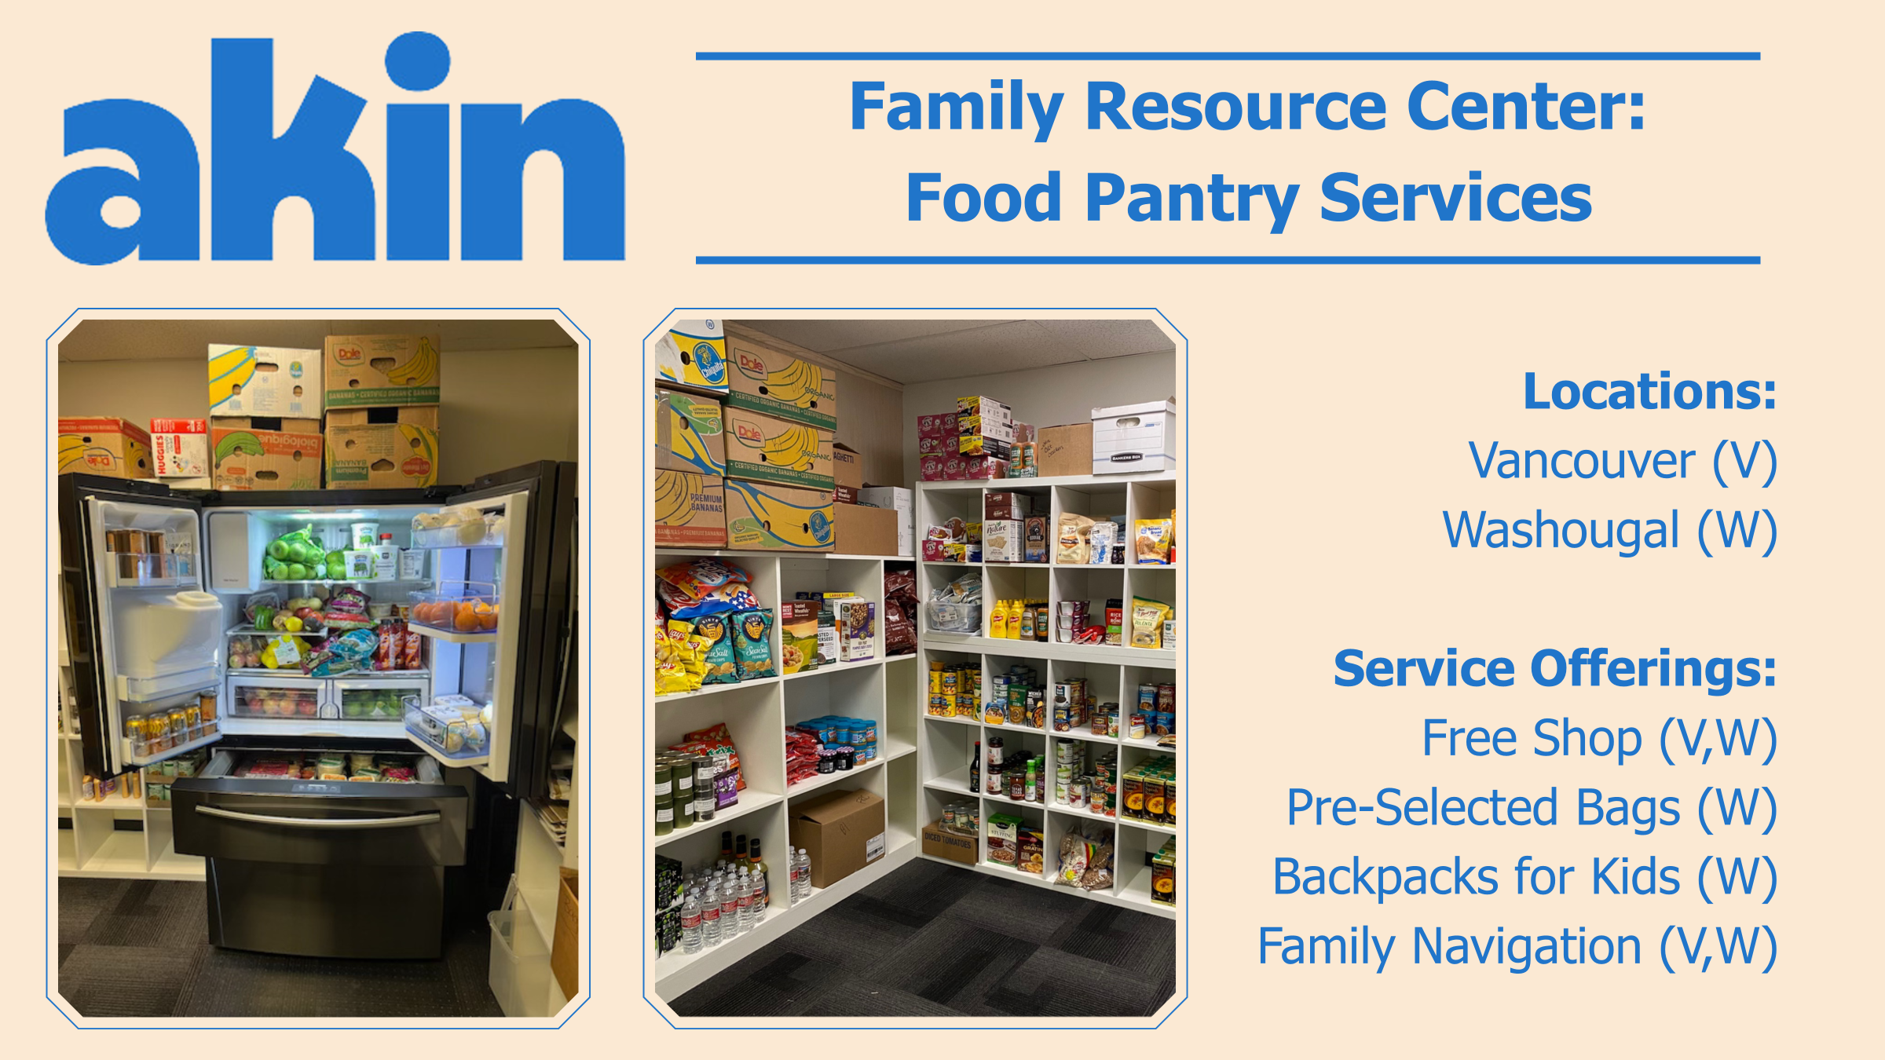

Slide 17
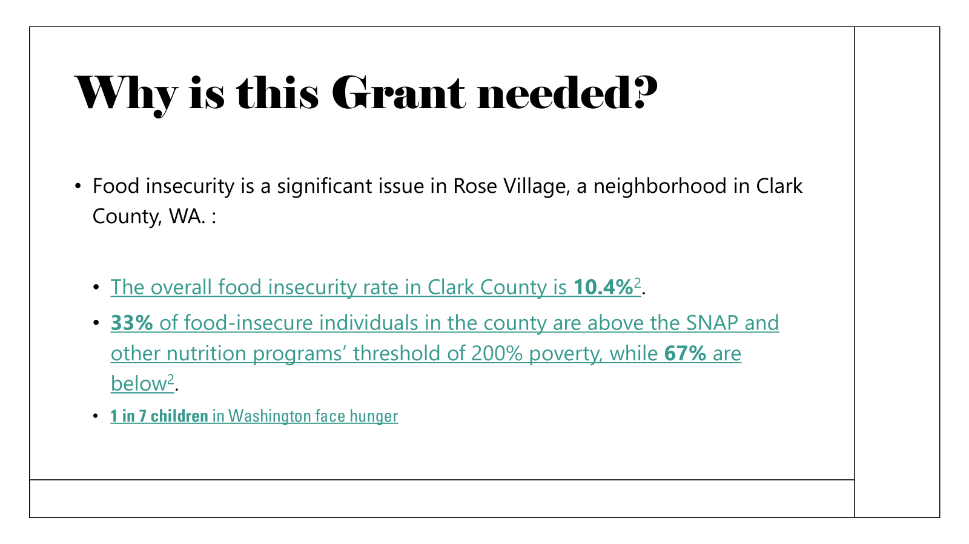

Slide 21
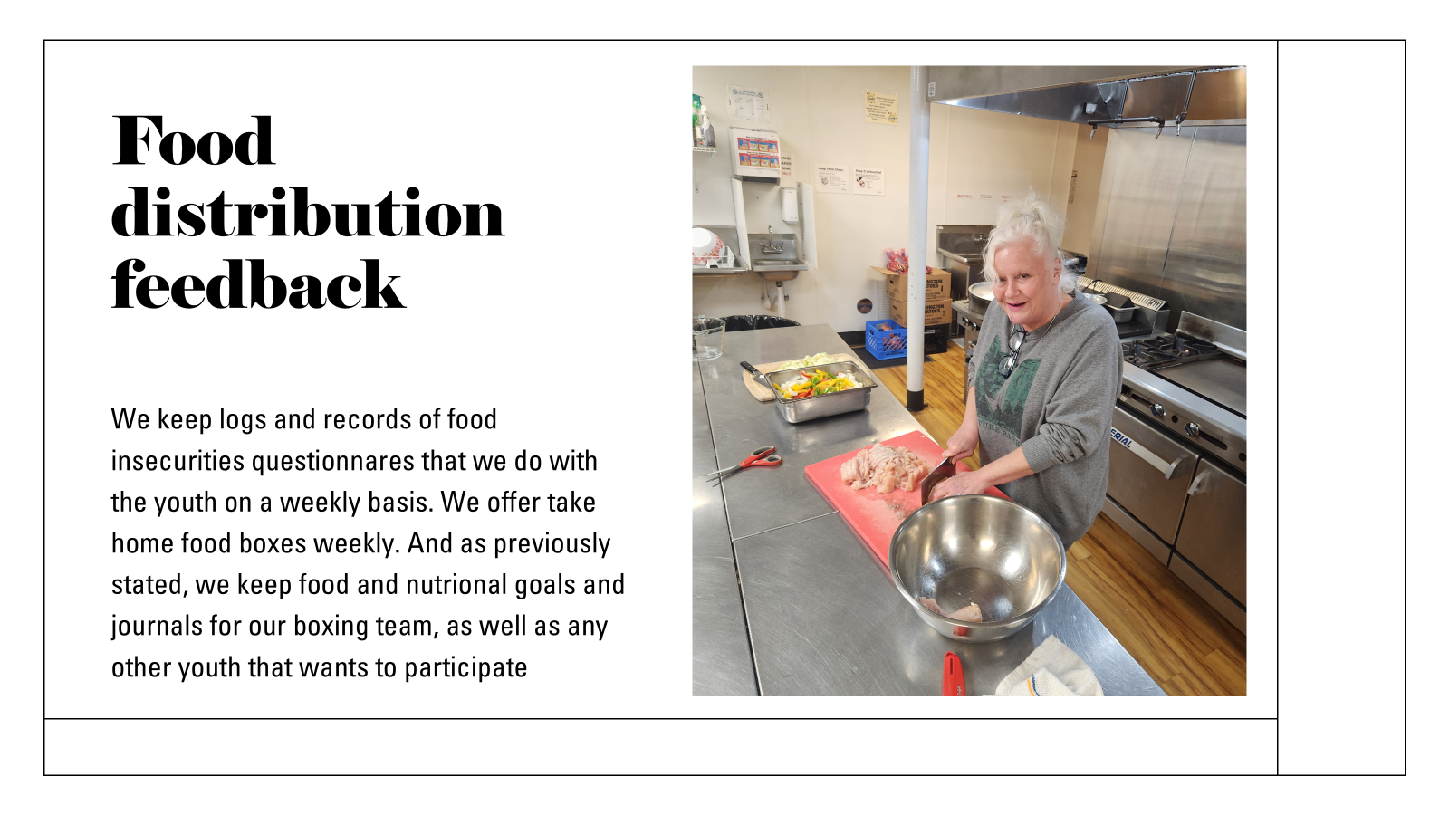

Slide 27
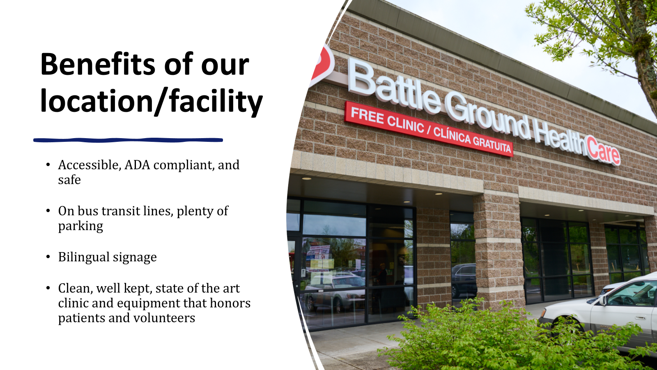

Slide 38
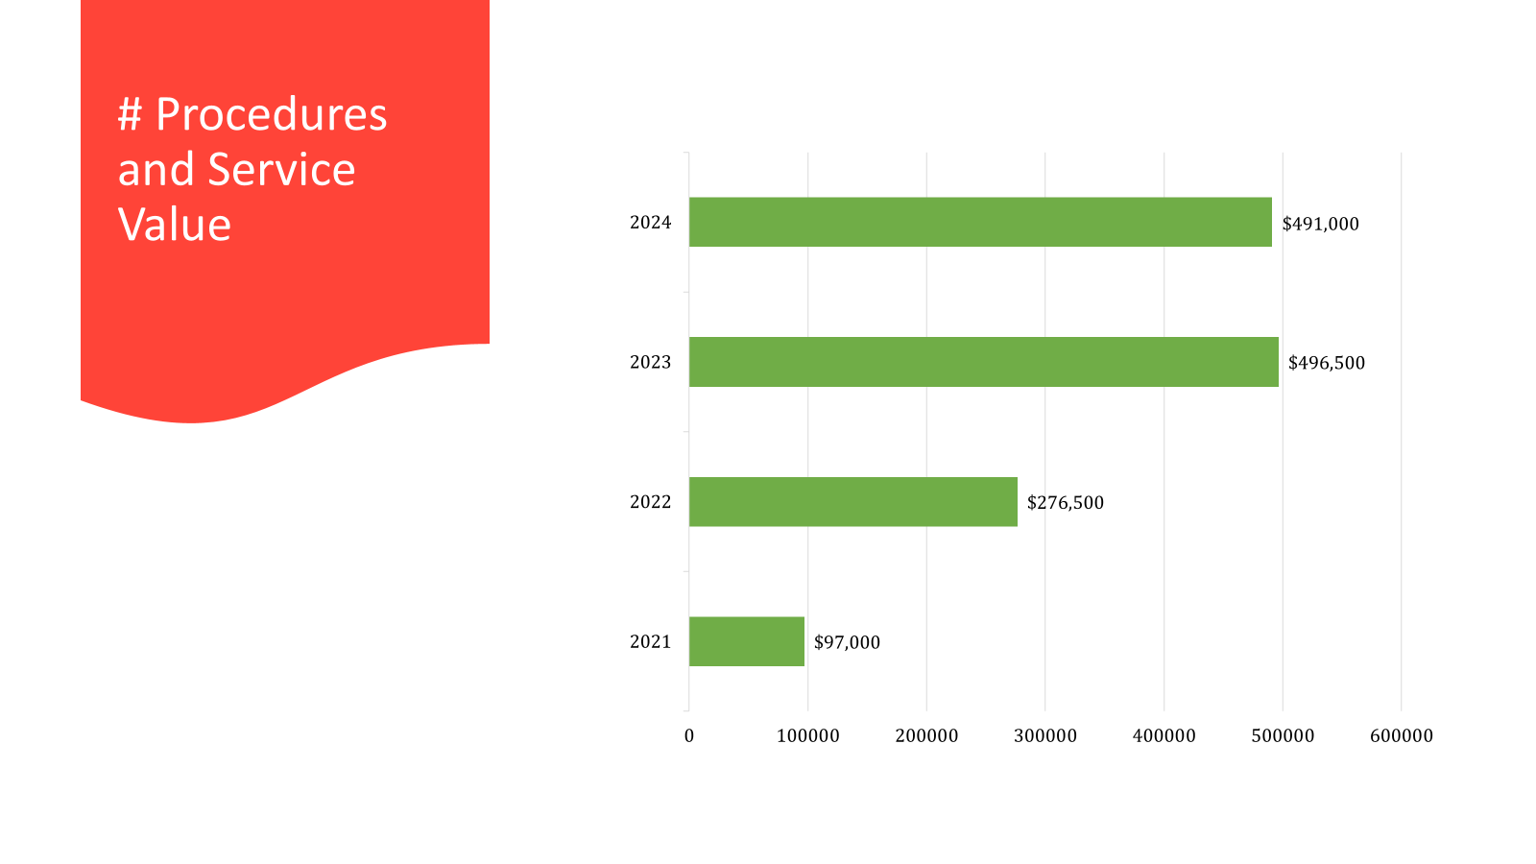

Slide 50
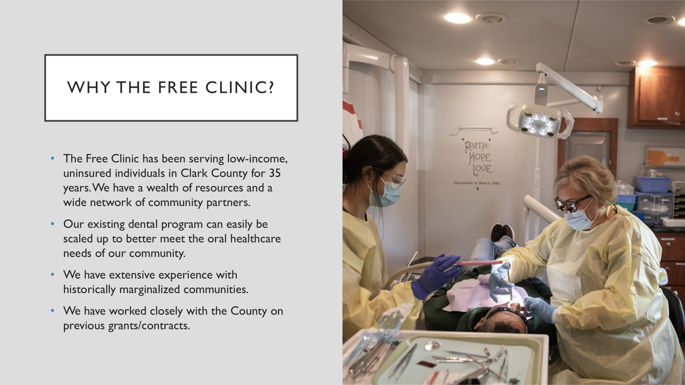

Slide 53
CAP – Income and Asset Building

Slide 54
CAAB Presentation - March 5, 2025
Save First, Live Well

Slide 55
Discussion Points
Mission, Vision, and Values
Financial Wellness Services
Our Partners, Clients, and Staff
The Need within the Community
Answering that Community Need
Projections to Support Request
Q & A
Save First, Live Well

Slide 56
Mission, Vision, and Values
Save First Financial Wellness is dedicated to empowering individuals to achieve financial stability and secure their basic needs by providing the guidance and support needed to navigate financial challenges and build a better future.
We envision a society where financial stability is fundamental to our basic needs and accessible to all who are willing to work at it.
We value a holistic approach based on trust-filled relationships, and we provide hope through our services.
We have served over 24,000 community members since we started in 2009
Save First, Live Well

Slide 57
Financial Wellness Services
Intake and assessment – a holistic evaluation for service
Resource navigation – referral to appropriate services
Education – in the areas of savings, budgeting, debt reduction, and understanding credit; additional resources on jump-starting an emergency fund, a deeper dive into credit, understanding consumer rights, first-time homebuyer education, student loan repayment, and purchasing a car.
Coaching/counseling addresses the client’s specific situation, providing resources, trust, accountability, relationship, tools, and guidance to help the client meet his/her self-identified goals.
Outreach
community partners to increase utilization by their clients
community events, Fix-it and community health fairs, etc., to increase community member engagement and awareness
local schools to engage families in financial wellness education
local culturally specific organizations to increase our services within the SWW Hispanic community
Save First, Live Well

Slide 58
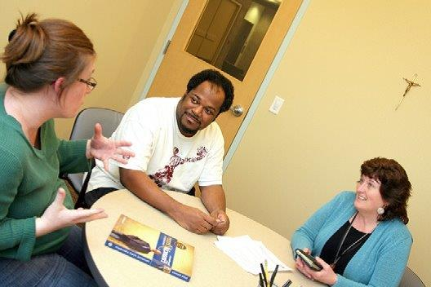
Our Partners, Clients, and Staff
Partners
31% of our WA clients come from our community partners: Evergreen Habitat, Vancouver Housing Authority, Partners In Careers, Clark Co. Food Bank, United Way, 4th Plain Forward, YWCA, Proud Ground, and Open House Ministries
69% of our clients come from our two employer contracts with Vancouver Clinic & PeaceHealth
Clients
90% of clients identify as Female
90% of clients are 200% of the poverty level for a family of 4
47% of clients are under 40
12% of clients are Latino/Hispanic, and 10% are Black/African American/African
Staff
5.5 Staff including certified financial coaches, social workers, financial educators, and emergency assistance fund administrator/resource navigator
Our services are available in Spanish and English, and our curriculum was created with a trauma-informed lens
Save First, Live Well

Slide 59
The Need within the Community
Two significant needs emerged in the most recent Community Needs Assessment survey:
80% of respondents need housing assistance
78% of respondents need asset-building assistance
Of those who responded:
47% need credit counseling
44% want access to financial planning and budgeting classes
42% seek home-buying assistance and education
34% want financial assistance to start a business
There are a limited number of providers in Clark County offering these services
Save First, Live Well

Slide 60
Answering that Community Need
We propose to reopen our successful volunteer financial coaching program to serve more clients in the community. Volunteers will:
Increase program capacity without dramatically impacting staffing costs
Come from a variety of sources, adding diverse perspectives & lived experiences
Enhance client trust and engagement through peer support
Need no financial background but rather the heart of a teacher
Are an extension of our team
Volunteer Coordinator will:
Recruit, train, support, provide oversight, and continuing education
Ensure a structured onboarding
Boost retention and engagement via mentorship, recognition, and clear communication
Reduce staff workload
Expand community impact by engaging more volunteers to effectively serve more clients
Save First, Live Well

Slide 61
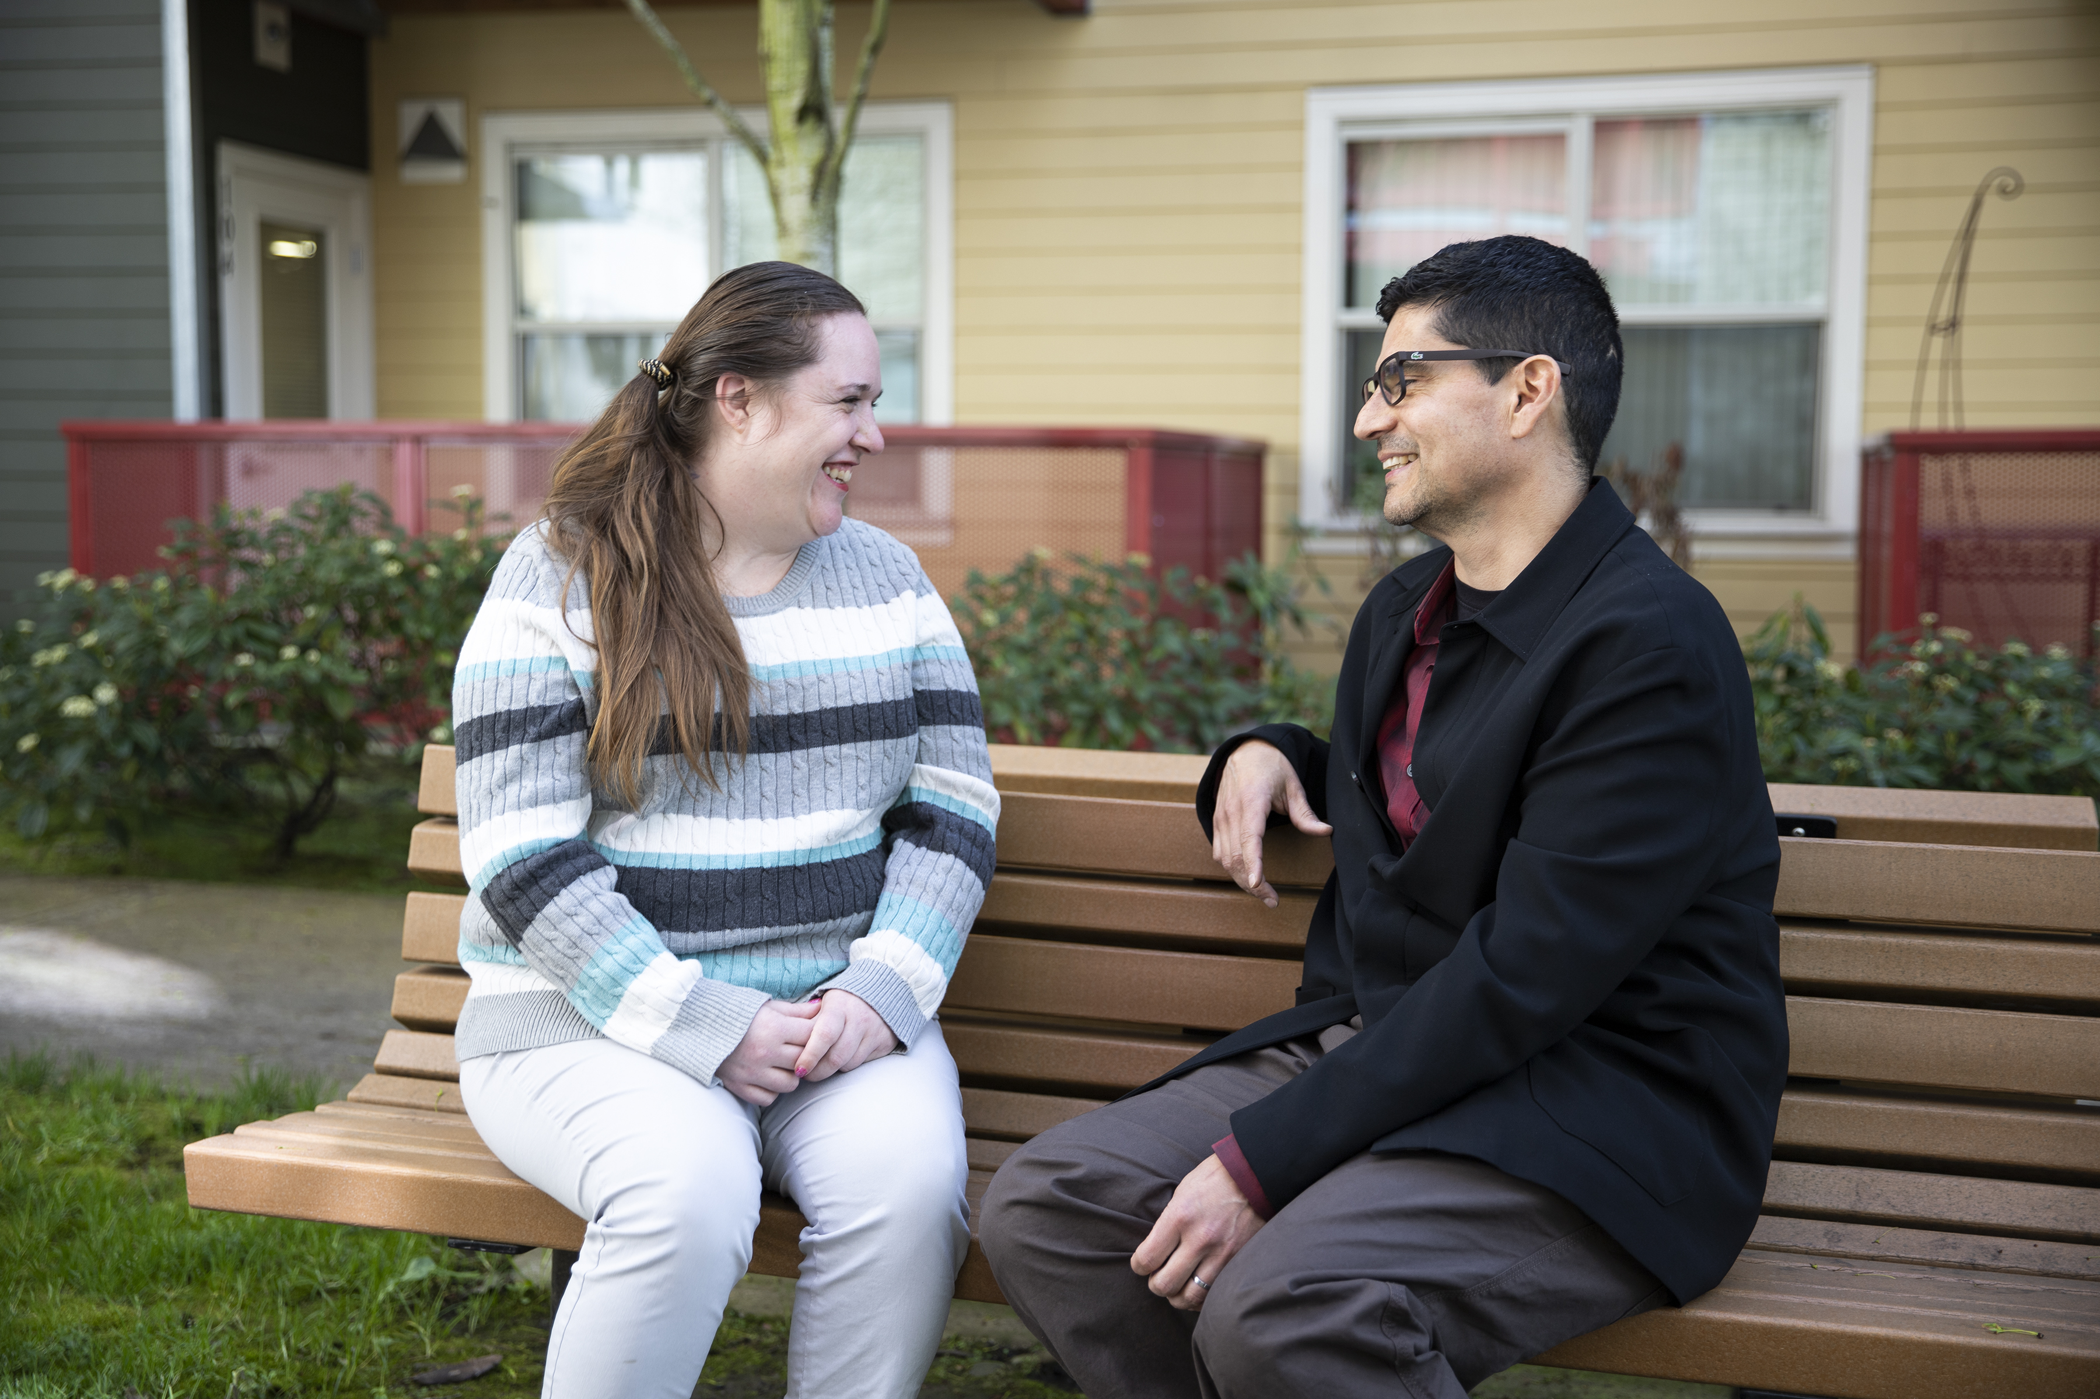
Projections to Support Request
Volunteer Financial Coaches
Historically, an average of 77 coaches augmented staff work with clients (35 active and consistently engaged)
Worked with clients approximately 2 to 4 hours/month and for as much as up to a year
Addressed clients' personal situations and goals
Assisted clients through:
Emergency situations (DV survivors, etc...)
Budgeting, setting financial goals, starting an emergency fund
Payday loan, credit building, debt settlement situations, etc.…
Purchasing an asset (home, car, education, etc...)
Projections
Six active volunteers would allow us to serve an additional 180 clients served clients served
In year two, 12 volunteers increases clients served to 360
Save First, Live Well

Slide 62
Q u e s t i o n s
Save First, Live Well

Slide 63
Save First, Live Well

Slide 64
CAP - Transportation

Slide 65
SAT Program Support Assistance Transportation Program
Recovery Services
Transportation with ongoing peer support
Notes:
For my SAT program, I will concentrate on the following key areas during my 5-minute presentation to the CAAB:

Slide 66
AGENDA
Program Services:
Transportation Assistance: We will provide transportation services for low-income Clark County residents who have a bed date for inpatient SUD treatment in Washington State.
Peer Support Specialist: A peer support specialist will accompany individuals needing a higher level of care, supporting them through the intake process, ongoing treatment phases (both inpatient and outpatient), and retention.
2. Priority Populations:
Low-Income Residents: Our program will serve low-income residents of Clark County who require transportation to SUD treatment facilities.
Individuals Needing Higher Level of Care: We will focus on individuals who need a higher level of care and support throughout their treatment journey.

Slide 67
3. Client Outreach and Engagement:
Notification to SUD Treatment Agencies: We will notify all SUD treatment agencies in Clark County about our services and the availability of our peer support specialist.
Screening by Referring Agencies: Individuals will be screened by the referring agency to ensure they meet the low-income requirements and are residents of Clark County.
4. Additional Program Information:
Support Throughout Treatment: Our peer support specialist will provide ongoing support throughout all phases of treatment, including intake, inpatient, outpatient, and retention, to ensure successful outcomes.
Collaboration with Agencies: We will work closely with SUD treatment agencies to identify and support eligible individuals.

Slide 68
Why does Clark County NEED SAT services…
Why SAT is needed in Clark County …
High Rates of Substance Use Disorders (SUD):
Clark County has a significant number of residents struggling with substance use disorders. According to recent reports, the county has seen an increase in opioid-related overdoses and other substance abuse issues¹. Providing transportation and support services for low-income residents seeking treatment can help address this critical public health issue.
2. Barriers to Treatment Access:
Many low-income residents in Vancouver face barriers to accessing SUD treatment, including lack of transportation. By offering transportation services and peer support, your program can help overcome these barriers and ensure that individuals receive the care they need².

Slide 69
Why does Clark County NEED SAT services…
Why SAT is needed in Clark County …
3. Support for Vulnerable Populations:
The SAT program targets low-income residents, a group that often lacks the resources to access comprehensive SUD treatment. By focusing on this population, this program aligns with local efforts to support vulnerable communities and improve health outcomes³.
4. Positive Impact on Community Health:
Improving access to SUD treatment can have a broader positive impact on community health. Effective treatment and support can reduce the incidence of substance abuse-related health issues, decrease emergency room visits, and lower healthcare costs¹.

Slide 70
Why does Clark County NEED SAT services…
Why SAT is needed in Clark County …
5. Alignment with Local Health Initiative
The SAT program supports local health initiatives aimed at addressing substance abuse and improving mental health services. By funding this program, the CAAB can contribute to these broader community health goals and demonstrate a commitment to addressing critical health issues in Clark County².
6. Evidence of Program Effectiveness:
Programs that provide comprehensive support, including transportation and peer support, have been shown to improve treatment retention and outcomes. By funding this program, the CAAB can invest in a proven approach to supporting individuals with SUD³.

Slide 71
THANK YOU
Recovery Services
Carl Robinson MSW, SUDP, CPC
New Life Recovery Services
Behavioral Health Program Director
crobinson@newliferecoveryservices.org

Slide 72
Rapid Re-Housing (RRH)

Slide 73
RAPID RE-HOUSING

Slide 74
Program Fundamentals
INW Service Model:
Housing First with barrier removal
Strength-Based, Person Centered Case Management
Progressive Engagement
Trauma Informed Care
Harm Reduction
Barrier Removal
Client-Centered Action Planning (including - tenant ed, life skills development, community involvement)
Landlord Advocacy/Coordination/Mediation
Retention and Follow-Up Support (After Care)
Intervention:
Mobile intake/outreach to CFTH ref’d clients
Safety planning and expedited response to crises
Creative partnerships for wrap-around support
Continual Landlord Engagement
Landlord/Tenant Mediation
Emergency Basic Need Resources
Notes:
74

Slide 75
RRH Experience
INW has been providing RRH for over 20 years; in Clark County for 10+ years
Prioritized Populations served:
Families,
Veterans,
Disproportionately impacted HHs,
HH experiencing unsheltered homelessness,
Chronically Homeless, and
DV Survivors.
Rapid Rehousing
FY24: 16 HH (27 individuals) served
FY25: 11 HH (14 individuals) served
Supportive Service for Veteran Families
464 HHs served with 105 HHs housed in Clark County

Slide 76
Clark RRH Program Goals
Number of HH served FY25 - 11
Number of individuals served FY25 - 14
Percentage of individuals maintaining or increasing income FY25 - 85%
Percentage of individuals increasing financial literacy before program exit FY25 - 93%
Percentage of individuals offered in-house SOAR application services FY25 -100%
Percentage of individuals referred to mainstream resources/services FY25 - 100%
Percentage of individuals remaining housed 12 months after exit FY25 -94%

Slide 77
Successes and Challenges
Successes
Obtain and Maintain Housing
Relationship/Trust Building
Improved Quality of Life
Addressing the historically marginalized and underserved populations in Clark County
Spectrum of programs meet variations of needs
Clark County Flexible Funds
Challenges
Higher vulnerability scores being referred to lower scope of services
Limited mental/behavioral health services
Substance Use Disorder vs. Engagement
Fixed Incomes/Low Wages vs. Housing Market
Difficulty finding living wage jobs
Community need is still above resources available
Staff turnover

Slide 78
Success Story
Ramona was a chronically homeless, visually impaired woman in her 60s who experienced housing insecurity for 10+ years prior to her enrollment in RRH in April 2022. Ramona was mainly sleeping in her vehicle during her periods of homelessness and previously was enrolled in a housing program in Oregon that was unable to retain its funding. Due to the traumas Ramona experienced and horrific things she witnessed during her periods of homelessness, she had absolutely no trust in the system and was on high alert and in fight-or-flight mode. She did not believe that INW could help her.
Ramona’s INW Housing Specialist was able to build trust with her after several months of consistently showing up in support. She slowly began letting her guard down and has had her trust in the system restored. Her INW Housing Specialist assisted her in reestablishing medical care and obtaining new glasses. Ramona used to teach and write music, so by getting new glasses allowed her to see and write music again. She hopes to eventually start teaching music lessons again and has begun composing music too.
Ramona was also able to obtain Social Security benefits as well as part-time employment for a few hours per week. The income from Social Security and her employment enabled her to pay expenses to make her vehicle operable and road legal. She also has begun paying a portion of her rent, which has increased her self-esteem. Having stabilized her housing, Ramona can live her life again and feels safe in her surroundings. Ramona has also been able to quit smoking as she does not feel she needs it anymore as her stress is now minimal.

Slide 79
Partnerships
Council for the Homeless/Housing Solutions Center: coordinated entry, referrals, warm handoffs
Partners In Careers: shared office space, coordination of services, community resource referrals.
NAMI of SW Washington: mental health and crisis intervention resource referrals
Clark County Volunteer Lawyers: legal barrier removal, legal resource coordination, eviction mediation & support
YWCA: provides emergency D/V services and ongoing supports
Providence & Kaiser Medical: healthcare navigation, benefit registration, information/referral
Private landlords and Property Managers
Notes:
79

Slide 80
Questions?

Slide 81
Nest

Slide 82
Who we serve:
Youth ages 18- 24
Youth living on the streets or places not meant for habitability
60% BIPOC Community
Often families with children

Slide 83
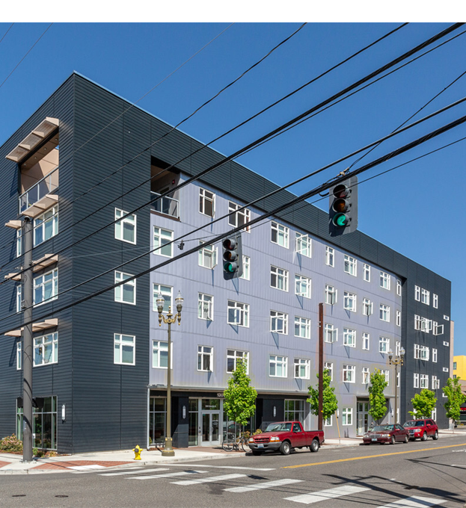
Case Management
Build trust
Obtain housing
Eliminate barriers
Find suitable housing
Positive Youth Development
Life skills
Referrals to outside agencies

Slide 84
Best Practice Models
Positive Youth Development
Self Governing Model
Progressive Engagement
Trauma informed Care
Housing First
Harm Reduction
Motivational Interviewing
DEI
Service Integration

Slide 85
Outcomes
&
Success Rates
Success defined as:
Youth being self-sufficient
Maintaining housing
This year:
Spent $1300K
Assisted 31 individuals
Exceeded goal of 30 already
Success rate: 100%

Slide 86
Return on Investment
The goal of Nest is to be the last service youth will ever need for housing.
Nest average cost per household this year: $4,200
Estimated savings to community:
Male: $1,000,000
Female: $2,000,000

Slide 87
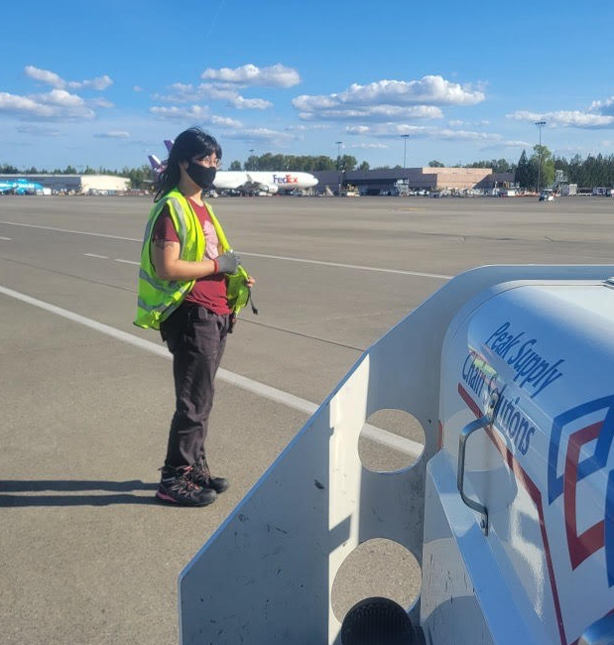
Success Story
Over the years Nest has helped to create hundreds of success stories, here is one.

Slide 88
Questions about Nest?

Slide 89
Clark County Homeless Crisis Response
Rapid Re-Housing Program
By Gina Van Dyken March 5th, 2025
Notes:
Thank you for letting us speak with you today. More than 90% of our patients are low-income or very-low income. Many have been or are homeless. As we’ll discuss, safe housing is absolutely essential to achieving a successful recovery.

Slide 90
Lifeline Connections Clark County Rapid Re-Housing
In Fiscal Year 2023-2024 successfully housed 16 individuals, among 6 households with the following funds:
RENT & UTILITY ASSISTANCE: $75,000
OPERATIONS, FLEX, ESSENTIAL NEEDS: $25,000
ADMIN: $5,000
TOTAL; $100,000

Slide 91
Scope of the Problem
We find many of our participants seeking housing report it’s impossible for them to rent an apartment of their own due to discriminatory proof of income requirements and unaffordable rent amounts.
Programs like RRH help them overcome these barriers because properties cannot discriminate households with rental assistance.
These funds get them access to apartment qualification requirements while giving them time to increase their income to take on their full rent when the subsidy ends.

Slide 92
Rapid Re-Housing
Outcomes: In FY24 we served 6 households with RRH (CHG). All 6 households maintained their housing at the 12-month mark when the subsidy ended.
Clients in our Supportive Housing program reported a 96% satisfaction rate with services received. We served an average of 25 clients per month across various RRH, Prevention and PSH subsidy programs in 2024.
Our housing support includes housing identification, rent and move in assistance and monthly case management. We connect those served to any other services needed such as employment, behavioral health treatment, care coordination and self-sufficiency workshops. When subsidy allotments end our clients are eligible to receive continued housing support through our FCS Supportive Housing program.

Slide 93
QUESTIONS?
Andrea Brooks, President and CEO
360-397-8246, ext. 30554
abrooks@lifelineconnections.org
Kinh Reynolds, VP of Finance
360-397-8246, ext. 33035
kreynolds@lifelineconnections.org
Christopher Cone, Development Director
360-397-8246, ext. 30548
ccone@lifelineconnections.org
Gina Van Dyken, Recovery Supports Director
Lifeline Connections
360-397-8246, ext. 30287
gvandyken@lifelineconnections.org
Notes:
Thank you for your time. We’re happy to answer any questions you may have.

Slide 94
Rapid Rehousing Program Application Presentation
Thalia McDaid-O'Neill
Affordable Housing and Stability Program Director
Feb. 2025

Slide 95
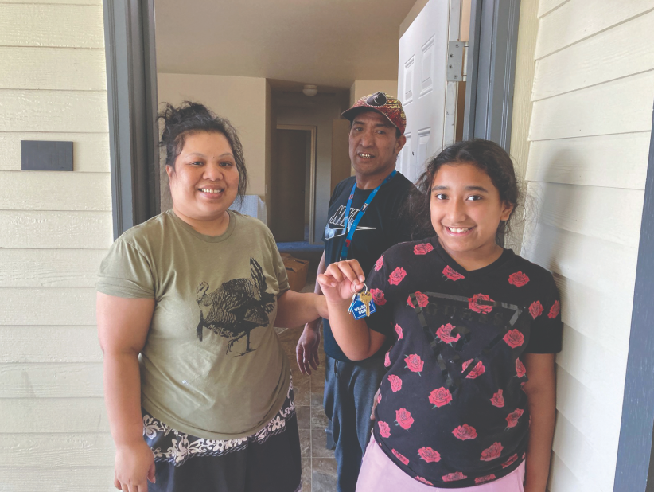
Approaches & Program Impact
Rapid Rehousing services for vulnerable individuals and families experiencing homelessness.
Rental subsidies matched with client’s individual needs
Housing navigation
Identifying barriers, identifying housing needs, advocating
Case management
How’re we aiming to address homelessness with this program?
Moving individuals rapidly into housing
Tools & Support
Community partnerships
Employment focus

Slide 96
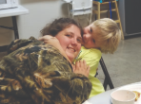
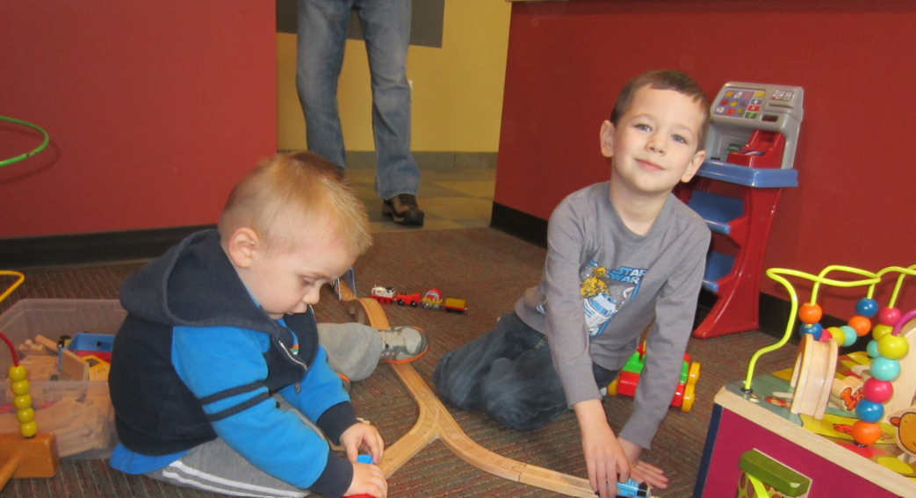
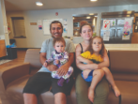
Case Management in the Rapid Rehousing Program
Housing First Approach
Strengths-based and client-centered
What skills and abilities are identified? Informed decisions and personal autonomy
Housing Stability Plans
Resource and referral connections
WorkSource, Partners in Careers, Goodwill Job Connections
Landlord negotiation and conflict resolution
Advocate and communication

Slide 97
Previous One-Year Outcomes 07.01.23 – 06.30.24
Number of individuals served: 59
Percent of successful exits 82 %, Length of Stay 77 days, Time from entry to housed 16 days, Unsheltered entries 100%, Percent of chronic move-ins 75%, Percent of chronic housed 9%, Percent returning to homelessness 7%
Participant Anecdote:
“Before I was granted an opportunity to receive this housing program, I was broken, my life was chaos and honestly, I and my actions were just awful. I know you may not like to read someone talking about themselves in such a way, but it's just the truth. I was about 15 years into heavy drug use which led me to being unemployable. With no family, no real/good friends left, I turned to criminal activity to supply myself with basic necessities, drugs and every so often maybe a place to sleep.”
Case Management: employment resources, recovery support referrals, goal setting.

Slide 98
Thank you! Q & A
Thalia McDaid-O’Neill
Tmcdaid-oneill@sharevancouver.org
360-952-8205

Slide 105
Permanent Supportive Housing (PSH)

Slide 106
PERMANENT SUPPORTIVE HOUSING (LOCAL)

Slide 107
PSH Local Experience
INW has been providing PSH in Clark County for 10+ years
Prioritized Populations served:
Families,
Veterans,
Disproportionately impacted HHs,
HH experiencing unsheltered homelessness,
Chronically Homeless, and
DV Survivors.
PSH Local
FY24: 3 HH (9 individuals) served
FY25: 4 HH (12 individuals) served

Slide 108
Clark PSH Program Goals
Number of HH served FY25 - 4
Number of individuals served FY25 - 12
Percentage of individuals maintaining or increasing income FY25 - 100%
Percentage of individuals engaged with health/wellness services FY25 - 100%
Percentage of individuals offered in-house SOAR application services FY25 - 100%
Percentage of individuals referred to mainstream resources/services FY25 - 100%
Percentage of chronically homeless households who were successfully housed FY25 -100%

Slide 109
Successes and Challenges
Successes
Obtain and Maintain Housing
Relationship/Trust Building
Improved Quality of Life
Addressing the historically marginalized and underserved populations in Clark County
Spectrum of programs meet variations of needs
Clark County Flexible Funds
Challenges
Higher vulnerability scores being referred to lower scope of services
Limited mental/behavioral health services
Substance Use Disorder vs. Engagement
Fixed Incomes/Low Wages vs. Housing Market
Difficulty finding living wage jobs
Community need is still above resources available
Staff turnover

Slide 110
Success Story
Courtney is a single white female in her 50s who has been a successful participant in INW’s PSH Local program since 2016. She experiences disabling depression.
In the last year, she developed cardiac symptoms that required multiple medical visits, including surgical intervention. Courtney’s INW Supportive Housing Specialist helped her navigate DSHS for additional supportive services. They also assisted Courtney in scheduling medical transportation to ensure Courtney could attend these critical medical appointments.
Her INW Supportive Housing Specialist also assisted her in obtaining utility assistance via LIHEAP though Clark Public Utilities. Secondarily to the support her Impact NW case manager provided during her medical crisis, Courtney experienced some improvements in her depressive symptoms which enabled her to reconnect with family members and strengthen her social support network.

Slide 111
Questions?

Slide 112
PSH HUD MATCH

Slide 113
PSH HUD Experience
INW has been providing PSH in Clark County for 10+ years
Prioritized Populations served:
Chronically homeless individuals with a disability as defined by HUD
PSH HUD
FY24: 8 HH (8 individuals) served
FY25: 7 HH (7 individuals) served

Slide 114
Clark PSH HUD MATCH Program Goals
Number of HH served FY25 - 7
Number of individuals served FY25 - 7
Percentage of individuals maintaining or increasing income FY25 - 100%
Percentage of individuals who engaged with health/wellness services FY25 - 100%
Percentage of individuals offered in-house SOAR application services FY25 -100%
Percentage of individuals referred to mainstream resources/services FY25 - 100%
Percentage of chronically homeless households who were successfully housed FY25 - 100%

Slide 115
Success Story
George is a single white male in his late 70s who enrolled in INW’s PSH HUD program in September 2021. Due to his age, he was experiencing onset dementia symptoms along with other chronic medical conditions. His memory and cognitive impairment made it challenging for him to manage many instrumental activities of daily living as well as leaving him vulnerable to predatory individuals seeking to exploit him.
Unfortunately, George was victimized financially by a neighbor. This incident was reported to Adult Protective Services and an investigation was opened. George’s INW Supportive Housing Specialist coordinated services with many agencies supporting George, including his home health aid, his nurse care manager at PeaceHealth, his medical insurance, his Area Agency on Aging and Disabilities caseworker, along with Adult Protective Services.
His INW Supportive Housing Specialist also assisted George with scheduling medical appointments, arranging transportation to his medical appointments, and obtaining a medical alert system through his insurance provider. The collaboration across these parties allowed George to sustain some degree of stability in his housing, health, and finances. It also eased George’s transition into an Adult Family Home after he was hospitalized after a fall in his apartment. Without the support provided in tandem with these partners, it is highly likely that George would have continued to face ongoing victimization by unscrupulous individuals as well as further deterioration in his health or even death.

Slide 116
Questions?

Slide 117
Permanent Supportive Housing Program Application Presentation
Thalia McDaid-O'Neill
Affordable Housing and Stability Program Director
Feb. 2025

Slide 118
Program Impact
Participants: previous long-term homelessness, vulnerable, high-needs, disabilities, aging population
How’re we aiming to address homelessness with this program?
Improving physical and mental well-being
Interrupting generational homelessness cycles with our families
Quality of life support
Resources & Referrals
To support all members of the family
Wrap around services

Slide 119
What does PSH and Case Management look like?
The story of a single mom and her 4 kids
Housing First Approach
Substance use relapse and criminal charges
Strengths-based & Client-centered
Determined, resourceful, motivated by her children, informed decisions
Resource and referral connections
Lifeline Pregnant and Parenting Women Program
YWCA
Landlord negotiation and conflict resolution
Maintenance requests, renewal offers, coordinating communications during landlord turnover

Slide 120
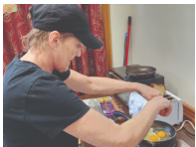
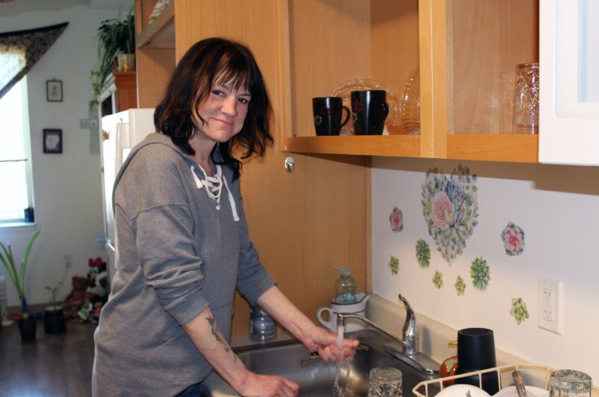
Previous One-Year Outcomes 07.01.23 – 06.30.24
Number of individuals served: 36
Chronic Move-Ins 100%, Time from entry to housed 54 days, Bed Utilization Rate 80%, Percent of Successful Exits 92%, Percent of Chronic Housed 31%
Client Satisfaction Survey Responses:
“Share Staff is always extremely caring and sensitive to our special needs”
“I am grateful and appreciative, and I feel seen and heard with Share”

Slide 121
Thank you! Q & A
Thalia McDaid-O’Neill
Tmcdaid-oneill@sharevancouver.org
360-952-8205

Slide 122
Permanent Supportive Housing HUD Match Application Presentation
Thalia McDaid-O'Neill
Affordable Housing and Stability Program Director
Feb. 2025

Slide 123
Program Impact
Operates similarly to Share’s County funded PSH Program
Similar:
Participants, case management approaches, and focuses –
Improving physical and mental well-being
Quality of life support
Resources & Referrals
Wrap around services
Program is used as a match for HUD Continuum of Care Program

Slide 124
“Tommy” Male, late 40’s, Veteran “Never been housed ever in my adult life”
Housing First Approach
Previous criminal history – in and out of jail for 10 years and substance use
Strengths-based & Client-centered
Motivated, engaging, resourceful, optimistic, friendly
Resource and referral connections
Outreach program, recovery community, Clark County Veterans Assistance Center
“Tommy” was housed this month!

Slide 125
Previous One-Year Outcomes 07.01.23 – 06.30.24
Number of individuals served: 54
Chronic Move-Ins 95%, Time from entry to housed 61 days, Bed Utilization Rate 95%, Percent of Successful Exits 80%, Percent of Chronic Housed 39%
Client Satisfaction Survey Responses:
“I can't place any complaints because I'm being taken care of. I can say anything else but Thank you.”
“I think everyone there has been so helpful. They saved my life! Very important to me! They all rock!”

Slide 126
Thank you! Q & A
Thalia McDaid-O’Neill
Tmcdaid-oneill@sharevancouver.org
360-952-8205

Slide 127
SOAR

Slide 128
SOAR(SSI/SSDI Outreach, Access, and Recovery)
Sara Gongora Garcia
Sea Mar-CSNW
BH Program Manager-Community Support Services

Slide 129
What is SOAR?
A model for assisting eligible individuals to apply for Social Security Administration (SSA) disability benefits
For individuals who are experiencing or at risk of homelessness and have a serious mental illness, co-occurring substance use disorder, or other physical disabilities
Sponsored by SAMHSA in collaboration with the Social Security Administration (SSA) since 2005
All 50 states and Washington, DC currently participate

Slide 130
SOAR Critical Components
Using these five SOAR Critical Components, case workers play a central role in gathering complete, targeted, and relevant information for SSA and DDS, resulting in high-quality SSI/SSDI applications. These components significantly increase the likelihood of an approval for those who are eligible.
Serving as the Applicant’s Representative
Collecting and Submitting Medical Records
Writing and Submitting a Medical Summary Report (MSR)
Obtaining a Co-signature on the MSR by an Acceptable Medical Source
Completing a Quality Review of Applications Prior to Submission

Slide 131
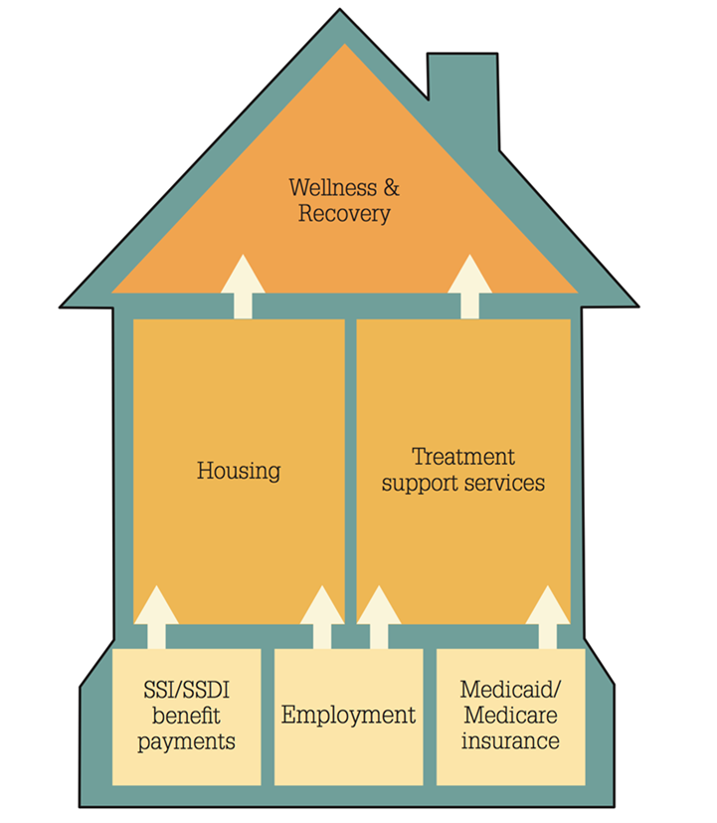
A Foundation for Recovery and Resiliency
More Than Income
Access to health care and housing
Increased education and employment opportunities
Decrease in incarcerations and hospitalizations
SSI/SSDI: One Brick in Foundation

Slide 132
How do States and Communities Benefit?
SSI and Medicaid bring federal dollars into states, localities, and community programs:
Health providers can recoup cost of uncompensated care.
States and localities can recoup the cost of public assistance.
ABD payments
Cash benefits and back payments received by individuals is spent in the local community (2024: 774 million*).
*https://soarworks.samhsa.gov/about-the-model/oat-and-outcomes

Slide 133
Clark County SOAR: Sea Mar-CSNW
Provides:
SOAR Claims (last 22 months: 57 apps, 56% approvals)
In-person Cohorts
SOAR Collaboration Meetings
Support & Technical Assistance
Acts as a Liaison with local SSA,DDS, and DSHS

Slide 134
Thank You!

Slide 135
Open Public Forum and Other Business
Open Public Forum (up to 3 minutes)
Other Business
Legislative advocacy update
Adjourn
Save the date: Next CAAB Meeting
April 2, 2025 starting at 9am

