Slide 1

Families & Educators Training Series
Sessions:
Orientation - 10/15/24
Adult Life, What Can it Look Like? - 11/19/24
Navigating the Adult System – 1/21/25
Introduction to SSI & Benefits Planning – 2/18/25
Guardianship, ABLE & WA's Endowment Trust Fund – 3/18/25
Community Resource Fair – 5/17/25, 10am-1pm
Series Information:
October-February total attendance: 50 online, 76 in-person
In-person student workshops at each session
Series website with on-demand trainings, presentation materials, community organizations, and further resources
All sessions provided virtual and in-person with ASL and Spanish interpreters
Notes:
This is the summary of the attendance so far this year. This event is a hybrid event.
November- February
Online attendance 50
In person attendance 76
Student component in person
Website with additional training/ resources- There was website developed by Wise/ the committee to capture online training needs and growing resources
Mar. 18th, 2025- "Guardianship, the ABLE ACT, and WA’s Endowment Trust Fund“
Recorded training available for use afterwards
English
Spanish
ASL
Hybrid

Slide 2
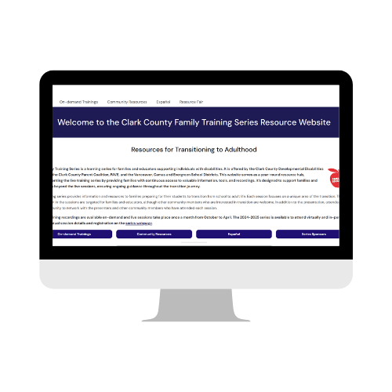
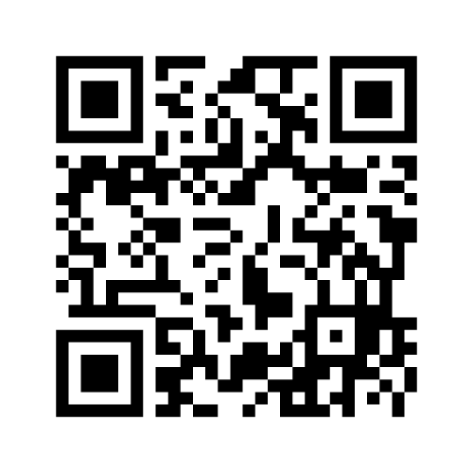
Families & Educators Resource Website:
www.clarkfamilyresources.org
Notes:
https://clarkfamilyresources.org/

Slide 3

"Putting it all Together - Creating Your Plan & Resource Fair"
May 17, 2025
Notes:
Community resource fair at Henrieta Lacks HS.
Currently already have over 20 interested vendors. Last year 175 people attended this event.

Slide 4
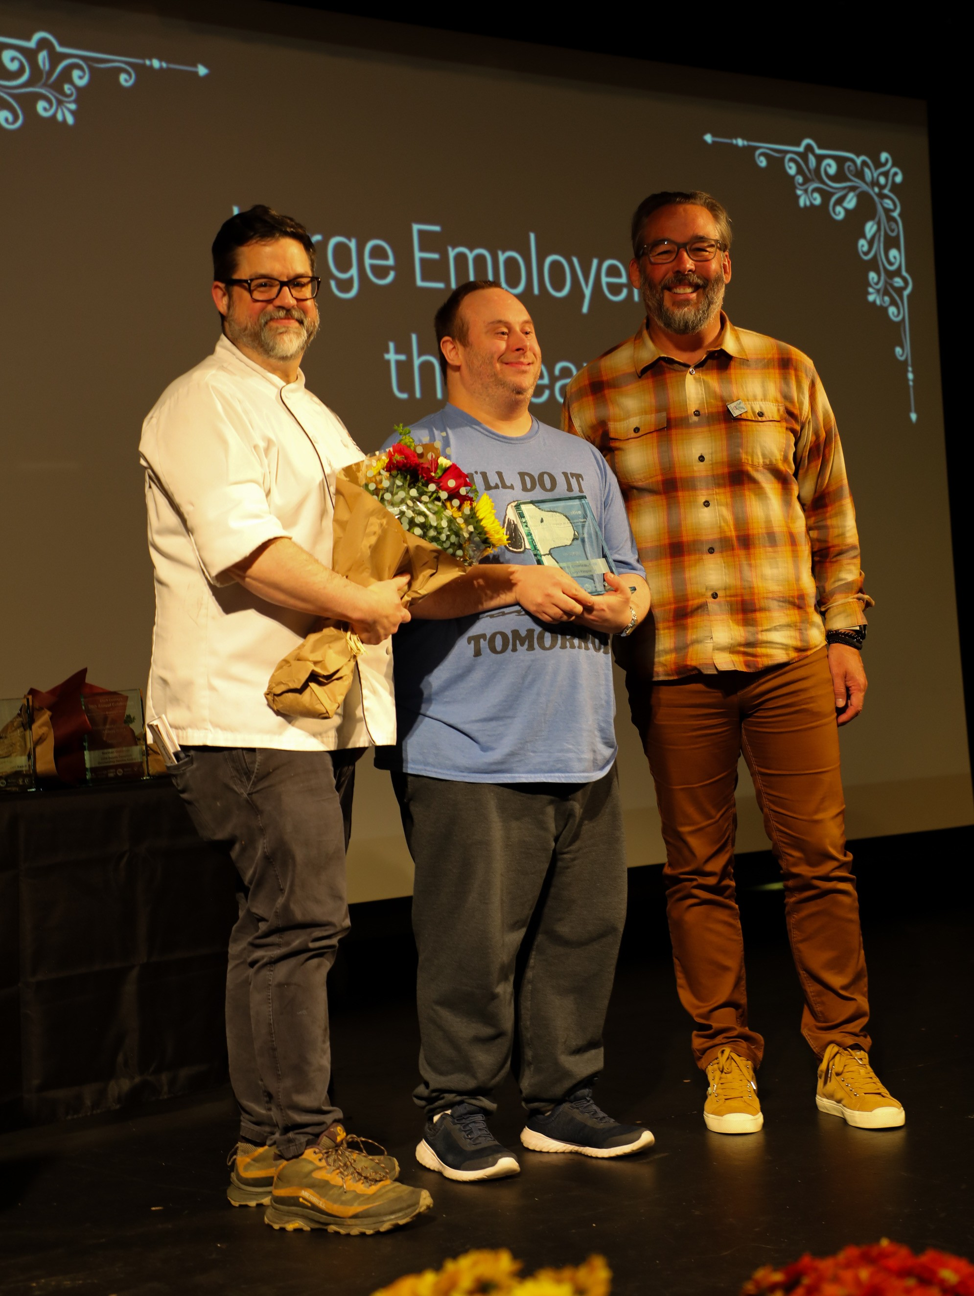
National Disability Employment Awareness Month Celebration
October 9, 2024
Mario Eiland was the Keynote speaker
Community Showed up! 233 registrants
Streamed virtually by CCTV
Notes:
Summary of who attended.
This event was hybrid and streamed by cvtv.

Slide 5

2025
October 8, 2025
Who is interested?
Let’s be in touch
Emily Harris, Emily@gowise.org
Notes:
Anyone interested in joining this event?

